Slide 1
Chef Fundamentals For Windows and Linux
training@chef.io
Copyright (C) 2014 Chef Software, Inc.

Slide 2
Chef Fundamentals For Windows
training@chef.io
Copyright (C) 2014 Chef Software, Inc.

Slide 3
Chef Fundamentals For Linux
training@chef.io
Copyright (C) 2014 Chef Software, Inc.

Slide 4
Course Logistics

Slide 5
Logistics
Class Start Time:
We’ll take a break about once an hour
We’ll break for lunch:
Class End Time:

Slide 6
Agenda

Slide 7
Course Objective
Learn To Use Chef
To Make Your Life
More Awesome!

Slide 8
Course Objectives
We are going to learn how to:
Automate infrastructure and application deployment
Read and write Chef Recipes and Cookbooks
Understand Chef’s architecture
Apply Chef’s basic building blocks to solve problems
Use the multitude of assets already created within the Global Chef Community

Slide 9
Topics
Introductions
Overview of Chef
Chef Call flow
Organizations
Creating a local chef-repo

Slide 10
Topics
Bootstrapping a Node
Secure Communications with the Chef Server
What are Resources, Recipes & Cookbooks
Writing a web server Cookbook
Node Object
Attributes

Slide 11
Topics
Search
Environments
Roles
Data_bags
Supermarket

Slide 12
Training is really a discussion
Ask questions when they come to you
Ask for help when you need it
Ask the other people in the class
Letting them help you is the biggest favor you can do for them!
You will have the slides available to you

Slide 13
Fundamentals
This course covers the fundamentals of Chef
We likely will not have time to discuss the latest trends in the Chef ecosystem
Any discussion items that are too far off topic will be captured

Slide 14
Introductions

Slide 15
Introductions
Name:
Where are you located?
Company:
Current job role:
Experience with Chef/Config Management:
Which Workstation / Server platforms do you work with?
What do you want from / expect from this course:

Slide 16
Why Chef

Slide 17
A tale of growth...
Application
Notes:
You finally got the app running by managing a bunch of those resources

Slide 18
Add a database
Application
Application Database
Notes:
Apps are cool, but storing data is cooler

Slide 19
Make database redundant
Application
App Databases
Notes:
Of course, we want to have redundant HA database servers

Slide 20
Application server redundancy
App Servers
App Databases
Notes:
We need more app servers, redundancy right?

Slide 21
Add a load balancer
App LB
App Servers
App Databases
Notes:
We need a load balancer in front of all these app servers

Slide 22
Webscale!
App LBs
App Servers
App Databases
Notes:
Scaling out the app layer, redundant LB

Slide 23
Now we need a caching layer
App LBs
App Servers
App DB Cache
App DBs

Slide 24
Infrastructure has a Topology
App LBs
App Servers
App DB Cache
App DBs

Slide 25
...and change happens!
App LBs
Cache
App Servers
DB Cache
DB slaves
DBs

Slide 26

...and change happens!
Add a Central Log Host
Update syslog.conf on all Nodes
App LBs
Cache
App Servers
DB Cache
DB slaves
Central Log Host
DBs
Notes:
Now you need to change syslog.conf on all nodes in your infrastructure to log all kernel messages to the central log host

Slide 27
What did Chef do here?
First, we used Chef to create each of the individual servers, including deploying our database and our application code
Second, we used Chef to configure the servers to communicate with each other
Third, we used Chef to automate any changes (such as modifying syslog.conf, or adding a webserver), making our lives easier

Slide 28
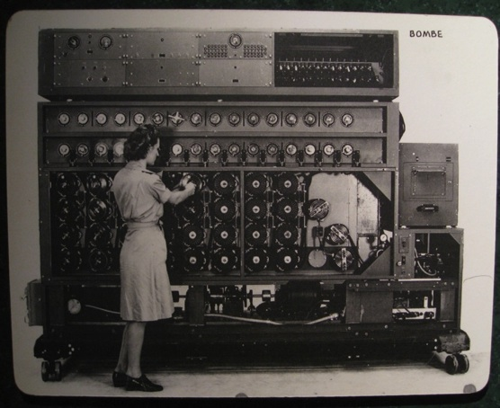
Chef is Infrastructure as Code
http://www.flickr.com/photos/louisb/4555295187/

Slide 29
Chef is Infrastructure as Code
Programmatically provision and configure components
http://www.flickr.com/photos/louisb/4555295187/

Slide 30
Chef is Infrastructure as Code
Programmatically provision and configure components
Treat like any other code base
http://www.flickr.com/photos/louisb/4555295187/

Slide 31
Chef is Infrastructure as Code
Programmatically provision and configure components
Treat like any other code base
Reconstruct business from code repository (chef server), data backup, and compute resources
http://www.flickr.com/photos/louisb/4555295187/

Slide 32
Chef is a Language
Learning Chef is like learning the basics of a language
Chef is based on Ruby, a relatively easy programming language to learn
80% fluency will be reached very quickly
The remaining 20% just takes practice
The best way to learn Chef is to use Chef

Slide 33
Chef Overview – The Call Flow

Slide 34
Lesson Objectives
Describe how Chef thinks about Infrastructure Automation
Identify the three major system components in the Chef ecosystem:
Workstation
Chef Server
Node

Slide 35

The Major System Components
Repo:
Git/SVN
Chef Server
Workstation
Node

Slide 36
Workstation
Repo:
Git/SVN
Chef Server
Workstation
Node

Slide 37
Workstation
Write your Chef configuration here
Local copy of all your Chef configuration files
Upload your Chef configuration to Chef Server
Your configuration can be synced with an external repo (such as Github or SVN) for:
Team workflows
Data backups
Version control

Slide 38
Chef Server
Repo:
Git/SVN
Chef Server
Workstation
Node

Slide 39
Chef Server
Stores your system configuration
Authenticates workstations and nodes
(“nodes” == “servers”)
Delivers system configuration to nodes
Scales by design to handle continuous configuration for thousands of nodes

Slide 40
Scalability
Node
1
Node
2
Node
3
Node
N
Enterprise Chef
Server
Chef Server delivers the configuration to the nodes
(i.e. “Apache needs to be Installed”)
but all processing of that configuration
(i.e. Actually installing Apache) happens on the nodes.
These configuration packages (known as Cookbooks) might be as small as 50Kb each.

Slide 41
Scalability
Enterprise Chef
Server
Node
1
Node
2
Node
3
Node
N
MOST OF THE WORK IS DONE HERE
Each node handles its own convergence efforts
Adding nodes doesn’t overwhelm Chef Server
The result is Incredible Built-In Scalability
NO
STRESS
HERE

Slide 42
Nodes
Repo:
Git/SVN
Chef Server
Workstation
Node

Slide 43
Nodes
The computer you are managing with Chef
Most any device that can run the chef-client application and ruby
Typically a Server
Can be virtual, physical, owned or rented from a cloud, either public or private
Can also be:
Network devices, tablets, phones
Chef can also manage most any device that has an API that allows management from another server

Slide 44
Team Workflows
Repo:
Git/SVN
Chef Server
Workstation
Node

Slide 45
Team Workflows and Backups
Integrate your Workstation with an external repo
Such as: Git, SVN, BitBucket
Allows version control for infrastructure configuration
Good method for making Chef code backups
Offers Team Collaboration

Slide 46
Legend

Slide 47
Legend: Where do I run that command?
Example command to run on your local workstation (ws)
ws> whoami
i-am-a-workstation
Hint: In this class, ‘knife’ commands will always be run on the local Workstation
Example command to run on your remote node (rn) i.e. in CloudShare
rn> whoami
i-am-a-chef-node

Slide 48
Legend: Example Terminal Command and Output
ws> ipconfig
Windows IP Configuration
Ethernet adapter Local Area Connection:
Connection-specific DNS Suffix . :
IPv4 Address. . . . . . . . . . . : 10.38.161.230
Subnet Mask . . . . . . . . . . . : 255.255.255.0
Default Gateway . . . . . . . . . : 10.38.161.1

Slide 49
Legend: Example of editing a file on your workstation
OPEN IN EDITOR:
Windows: cookbooks\iis_demo\recipes\default.rb
-------------------------------------------------------------------------------------------------------------
Mac/Linux: cookbooks/iis_demo/recipes/default.rb
Hi!
I am a friendly file.
SAVE FILE!

Slide 50
A word about copy/paste
Don’t Do It!
Our class .pdf has embedded errors, making copy/paste a dangerous proposition
Writing code by hand is important for learning

Slide 51
Workstation Setup

Slide 52
Lesson Objectives
After completing the lesson, you will be able to
Install Chef on your Workstation
Describe how to configure and use Knife, the Chef command line utility

Slide 53
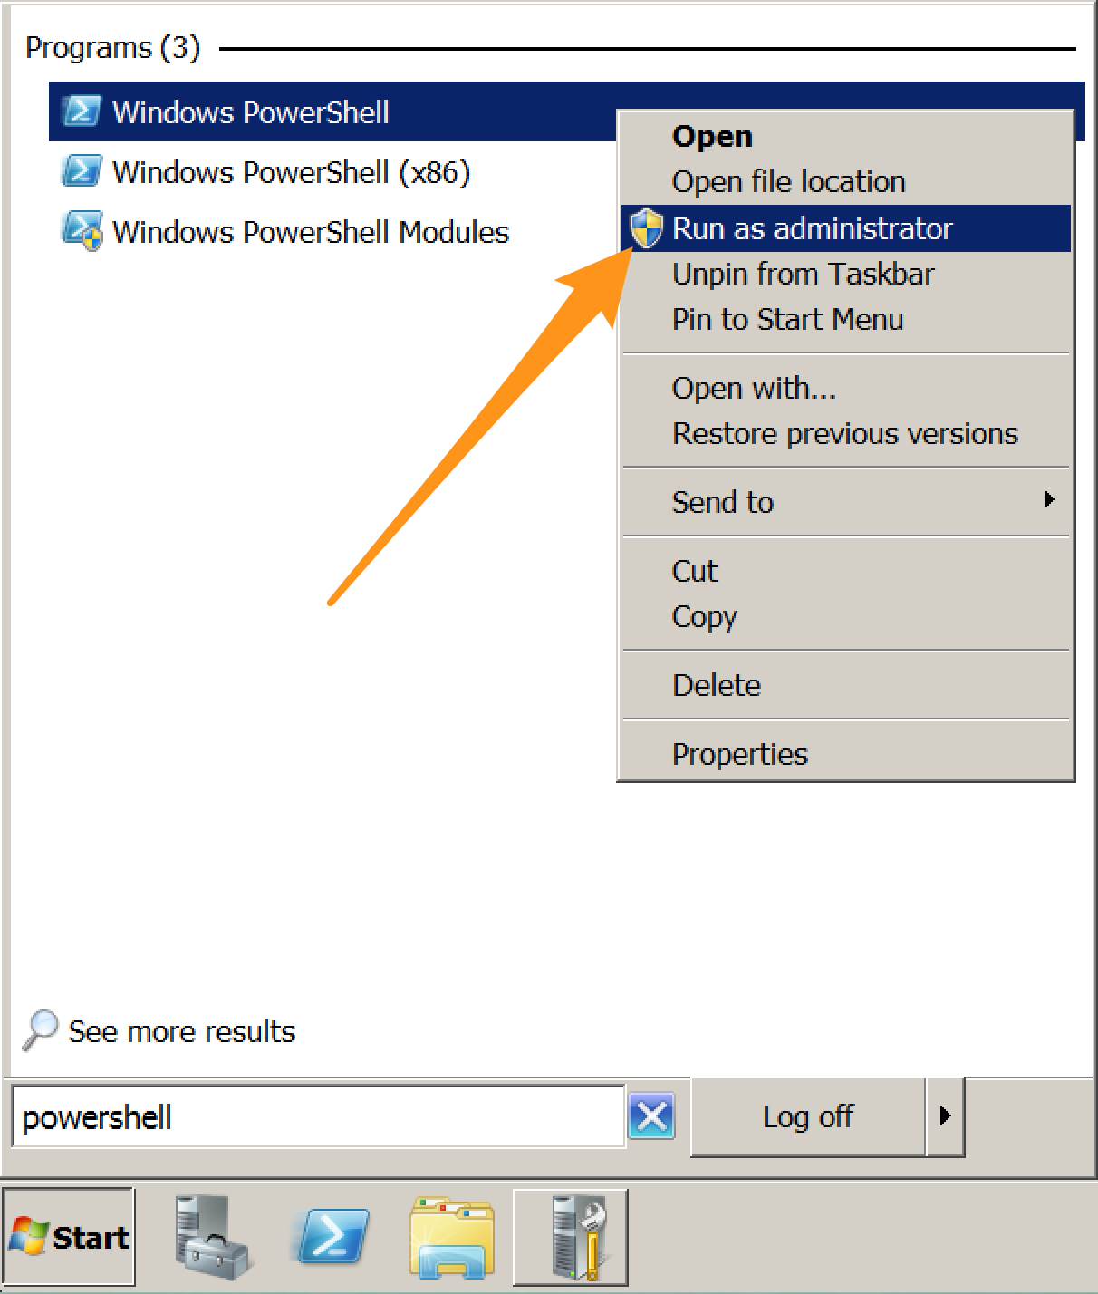
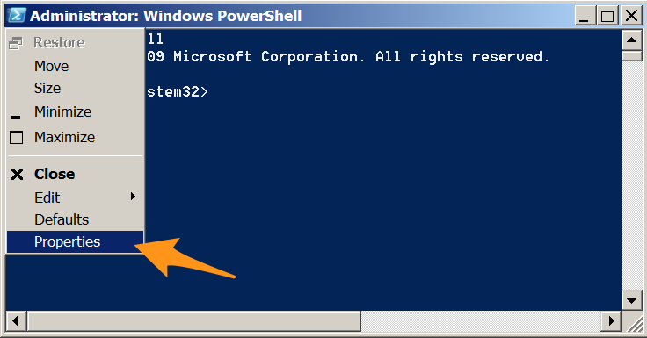
Configure PowerShell
Run PowerShell as Administrator and open Properties

Slide 54
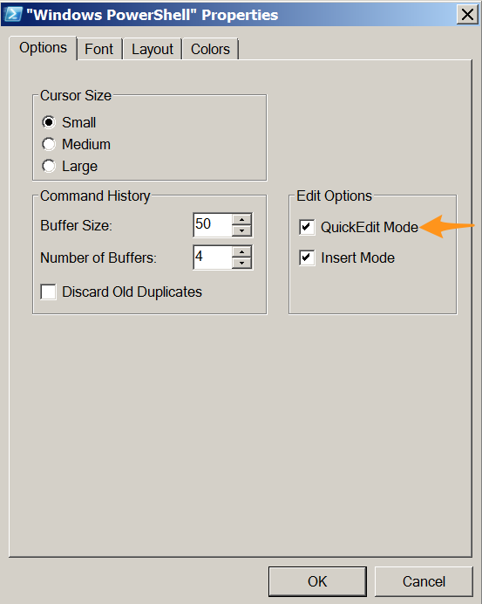
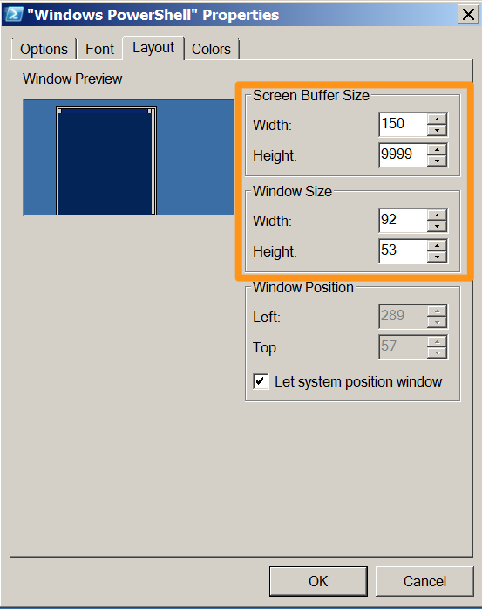
Configure PowerShell
Enable QuickEdit Mode
Set Height buffer to 9999

Slide 55
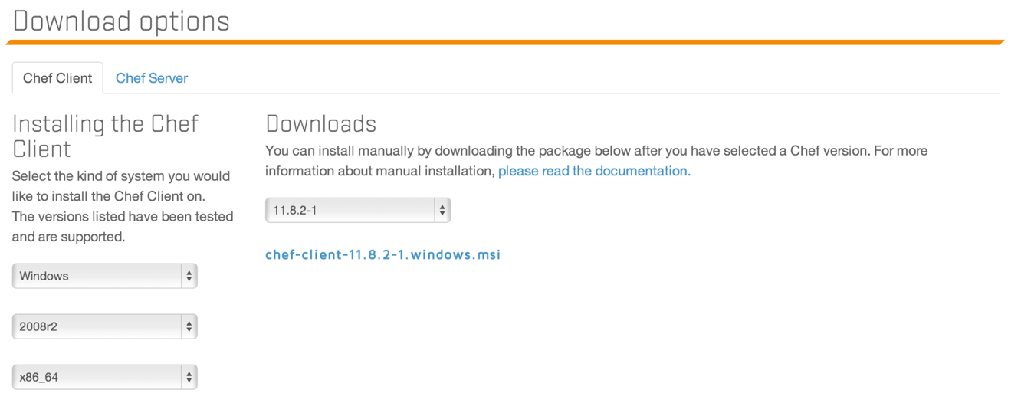
Workstation Setup
http://downloads.chef.io
2008 (Windows 7) or 2012 (Windows 8)
i686 (32-bit) or x86_64 (64-bit)
Or browse to
https://www.chef.io/chef/install.msi
Download and install this file
Notes:
DON’T USE IE – IE DOESN’T WORK
The versions shown for Windows are for Windows Server, but you're probably not running that one your workstation, so get the closest without going over (2008 ~= Windows7, 2012 ~=Windows8)

Slide 56
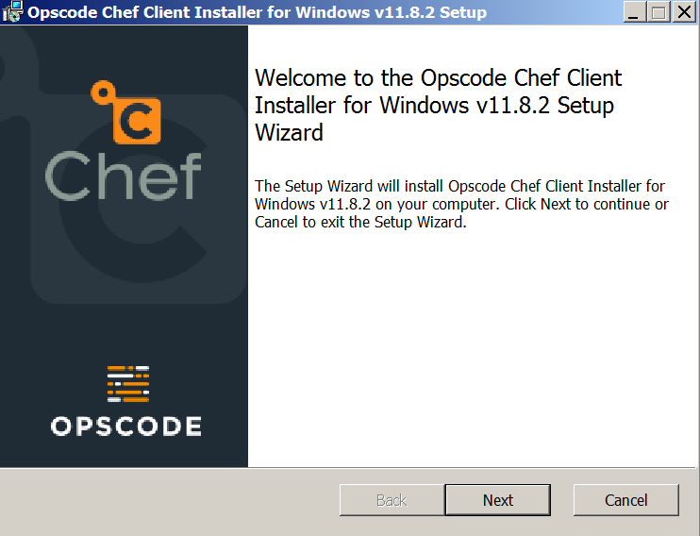
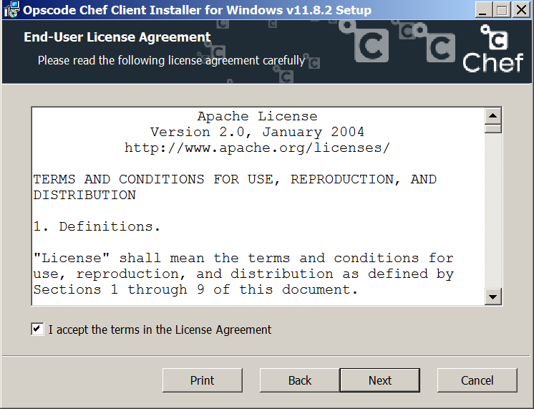
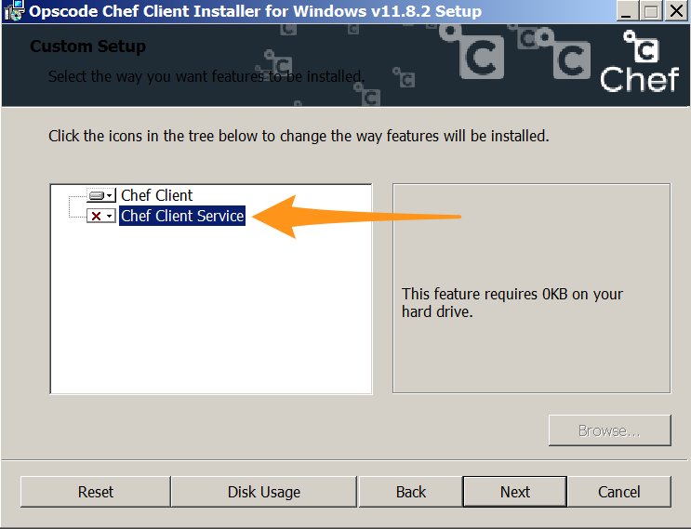
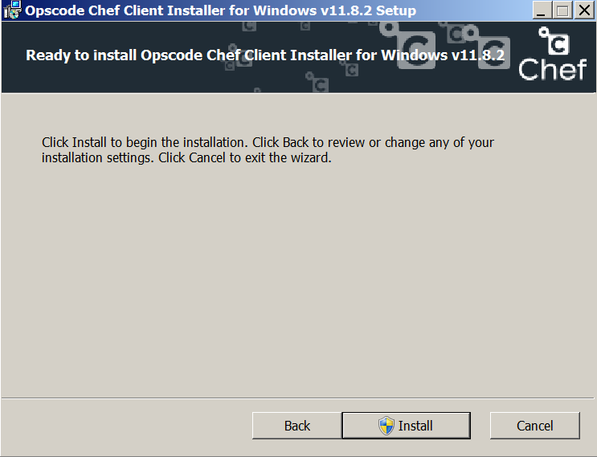
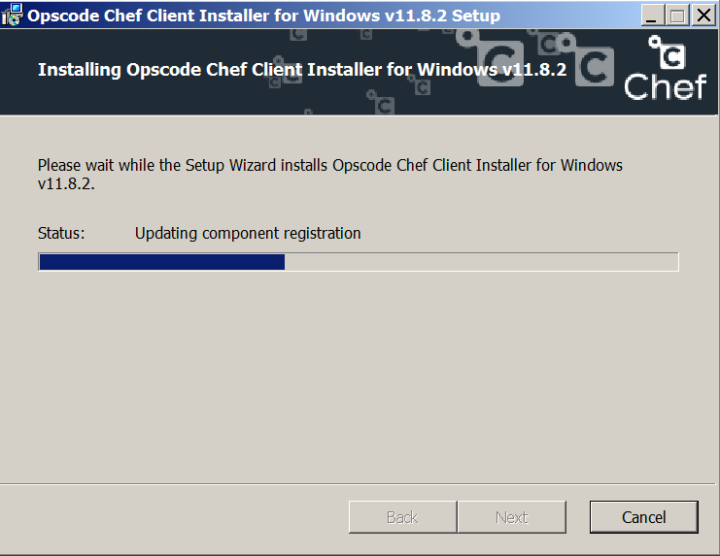
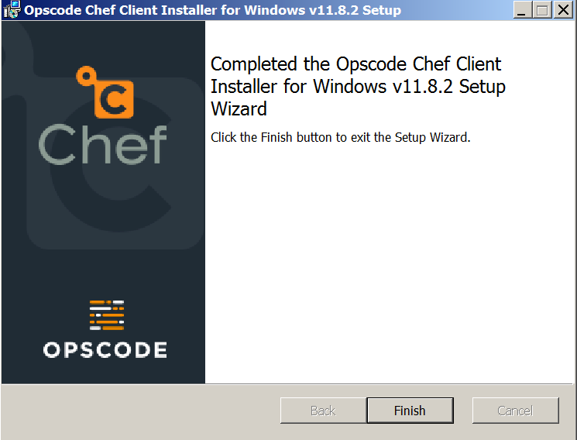
Install on Windows
Notes:
Screen shot of Windows installer

Slide 57
After install
Exit and restart your CMD and PowerShell windows to read the new Environment variables
Check your system path (next slides)

Slide 58
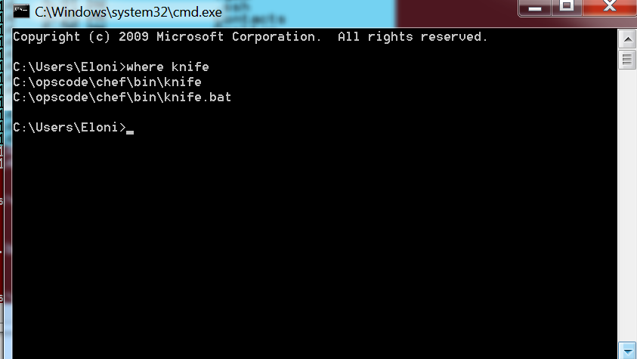
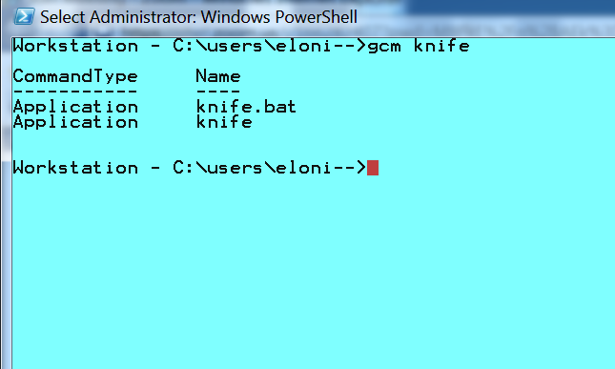
Test your install from CMD and PS
In Windows CMD prompt: where knife In Windows PowerShell: gcm knife

Slide 59
Fixing your Windows path (if needed)
On your Windows Workstation:
Start -> View advanced system settings
Advanced -> Environment Variables
Find “Path” (under System variables)
Add c:\opscode\chef\bin; c:\opscode\chef\embedded\bin;
Put this at the beginning of the path
Re-open all CMD and/or PowerShell windows

Slide 60
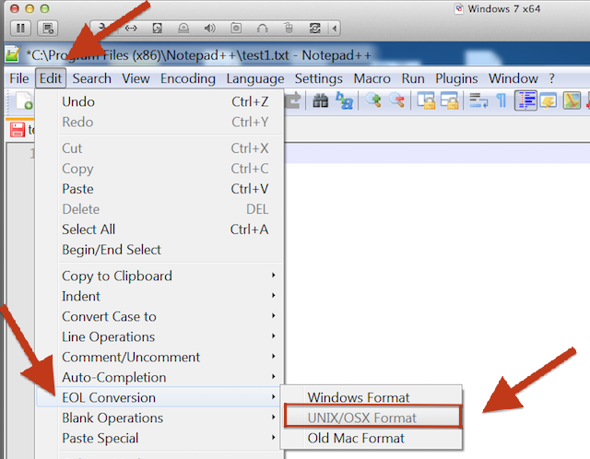
A Note About Notepad++
In Notepad++, be
sure to save your
files as UNIX files,
otherwise control
characters that are
undiscoverable
will be embedded into your code.

Slide 61
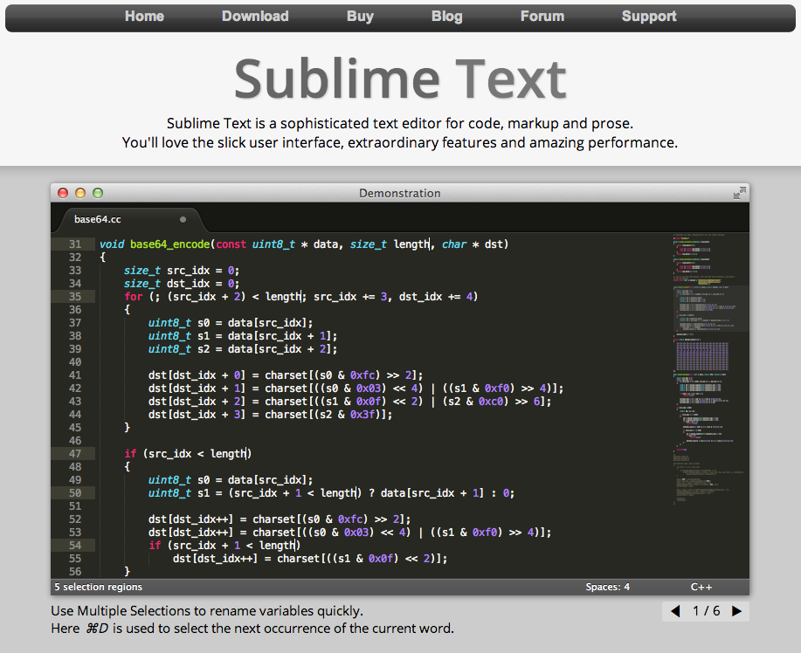
If you do not have a preferred text editor on your workstation already...
Download Sublime Text
Free trial, not time bound
Works on every platform
sublimetext.com

Slide 62
Workstation Setup - Mac OS X / Linux
ws> curl -L http://www.opscode.com/chef/install.sh | sudo bash
% Total % Received % Xferd Average Speed Time Time Time Current Dload Upload Total Spent Left Speed100 6515 100 6515 0 0 20600 0 --:--:-- --:--:-- --:--:-- 31172Downloading Chef for ubuntu...Installing ChefSelecting previously unselected package chef.(Reading database ... 47446 files and directories currently installed.)Unpacking chef (from .../tmp.MqRJP6lz/chef__amd64.deb) ...Setting up chef (11.4.4-2.ubuntu.11.04) ...Thank you for installing Chef!Processing triggers for initramfs-tools ...update-initramfs: Generating /boot/initrd.img-3.2.0-48-virtual
Notes:
Alternatively, Chef may be programmatically installed via the install.sh script. This is the method used during chef bootstraps.

Slide 63
Fixing your Mac OSX/Linux path (if needed)
From a Terminal Window run: $> echo $PATH
Verify this is at the beginning of your path: /opt/chef/embedded/bin
If it needs to be modified: $> export PATH=/opt/chef/embedded/bin:$PATH
Note: no ‘$’ in front of “PATH”

Slide 64
What just happened?
Chef and all of its dependencies installed via an operating system-specific package ("omnibus installer")
Installation includes
The Ruby language - used by Chef
knife - Command line tool for administrators
chef-client - Client application
...and more

Slide 65
Install Windows Knife plugin (all platforms)
- This step is only required when managing Windows Nodes
- You may need to re-run the gem install if you get a failure
ws> chef gem install knife-windows --no-ri --no-rdoc -V
OR
ws> sudo chef gem install knife-windows --no-ri --no-rdoc -V
Successfully installed knife-windows 0.8.2
19 gems installed
Notes:
Lets Knife know about WinRM protocol

Slide 66
Organizations

Slide 67
Lesson Objectives
After completing the lesson, you will be able to
Explain the purpose of Organizations
Create an Organization on Hosted Enterprise Chef
Login to your Organization
View and manage Organization in Enterprise Chef
Invite users into your Organization
Accept invitations into other Organizations

Slide 68
Organizations exist on the Chef Server
Repo:
Git/SVN
Chef Server
Workstation
Node

Slide 69
Organizations
The “sandbox” where all your nodes are registered and all your policies (configurations) are stored
Nothing is shared between Organizations – they are completely independent
One Enterprise Chef Server can contain many independent Organizations
Different Organizations can represent different companies, departments, business units or projects

Slide 70
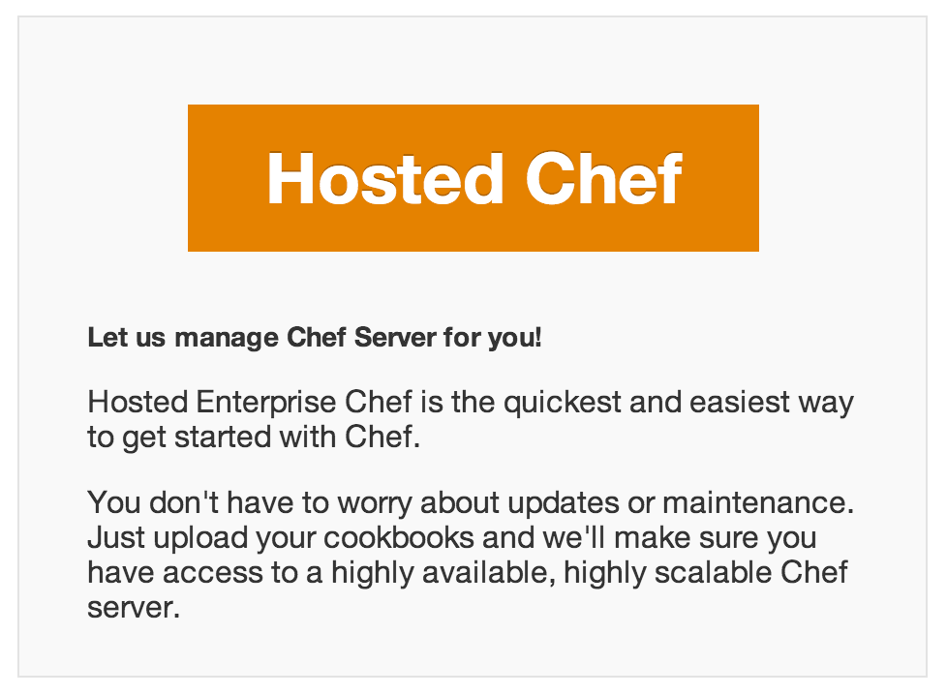
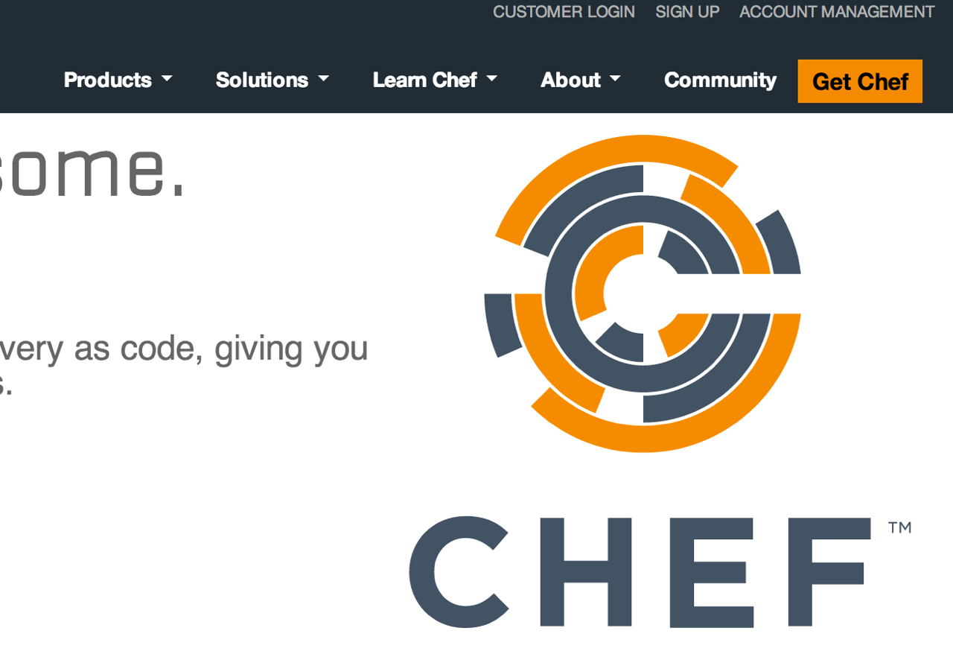
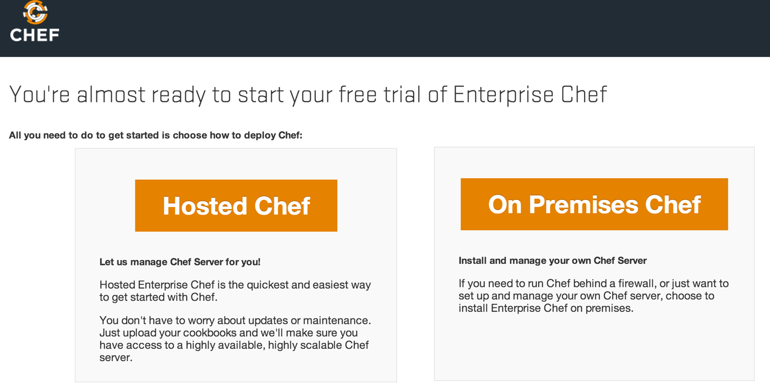
Your Chef Server for this class...
Hosted Enterprise Chef http://www.chef.io

Slide 71
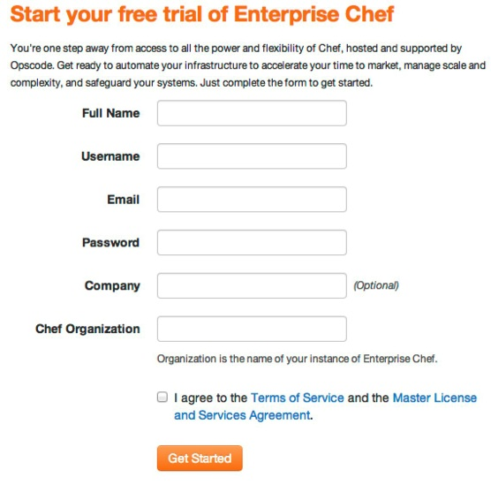
Create new account
Sign up for a new account
Chef Organization
provides multi-tenancy
name must be globally unique (to this particular Chef Server)

Slide 72
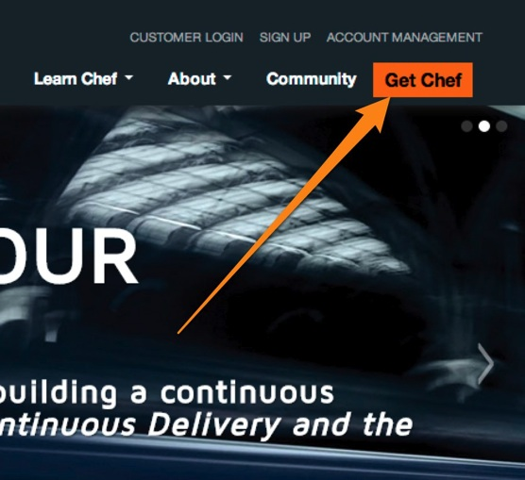
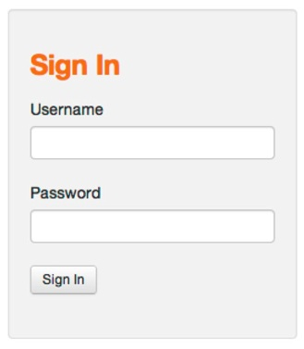
Manage Organizations
Login to your Hosted Enterprise Chef
https://manage.chef.io/login
Notes:
Login to Enterprise Chef to view your nodes

Slide 73
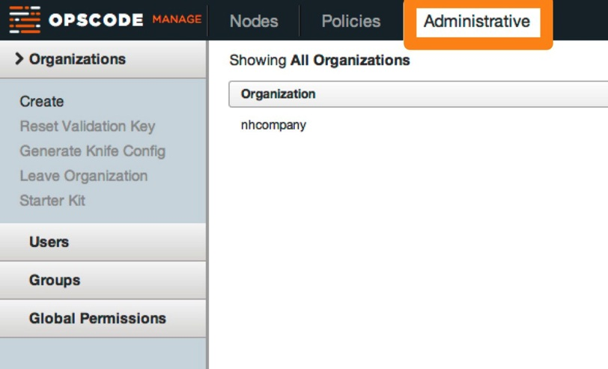
Organizations
Notes:
Click the Administrative tab to see the Organizations
The name of your organization was specified when signing up for Enterprise Chef.

Slide 74
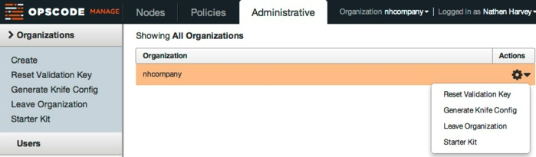
Manage Organizations
Reset Validation Key
Generate Knife Config
Leave Organization
Download the 'Starter Kit'
Notes:
From the Organizations page you can:
Reset the organization’s validation key
Generate a knife.rb
Leave the Organization
Recreate and download the starter kit

Slide 75
Download the "Starter Kit" for your Org
Notes about the Starter Kit:
Every time you download a new Starter Kit, you get a new authentication certificate, invalidating the old one, so you have to use the NEW .pem files, NOT the old .pem files
If one person on a team downloads a new Starter Kit, they need to share the new certificate with the rest of the team, or the team won’t have access to the Organization
Notes:
Download the starter kit from the Chef Server
Make a decision about where to store the work from this class.
NOTE: Windows XP users should NOT have spaces in their directory- if they put it in a path with spaces (like C:\Documents and Settings\chef-repo), they will get errors when they try to upload cookbooks.
Unzip the zip file in that directory.
A chef-repo directory, or folder, is now available.
The 'Starter Kit' is a archive file (e.g. chef-starter.zip) that contains-) A sample chef repository with a sample 'starter' cookbook-) Configuration files allowing the workstation to talk to the chef serverWe'll look at this in detail later...

Slide 76
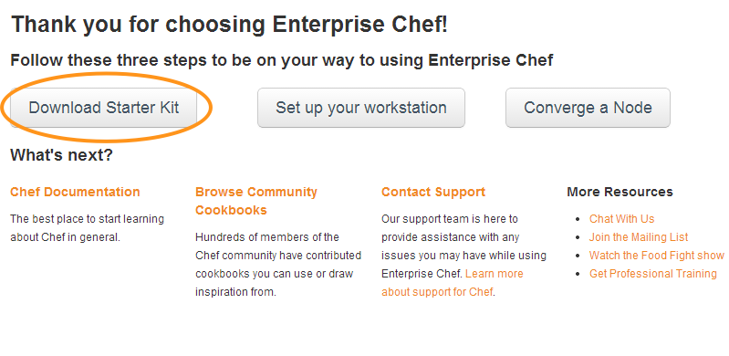
Download the "Starter Kit" for your Org
You’ll download chef-starter.zip from clicking this button
When you unzip chef-starter.zip you’ll get a directory named "chef-repo”
Put "chef-repo" in your home directory
C:\Users\<your_name>\chef-repo (Win)
/Users/<your_name>/chef-repo (Mac)
/home/<your_name>/chef-repo (Linux)
Notes:
Download the starter kit from the Chef Server
Make a decision about where to store the work from this class.
NOTE: Windows XP users should NOT have spaces in their directory- if they put it in a path with spaces (like C:\Documents and Settings\chef-repo), they will get errors when they try to upload cookbooks.
Unzip the zip file in that directory.
A chef-repo directory, or folder, is now available.
The 'Starter Kit' is a archive file (e.g. chef-starter.zip) that contains-) A sample chef repository with a sample 'starter' cookbook-) Configuration files allowing the workstation to talk to the chef serverWe'll look at this in detail later...

Slide 77
A quick tour of the chef-repo
Every infrastructure managed with Chef has a Chef Repository ("chef-repo")
Type all commands in this class from the chef-repo directory
The policies (configurations) in your chef-repo match the policies in your Organization

Slide 78
Exercise: View the chef-repo
ws> cd SOMEDIR/chef-repo
Note: You are on your local Workstation

Slide 79
View the chef-repo
Windows workstation:
Mac/Linux workstation:
ws> dir
ws> ls -al
9/24/2013 11:09 PM .chef
9/24/2013 11:09 PM cookbooks
9/24/2013 11:09 PM roles
9/24/2013 11:09 PM 495 .gitignore
9/24/2013 11:09 PM 2292 README.md
9/24/2013 11:09 PM 3572 Vagrantfile
Notes:
http://docs.opscode.com/essentials_repository.html
For reference

Slide 80
Inside the .chef directory
Windows workstation:
Mac/Linux workstation:
ws> dir .chef
ws> ls –l .chef
ORGNAME-validator.pem
USERNAME.pem
knife.rb
Note: Contents of the .chef directory are the same for Mac, Linux and Windows workstations

Slide 81
What’s inside the .chef directory?
knife.rb is the configuration file for Knife.
The other two files in .chef are certificates for authentication with the Chef Server (covered later)

Slide 82
knife.rb sample
OPEN IN
EDITOR:
Windows: C:\Users\You\chef-repo\.chef\knife.rb
------------------------------------------------------------------------------------------------------------------------------------------------
Mac/Linux: ~/chef-repo/.chef/knife.rb
current_dir = File.dirname(__FILE__)
log_level :info
log_location STDOUT
node_name "USERNAME"
client_key "#{current_dir}/USERNAME.pem"
validation_client_name "ORGNAME-validator"
validation_key "#{current_dir}/ORGNAME-validator.pem"
chef_server_url "https://api.opscode.com/organizations/ORGNAME"
cache_type 'BasicFile'
cache_options( :path => "#{ENV['HOME']}/.chef/checksums" )
cookbook_path ["#{current_dir}/../cookbooks"]

Slide 83
Navigating a proxy from Workstation
http://docs.chef.io/config_rb_knife.html
Can set proxy details to allow communication between the Workstation and the Chef Server, if needed

Slide 84
Knife is the command-line tool for Chef
Knife provides an API interface between a local Chef repository and the Chef Server, and lets you manage:
Nodes & cloud resources, including provisioning
Cookbooks and recipes
Roles and Environments
Data Bags (stores of JSON data), including encrypted data
Searching of indexed data on the Chef Server
Notes:
It is also where you will spend the bulk of your time when working with Chef. Knife is the primary user interface for working with Chef. As a bonus, it very closely mirrors how our actual APIs are structured - so working with knife also gets you familiar with our lower-level abstractions that you may wind up using as you grow.
* This class teaches best practices - and all the pro Chefs use the command line interface almost exclusively.

Slide 85
Verify Knife
ws> knife --version
Chef: 11.16.4
Your version may be slightly different, that’s ok!
During this course, the ‘knife’ command is only run on the workstation
Notes:
May need to close out of PowerShell then reopen it for chef install changes to take effect & can use knife

Slide 86
‘knife client list’ command
Displays a list (from Chef Server) of all clients with access to your Organization
Includes all Workstations and Nodes
Reads the chef_server_url from knife.rb
Invokes HTTP GET to the Chef Server at: #{chef_server_url}/clients

Slide 87
Exercise: Run ‘knife client list’
Note: ORGNAME-validator
represents your workstation.
When we have nodes configured, they will show up here as well.
ws> knife client list
ORGNAME-validator
If this command works, then the connection from your workstation to the Chef Server is setup correctly!
Notes:
May need to close out of PowerShell then reopen it for chef install changes to take effect & can use knife

Slide 88
Exercise: Run ‘knife help list’
ws> knife help list
Available help topics are:
bootstrap
chef-shell
client
configure
cookbook
cookbook-site
data-bag
environment
exec
index
Knife
…
Notes:
Careful - this doesn’t work on Windows XP
Also, careful, help pages don’t work very well on Windows.

Slide 89
Exercise: Invite users into your org
The Problem: You need assistance from the instructor for your chef course
Proposed Solution: Invite the instructor into your organization so they can log into the chef server with their own credentials, but can see your organization
Notes:
Use when teaching the Online course

Slide 90
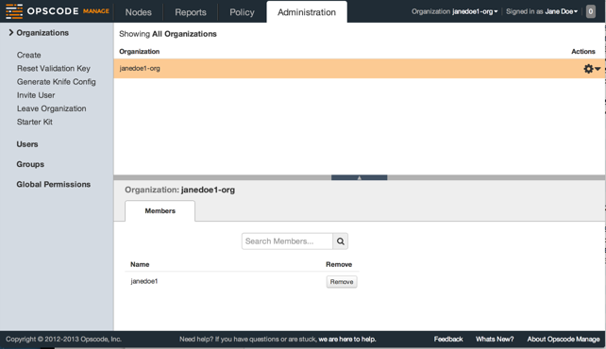
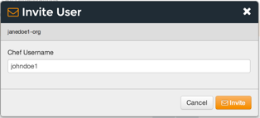
Exercise: Invite your instructor into your org
Navigate to http://manage.chef.io
Click the "Administration" tab,
Select the appropriate Organization
Click "Invite User" from the left menu
Enter your instructors 'Chef Username' and click Invite
Notes:
This is specific to the Instructor Led Online Course

Slide 91
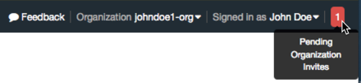
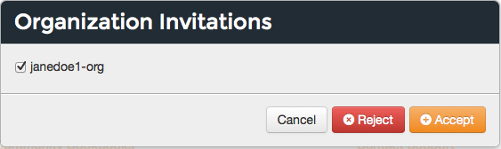
Exercise: Accepting an invite
Your instructor will get a notification and an email once you have invited them into your account
They will click the notification, select the Organization and click 'Accept'
Notes:
This is specific to the Instructor Led Online Course

Slide 92
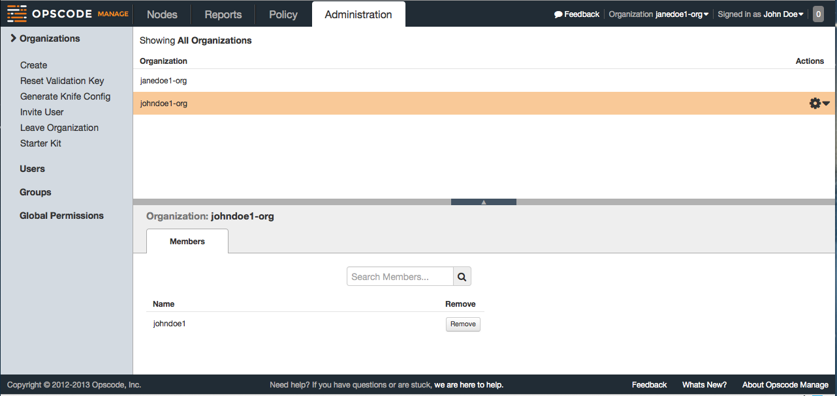
Exercise: Viewing an org
Selecting an organization from the drop down list and perusing that org
Notes:
This is specific to the Instructor Led Online Course

Slide 93
Review Questions
What is an Organization?
How do you regenerate the Starter Kit for your Organization?
What is the chef-repo?
What is knife?
What is path and name of the knife configuration file?
Notes:
-)
-)
-) knife.rb
-) <pwd>/.chef/knife.rb or ~/.chef/knife.rb or /etc/chef/knife.rb
-)

Slide 94
Configuring Nodes

Slide 95
Lesson Objectives
After completing the lesson, you will be able to
Chef enable an instance using "knife bootstrap”
Making it a “node”
Explain how knife bootstrap configures a node to use the Organization created in the previous section

Slide 96
Nodes
Nodes represent the servers in your infrastructure
Could be physical servers or virtual servers
May represent hardware that you own or compute instances in a public or private cloud
Could also be network hardware - switches, routers, etc
Notes:
network device support for some vendors - Arista, Juniper, Cisco

Slide 97
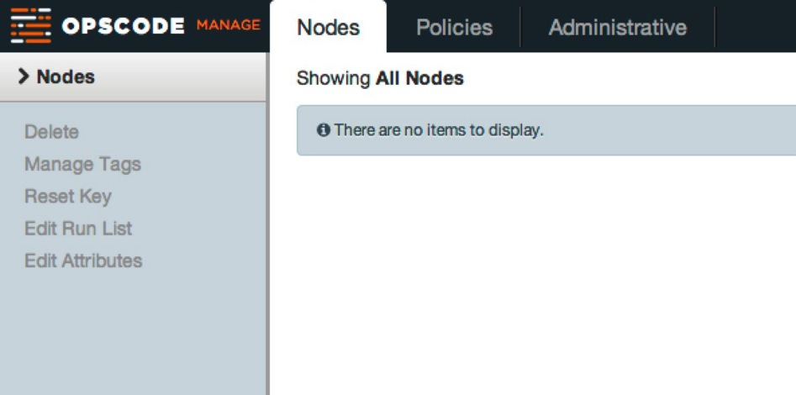

We Have No Nodes Yet
Notes:
Just to show there aren’t any nodes yet

Slide 98
Training Nodes For Windows/Linux Labs
We each have two nodes in the CloudShare training environment
Windows Node: Windows Server 2012 x64
2GB RAM / 40GB HDD
Administrator level permissions
Linux Node: Centos 6.X
2GB RAM / 15GB HDD
‘sudo’ or root level permissions
Notes:
Use this if cloudshare or some other on-demand training lab / environment are unavailable.

Slide 99
Training Nodes For Our Windows Labs
We each have a node in the CloudShare training environment
Windows Node: Windows Server 2012 x64
2GB RAM / 40GB HDD
Administrator level permissions
Notes:
Use this if cloudshare or some other on-demand training lab / environment are unavailable.

Slide 100
Training Nodes For Our Linux Labs
We each have a node in the CloudShare training environment
Linux Node: Centos 6.X
2GB RAM / 15GB HDD
‘sudo’ or root level permissions
Notes:
Use this if cloudshare or some other on-demand training lab / environment are unavailable.

Slide 101
CloudShare Node
Register and login to CloudShare (see invite)
Start Using This Environment

Slide 102
CloudShare Node

Slide 103
CloudShare Node Hostname
Notes:
Copy the External Address. This will be used to ssh into the server.

Slide 104
Checkpoint – Windows and Linux
At this point you should have
One Windows and one Linux Virtual Machine (VM)
The IP Address or public hostname of each VM
An application for establishing an RDP connection
'RDP' permissions on the Windows VM
An application for establishing an SSH connection
’sudo’ or root-level permissions on the Linux VM

Slide 105
Checkpoint - Windows
At this point you should have
One Windows Virtual Machine (VM)
The IP Address or public hostname of the VM
An application for establishing an RDP connection
'RDP' permissions on the Windows VM

Slide 106
Checkpoint - Linux
At this point you should have
One Linux Virtual Machine (VM)
The IP Address or public hostname of the VM
An application for establishing an SSH connection
’sudo’ or root-level permissions on the Linux VM

Slide 107
Bootstraping a Node
First: The Workstation bootstraps the Node
Chef Server
Workstation
Node
Install Chef
Configure Client
Converge with Chef Server
Bootstrap using: WinRM for Windows nodes SSH for Linux nodes

Slide 108
Bootstraping a Node
Second: The Node contacts Chef Server
Chef Server
Workstation
Node
Install Chef
Configure Client
Converge with Chef Server
Bootstrap using: WinRM for Windows nodes SSH for Linux nodes

Slide 109
"Bootstrap” command
To Bootstrap a Linux node
ws> knife bootstrap <hostname or IP Address> -x username –P password -N ”linuxnode"
-x = username
-P = password
-N = rename the node (from the default of FQDN)
To Bootstrap a Windows node
ws>knife bootstrap windows winrm <hostname or IP> -x username –P password -N ”windowsnode"
NOTE: If you are using more then one node within your Organization,
name them differently or you’ll get an error!

Slide 110
Each node must have a unique name
Every node must have a unique name within an organization
Chef defaults to the Fully Qualified Domain Name of the server, i.e. in the format server.domain.com
We overrode the FQDN to make typing easier using:
–N “windowsnode” or –N “linuxnode”
In production, let the default FQDN be the node name

Slide 111
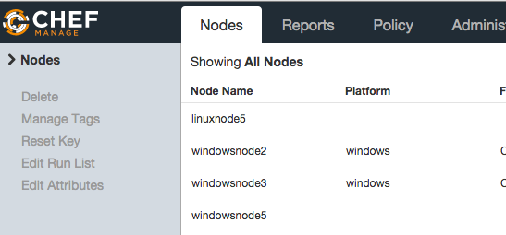
Node names
View node names here

Slide 112
What just happened?
Chef and its dependencies installed on the Node via an operating system-specific package ("omnibus installer")
Installation includes
The Ruby language - used by Chef
Configured the node with correct security certificates
chef-client - Client application (same version as your workstation)
ohai - System profiler (which creates the node object)
Notes:
A quick mention that we just used the omnibus installer which puts Chef and all of its dependencies on the workstation. The tools are installed under /opt/chef (linux/mac) or C:\Chef (Windows).
Also mention that ‘gem install chef’ is also a valid installation method if students are already using rvm, rbevn, or chruby to manage their Ruby installations or if they’d prefer to use the system ruby (which should be at version 1.9 or better to use this method).
Opscode manages an open source project called "Omnibus". Use omnibus to create OS-specific packages.

Slide 113
What just happened?
The security and configuration files can be found at:
Windows node: C:\chef
Linux node: /etc/chef
ORGNAME-validator.pem copied from the Workstation to the Node, and renamed to validation.pem
client.rb created on the Node, with the configuration needed by the Node to connect with the Chef Server
Notes:
A quick mention that we just used the omnibus installer which puts Chef and all of its dependencies on the workstation. The tools are installed under /opt/chef (linux/mac) or C:\Chef (Windows).
Also mention that ‘gem install chef’ is also a valid installation method if students are already using rvm, rbevn, or chruby to manage their Ruby installations or if they’d prefer to use the system ruby (which should be at version 1.9 or better to use this method).
Opscode manages an open source project called "Omnibus". Use omnibus to create OS-specific packages.

Slide 114
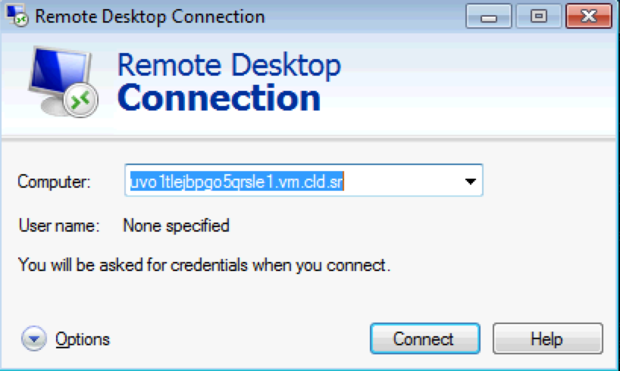
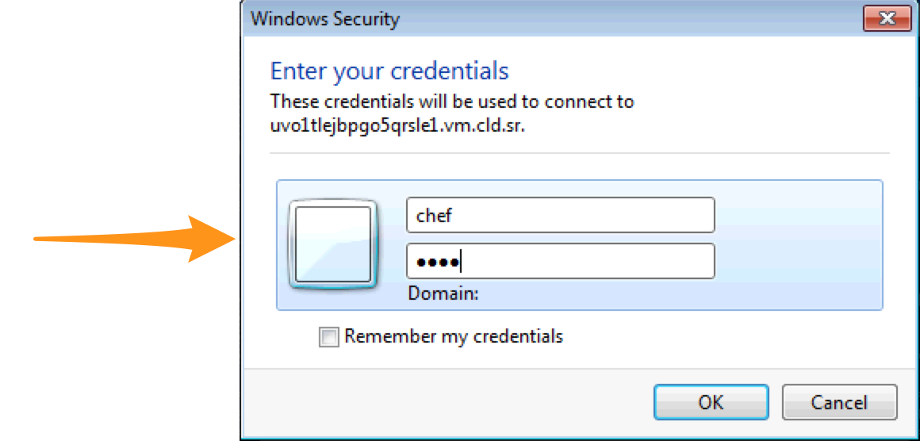
Windows node: Verify Target Instance is Configured Properly
Use Remote Desktop to connect to the host.
User: Administrator Password: <your_password>

Slide 115
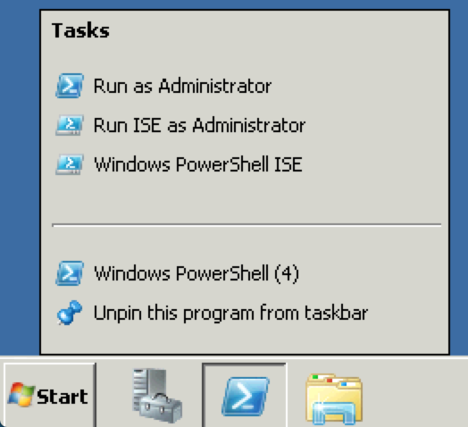
Windows node: Verify Target Instance is Configured Properly
On the VM
Close all existing PowerShell windows
Open an Administrator Powershell window

Slide 116
Windows node: Verify Target Instance is Configured Properly
rn\> dir c:\chef
Directory: C:\chef
Mode LastWriteTime Length Name
---- ------------- ------ ----
d---- 10/7/2013 3:41 PM cache
-a--- 10/4/2013 7:18 PM 1702 client.pem
-a--- 10/4/2013 7:17 PM 434 client.rb
-a--- 10/4/2013 7:17 PM 17 first-boot.json
-a--- 10/4/2013 7:17 PM 1706 validation.pem
-a--- 10/4/2013 7:16 PM 161 wget.ps1
-a--- 10/4/2013 7:16 PM 1273 wget.vbs

Slide 117
Windows node: Examine C:\chef\client.rb
rn> gc c:\chef\client.rb
log_level :info
log_location STDOUT
chef_server_url "https://api.opscode.com/organizations/ORGNAME"
validation_client_name ORGNAME-validator"
client_key "c:/chef/client.pem"
validation_key "c:/chef/validation.pem"
file_cache_path "c:/chef/cache"
file_backup_path "c:/chef/backup"
cache_options ({:path => "c:/chef/cache/checksums", :skip_expires => true})
node_name ”windowsnode"

Slide 118
Windows node: Examine C:\chef\first-boot.json
rn> gc c:\chef\first-boot.json
{"run_list":[]}
You can bootstrap nodes with recipes/run lists right away
Disaster recovery!

Slide 119
Linux node: Verify Target Instance is Configured Properly
ws> ssh root@<EXTERNAL ADDRESS>
The authenticity of host 'uvo1qrwls0jdgs3blvt.vm.cld.sr (69.195.232.110)' can't be established.
RSA key fingerprint is d9:95:a3:b9:02:27:e9:cd:74:e4:a2:34:23:f5:a6:8b.
Are you sure you want to continue connecting (yes/no)? yes
Warning: Permanently added 'uvo1qrwls0jdgs3blvt.vm.cld.sr,69.195.232.110' (RSA) to the list of known hosts.
chef@uvo1qrwls0jdgs3blvt.vm.cld.sr's password:
Last login: Tue July 8 16:26:24 2014 from host86-145-117-53.range86-145.btcentralplus.com
[chef@CentOS63 ~]$

Slide 120
Linux node: Verify Target Instance is Configured Properly
rn> ls /etc/chef
client.pem client.rb first-boot.json validation.pem
rn> which chef-client
/usr/bin/chef-client

Slide 121
Linux node: Examine /etc/chef/client.rb
rn> cat /etc/chef/client.rb
log_level :info
log_location STDOUT
chef_server_url "https://api.opscode.com/organizations/ORGNAME"
validation_client_name "ORGNAME-validator"
node_name ”linuxnode"

Slide 122
Linux node: Examine /etc/chef/first-boot.json
rn> cat /etc/chef/first-boot.json
{"run_list":[]}
You can bootstrap nodes with recipes/run lists right away

Slide 123
Change log level on the node (all platforms)
OPEN IN EDITOR:
Windows node: c:\chef\client.rb
-------------------------------------------------------------------------------------------------------------
Linux node /etc/chef/client.rb
log_level :info
log_location STDOUT
chef_server_url "https://api.opscode.com/organizations/ORGNAME"
validation_client_name "ORGNAME-validator”
Ensure the default log level for chef-client is :info
This setting gives you more information when you converge with Chef Server
More configuration options can be found on the docs site: http://docs.chef.io/config_rb_client.html

Slide 124
Run chef-client on the node
rn> chef-client
‘chef-client’ is the executable to start the convergence on either Windows or Linux nodes

Slide 125
View Node on Chef Server
Login to your Hosted Enterprise Chef
Notes:
Login to Enterprise Chef to view your nodes

Slide 126
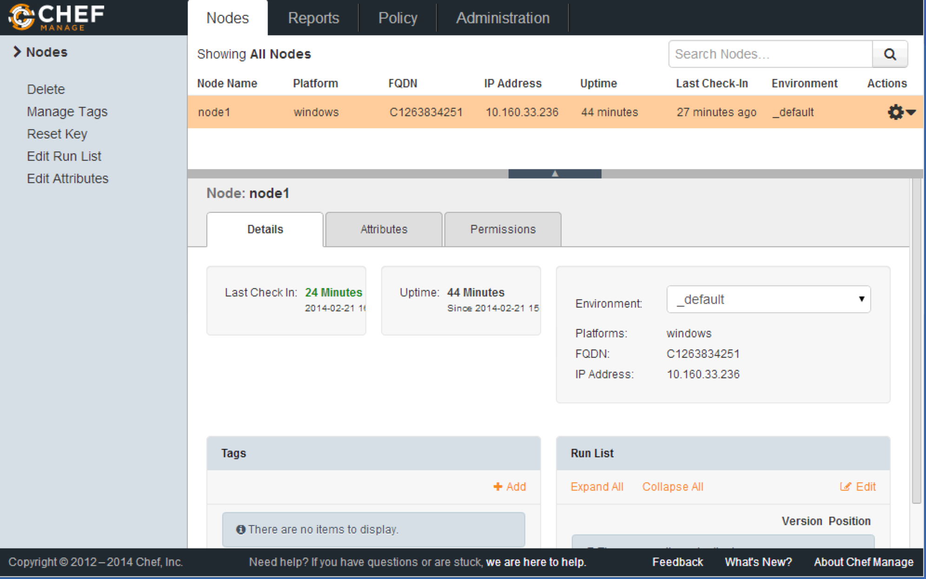
View Node on Chef Server

Slide 127
View Node on Chef Server
Click the 'Details' tab

Slide 128
Review Questions
What is the path and name of the chef-client configuration file on the node?
What is the command to run chef on the node?
What does a knife bootstrap do?
Notes:
-) /etc/chef
-) chef-client
-) Installs the chef-client on a target system so that it can run as a chef-client and communicate with a server.

Slide 129
Chef Configuration Concepts

Slide 130
Lesson Objectives
Define the purpose and relationship of:
Resources
Recipes
Cookbooks
Run Lists
Understand Configuration Drift, and now to mitigate this

Slide 131
Declarative Interface to Resources
A “Policy” is the collection of system configuration that you define
You define the policy in your Chef configuration Recipes and Cookbooks
Your policy declares what state each resource should be in but not how to get there

Slide 132
Nodes Adhere to Policy
Examples:
Policy states “IIS should be installed”
If IIS is not installed, then node installs it
If IIS is already installed, then node does nothing
Policy states ”/var/www/html/hello_world.html” should exist
If it does not, then create the file
If the file already exists (and has the exact same content), then do nothing

Slide 133
Resources -> Recipes -> Cookbooks
Resources configure individual items on a node
Eg: create a directory
Resources are gathered into Recipes
Recipes are stored in Cookbooks
Cookbooks contain:
Recipes and the items that support those recipes

Slide 134
Resources -> Recipes -> Cookbooks
Available resources
Recipe 1
Cookbook
Resource 1
Resource 1
Recipe 1
Resource 2
Resource 2
Recipe 2
Recipe 2
Resource 3
Resource 3
- Templates - Files - Attributes
- Other items
Resource 4
Resource 4
Resource 5
Resource 5

Slide 135
Resources
Represent a piece of the system and its desired state
Fundamental building blocks of Chef configuration
Affects a single element of the managed node
Examples:
Installing a package
Starting a service
Creating a directory, with specific permissions
Running a Powershell script on Windows Server

Slide 136
Windows Resource Example
Add a key to the registry registry_key "HKEY_LOCAL_MACHINE\\SOFTWARE\\Microsoft\\Windows\\CurrentVersion\\Policies\\System" do values [{ :name => "EnableLUA”, :type => :dword, :data => 0 }] action :create end

Slide 137
Linux Resource Example
Create an index.html file for Apache webserver to serve up cookbook_file ”/var/www/html/index.html" do source “index.html” mode “0644” action :create end

Slide 138
Recipes
Configuration files that contain one or more resources
Recipes have a larger business purpose then a resource
Example of a recipe:
A single configuration file that contains all the resources needed to install, configure and start a database for immediate access by application servers
Notes:
"Recipes are segments of code that do task X."

Slide 139
Example Windows Server Recipe
windows_package "Microsoft .NET Framework 4.0" do
action :install
source "http://download.microsoft.com/download/dotNetFx40_Full_x86_x64.exe"
options "/quiet /norestart"
end
windows_registry "HKLM\SYSTEM\CurrentControlSet\Control\Terminal Server" do
values "FdenyTSConnections" => 0
end
service "W3SVC" do
action [:disable,:stop]
end
Note: This recipe contains three resources
Notes:
As opposed to Linux (packages, files, services), the holy trinity in the Windows world is more “packages, registry keys, services).
The windows_package resource has a mock URL (MS URLs are dreadfully long). It takes options “/quiet and /restart”. The action is to install.
The windows_registry resource enables Remote Desktop and pokes a firewall hole.
The W3SVC is IIS.

Slide 140
Example Linux Server Recipe
package "net-snmp" do action :install end
template "/etc/snmpd.conf" do source "snmpd.conf.erb" owner "root" group "root" mode 0644 variables(:community_string => “not_public”)
notifies :restart, “service[snmpd]”
end
service "snmpd" do action [:enable,:start] end
Note: This recipe contains three resources
Notes:
Or Linux! Chef works on multiple platforms.
We will look at these resources more carefully

Slide 141
What is a cookbook?
A cookbook is like a “package” for Chef recipes.
It contains all the recipes, files, templates, libraries, etc. required to configure a portion of your infrastructure
Typically they map 1:1 to a piece of software or functionality, such as:
MySQL Cookbook
IIS Cookbook
Notes:
Example: “apache”, “mysql”, “mongodb”, “tomcat”, “jboss” - all of these things are software style cookbooks, and they would contain all the different ways you work with each. (A “mysql client”, “mysql server”, “mysql slave”, etc.)
Functional cookbooks might be something like “users”, “security”, etc.
We are going to write a lot of cookbooks - so you’re going to get comfortable with them.

Slide 142
Recipes in Cookbooks (all platforms)
Denote a recipe using this format: cookbook::recipe
Example:
recipe[iis::cleanup]
This points to the “cleanup” recipe inside the “iis” cookbook
The actual file will be called “cleanup.rb”
Path=‘chef-repo/cookbooks/iis/recipes/cleanup.rb’

Slide 143
Default Recipes (all platforms)
New cookbooks come with an empty default recipe
Filename is “default.rb”
Path: chef-repo/cookbooks/<cookbook_name>/recipes/default.rb
Can be referenced as either:
recipe[mysql::default] or
recipe[mysql]

Slide 144
Run List (all platforms)
If a cookbook can contain multiple recipes, how do you specify WHICH recipes to run on the node?
A run_list is an ORDERED list of which recipes to run, and in which cookbook(s) they can be found
The order of the recipes is important
The run_list can contain multiple recipes from multiple cookbooks

Slide 145
Run List
Cookbook-1
Recipe-A
Run List
Recipe-B
Cookbook-1::Recipe-B
The following recipes will be ignored
(they aren’t in the run_list)
Cookbook-1::Recipe-A
Cookbook-2::Recipe-C
Cookbook-2
Cookbook-2::Recipe-A
Recipe-A
Cookbook-2::Recipe-B
Recipe-B
Recipe-C

Slide 146
Duplication in the Run List
If a recipe is repeated more then once in a run_list, all subsequent iterations of the same recipe are ignored
Example: If the same IIS recipe is listed twice in the run_list, then:
The first IIS recipe installs IIS
The second IIS recipe doesn’t need to run, since IIS is now installed by the first run of the recipe
Chef Server makes sure the node only sees one of the duplicate IIS recipes

Slide 147
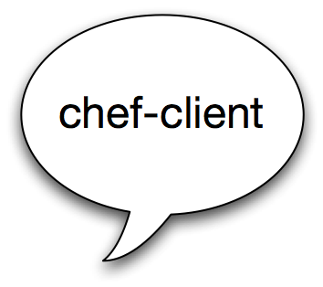

Run List
Chef Server
What policy should I follow?
Node
Notes:
When the chef-server run on the node it asks the chef server what policy should I follow, or what is my run list

Slide 148
Run List
Chef Server
Here is the policy you should follow!
Node
"recipe[ntp::configure]"
"recipe[users]”
Notes:
Chef server looks at the run_list and sends the appropriate cookbooks to the node

Slide 149
Configuration Drift
Configuration Drift happens when:
Your infrastructure requirements change
The configuration of a server falls out of policy
Convergence and Chef Search make it easy to find and correct issues automatically!
Notes:
I.e. Configuration Drift is when your code is out of date to your deployment needs.

Slide 150
Configuration Drift
Nodes can be configured to automatically check in with Chef Server every X minutes:
Node can put itself back into compliance
This is called “Test and Repair”
See the chef-client cookbook to enable this service
https://supermarket.chef.io
You would need to add ‘recipe[chef-client]’ to your run list
Notes:
I.e. Configuration Drift is when your code is out of date to your deployment needs.

Slide 151
Review Questions
What is a Node?
What is a Resource?
What is a Recipe? How is it different from a Cookbook?
What is a Run List?
What is configuration drift, and how does Chef mitigate this issue?
Notes:
A node is a server you want to configure
A resource is an item of manipulation, ie. a primitive thats contained in a recipe.
A recipe is collection of resources

Slide 152
Chef Documentation

Slide 153
Find the Docs
http://docs.chef.io
All you seek is within!
Click on ‘Search the Docs’
Search for “package resource”
Which action is the default?
While you might not know what an action is yet, just try searching for the requested information

Slide 154
Writing Webserver Cookbooks

Slide 155
Windows/Linux Lesson Objectives
In this lesson, we will
Create new cookbooks
Describe how to use the package(for Linux), powershell_script(for Windows), service and cookbook_file resources
Write completely functional Apache and IIS webserver recipes
Upload our cookbooks to the Chef Server
Set a run_list for our nodes using ‘knife’
Converge our nodes
Explain the output of a chef-client run

Slide 156
The Problem and the Success Criteria
The Problem: We need a web server configured to serve up our homepage(s).
Success Criteria: We can see the homepage(s) in a web browser.

Slide 157
Windows Lesson Objectives
In this lesson, we will
Create new cookbooks
Describe how to use the powershell_script(only for Windows), service and cookbook_file resources
Write a completely functional IIS webserver recipe
Upload our cookbook to the Chef Server
Set a run_list for our nodes via knife
Converge the node
Explain the output of a chef-client run

Slide 158
Linux Lesson Objectives
In this lesson, we will
Create new cookbooks
Describe how to use the package(only for Linux), service and cookbook_file resources
Write a completely functional Apache webserver recipe
Upload our cookbook to the Chef Server
Set a run_list for our nodes via knife
Converge the node
Explain the output of a chef-client run

Slide 159
Problem and the Success Criteria
The Problem: We need a web server configured to serve up our homepage.
Success Criteria: We can see the homepage in a web browser.

Slide 160
Writing an Apache cookbook for Linux nodes

Slide 161
Linux: Required steps
Install Apache on the node
Start Apache on the node, and configure Apache to start upon reboot
Write out the home page, to the location where Apache expects to find it

Slide 162
Exercise: Create a new Cookbook
ws> cd chef-repo ws> knife cookbook create apache
** Creating cookbook apache
** Creating README for cookbook: apache
** Creating CHANGELOG for cookbook: apache
** Creating metadata for cookbook: apache

Slide 163
Exercise: Explore the cookbook
Windows workstation
Mac/Linux workstation
ws> dir cookbooks/apache
ws> ls –l cookbooks/apache
Output
-rw-r--r-- 1 opscode opscode 412 Jan 24 21:25 CHANGELOG.md
-rw-r--r-- 1 opscode opscode 1447 Jan 24 21:25 README.md
drwxr-xr-x 2 opscode opscode 68 Jan 24 21:25 attributes
drwxr-xr-x 2 opscode opscode 68 Jan 24 21:25 definitions
drwxr-xr-x 3 opscode opscode 102 Jan 24 21:25 files
-rw-r--r-- 1 opscode opscode 276 Jan 24 21:25 metadata.rb
drwxr-xr-x 2 opscode opscode 68 Jan 24 21:25 providers
drwxr-xr-x 3 opscode opscode 102 Jan 24 21:25 recipes
drwxr-xr-x 3 opscode opscode 102 Jan 24 21:25 templates

Slide 164
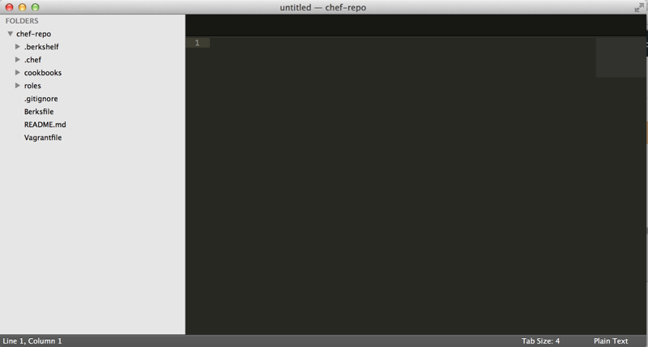
Exercise: Open a project drawer if you're using Sublime Text
If you're using Sublime, then File>Open the chef-repo directory you created earlier
Access the cookbook files from the left menu

Slide 165
Chef Resources
package "haproxy" do
action :install
end
template "/etc/haproxy/haproxy.cfg" do
source "haproxy.cfg.erb"
owner "root"
group "root"
mode "0644"
notifies :restart, "service[haproxy]"
end
service "haproxy" do
supports :restart => :true
action [:enable, :start]
end
Notes:
Let's take a moment to discuss the structure of a Chef resource.
This is a Linux example, but it’s generic enough for Windows. The only real difference would be that “package” would be “windows_package” in your students’ world.
Point out that resource parameters live between the “DO..END”.

Slide 166
Chef Resources
Have a type
package "haproxy" do
action :install
end
template "/etc/haproxy/haproxy.cfg" do
source "haproxy.cfg.erb"
owner "root"
group "root"
mode "0644"
notifies :restart, "service[haproxy]"
end
service "haproxy" do
supports :restart => :true
action [:enable, :start]
end

Slide 167
Chef Resources
Have a type
Have a name
package "haproxy" do
action :install
end
template "/etc/haproxy/haproxy.cfg" do
source "haproxy.cfg.erb"
owner "root"
group "root"
mode "0644"
notifies :restart, "service[haproxy]"
end
service "haproxy" do
supports :restart => :true
action [:enable, :start]
end

Slide 168
Chef Resources
Have a type
Have a name
Have parameters
package "haproxy" do
action :install
end
template "/etc/haproxy/haproxy.cfg" do
source "haproxy.cfg.erb"
owner "root"
group "root"
mode "0644"
notifies :restart, "service[haproxy]"
end
service "haproxy" do
supports :restart => :true
action [:enable, :start]
end

Slide 169
Chef Resources
Have a type
Have a name
Have parameters
Take action to put the resource into the desired state
package "haproxy" do
action :install
end
template "/etc/haproxy/haproxy.cfg" do
source "haproxy.cfg.erb"
owner "root"
group "root"
mode "0644"
notifies :restart, "service[haproxy]"
end
service "haproxy" do
supports :restart => :true
action [:enable, :start]
end

Slide 170
Chef Resources
Have a type
Have a name
Have parameters
Take action to put the resource into the desired state
Can send notifications to other resources
package "haproxy" do
action :install
end
template "/etc/haproxy/haproxy.cfg" do
source "haproxy.cfg.erb"
owner "root"
group "root"
mode "0644"
notifies :restart, "service[haproxy]"
end
service "haproxy" do
supports :restart => :true
action [:enable, :start]
end

Slide 171
Linux exercise: Edit the default recipe
OPEN IN EDITOR:
Windows workstation: cookbooks\apache\recipes\default.rb
-------------------------------------------------------------------------------------------------------------
Mac/Linux workstation: cookbooks/apache/recipes/default.rb
#
# Cookbook Name:: apache
# Recipe:: default
#
# Copyright 2014, YOUR_COMPANY_NAME
#
# All rights reserved - Do Not Redistribute
#

Slide 172
Linux Exercise: Add a package resource to install Apache
Add the following to: chef-repo/cookbooks/apache/recipes/default.rb
#
# Cookbook Name:: apache
# Recipe:: default
#
# Copyright 2014, YOUR_COMPANY_NAME
#
# All rights reserved - Do Not Redistribute
#
package ”httpd" do
action :install
end
SAVE FILE!
Notes:
Four concepts while they are typing:
1: Strings in ruby are enclosed in single or double quotes. Most of the time in Chef, you will use Double quotes.
2: :stop and :delete are Symbols - symbols in ruby are strings that live in only one place in memory. (No matter how many times you type :install, it refers to the same place.) In our material, anywhere we use a symbol, it is required - you can’t replace it with a string.
3: Arrays are noted by square brackets. This one has two items -- “:stop” and “:delete”. The first item has a trailing comma, the last item does not.
4: Idiomatic ruby uses two SPACES for indentation. Sublime defaults to four. At the end of the day, whitespace is whitespace.

Slide 173
So the resource we just wrote...
package ”httpd" do
action :install
end

Slide 174
So the resource we just wrote...
Is a package resource
package ”httpd" do
action :install
end

Slide 175
So the resource we just wrote...
Is a package resource
Whose name is ‘httpd’
package ”httpd" do
action :install
end

Slide 176
So the resource we just wrote...
Is a resource with a type of package
Whose name is ‘httpd’
With the action ‘install’
package ”httpd" do
action :install
end

Slide 177
Linux Exercise: Add a service resource to ensure the service is started and enabled at boot
OPEN IN EDITOR:
cookbooks/apache/recipes/default.rb
...
# All rights reserved - Do Not Redistribute
#
package ”httpd" do
action :install
end
service ”httpd" do
action [ :enable, :start ]
end
SAVE FILE!

Slide 178
Linux Exercise: Add a cookbook_file resource to copy the home page in place
Add the following to: cookbooks/apache/recipes/default.rb
service ”httpd" do
action [ :enable, :start ]
end
cookbook_file ”/var/www/html/index.html” do
source ”index.html"
mode “0644”
end
SAVE FILE!
Notes:
We are leaving the action off intentionally, in case anyone asks.

Slide 179
Linux: Full contents of the Apache recipe
package ”httpd" do
action :install
end
service ”httpd" do
action [ :enable, :start ]
end
cookbook_file “/var/www/html/index.html” do
source ”index.html”
mode ”0644”
end

Slide 180
Order Matters
Resources are executed in order
Body Level One
Body Level Two
Body Level Three
Body Level Four
Body Level Five
package ”httpd" do
action :install
end
service ”httpd" do
action [ :enable, :start ]
end
cookbook_file “/var/www/html/index.html” do
source ”index.html"
mode ”0644”
end
1st
2nd
3rd
Notes:
Order matters because the operating system was designed to be managed by hand
Think about adding a user, where the user ids are dynamically generated - if they aren’t added in the same order, you can’t guarantee that the system will be the same.

Slide 181
Linux Exercise: Add index.html to your cookbook’s files/default directory
OPEN IN EDITOR:
cookbooks/apache/files/default/index.html
<html>
<body>
<h1>Hello, Linux World!</h1>
</body>
</html>
SAVE FILE!

Slide 182
Linux: Full contents of the Apache recipe
apache/recipes/default.rb
apache/files/default/index.html
package ”httpd" do
action :install
end
service ”httpd" do
action [ :enable, :start ]
end
cookbook_file “/var/www/html/index.html” do
source ”index.html"
mode ”0644”
end
<html>
<body>
<h1>Hello, Linux World!</h1>
</body>
</html>

Slide 183
Linux Exercise: Upload the cookbook
ws> knife cookbook upload apache
Uploading apache [0.1.0]
Uploaded 1 cookbook.
Notes:
This checks for syntax errors, bundles the cookbook up, and uploads it to the chef server for distribution to the chef clients.
If they have syntax errors in the recipe, it will get caught here.
If you get a ‘ruby’ error on Windows, you need to make the Chef repo live in a path without spaces in it.

Slide 184
The Run List
The Run List is the ordered set of recipes and roles that the Chef Client will execute on a node
Recipes are specified by “recipe[name]”
Roles are specified by “role[name]”
If you leave off the recipe name, the default recipe is assumed (default.rb)
Notes:
We talk about Roles sometime in day two, for now , just get the reference out

Slide 185
Linux Exercise: Add the Apache recipe to the Linux test node’s run list
ws> knife node run_list add <nodename> “recipe[apache]”
linuxnode:
run_list: recipe[apache]
Notes:
Due to a bug in Windows, you must use single quotes here.

Slide 186
Linux Exercise: Run chef-client on your Linux test node
ws> knife node run_list add <nodename> “recipe[apache]”
Use the nodename you defined, Do NOT use the hostname
rn>$ chef-client
Starting Chef Client, version 11.10.4
[2014-02-24T05:37:54-08:00] INFO: *** Chef 11.10.4 ***
[2014-02-24T05:37:54-08:00] INFO: Chef-client pid: 260
[2014-02-24T05:38:09-08:00] INFO: Run List is [recipe[apache]]
[2014-02-24T05:38:09-08:00] INFO: Run List expands to [apache]
[2014-02-24T05:38:09-08:00] INFO: Starting Chef Run for linuxnode
[2014-02-24T05:38:09-08:00] INFO: Running start handlers
[2014-02-24T05:38:09-08:00] INFO: Start handlers complete.
Notes:
Typical errors:
* The file is not in the ‘default’ subdirectory
* The name of the package or service is wrong
* The site was created during a previous Chef run that eventually aborted due to an error. To resolve the error, remove c:\inetpub\wwwroot\test (and it’s contents), remove the test web site using the IIS manager, and clear the Chef cache
CLI IIS manager
c:\Windows\System32\inetsrv\appcmd.exe stop site site.name:/”Test Web Site”
c:\Windows\System32\inetsrv\appcmd.exe start site site.name:/”Test Web Site”

Slide 187
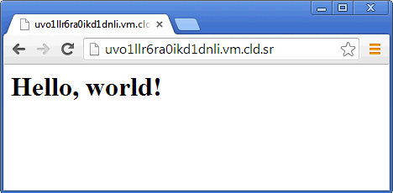
Exercise: Verify that the home page works
Open a web browser
Type in the URL for your test node
Notes:
If it’s not working at all - check the firewall rules. You can disable them. If you can’t reach your test node from your workstation, use ‘curl http://localhost’ from the command line on the test node.

Slide 188
Congratulate yourself!
You have just written your first Chef cookbook!
(clap!)

Slide 189
Linux: Reading the output of a chef-client run
Starting Chef Client, version 11.8.2[2014-01-06T07:06:00-05:00] INFO: *** Chef 11.8.2 ***[2014-01-06T07:06:00-05:00] INFO: Chef-client pid: 10781[2014-01-06T07:06:01-05:00] INFO: Run List is [recipe[apache]][2014-01-06T07:06:01-05:00] INFO: Run List expands to [apache][2014-01-06T07:06:01-05:00] INFO: Starting Chef Run for linuxnode[2014-01-06T07:06:01-05:00] INFO: Running start handlers[2014-01-06T07:06:01-05:00] INFO: Start handlers complete.
The run list is shown
The expanded Run List is the complete list, after nested roles are expanded
Notes:
Talk about the Processing lines - this means we are evaluating this resource for the “install” action. You will see these lines for every resource.

Slide 190
Linux: Reading the output of a chef-client run
* cookbook_file[/var/www/html/index.html] action create[2014-01-06T07:52:07-05:00] INFO: Processing cookbook_file[/var/www/html/index.html] action create (apache::default line 17)[2014-01-06T07:52:07-05:00] INFO: cookbook_file[/var/www/html/index.html] created file /var/www/html/index.html - create new file /var/www/html/index.html[2014-01-06T07:52:07-05:00] INFO: cookbook_file[/var/www/html/index.html] updated file contents /var/www/html/index.html - update content in file /var/www/html/index.html from none to 03fb1d --- /var/www/html/index.html 2014-01-06 07:52:07.285214202 -0500 +++ /tmp/.index.html20140106-10796-1kxknbg 2014-01-06 07:52:07.868365963 -0500 @@ -1 +1,6 @@ +<html> +<body> + <h1>Hello, world!</h1> +</body> +</html>[2014-01-06T07:52:07-05:00] INFO: cookbook_file[/var/www/html/index.html] mode changed to 644 - change mode from '' to '0644' - restore selinux security context
Checks for an index.html file
There is already one in place, backup the file
Set permissions on the file
A diff of the written file is shown with the modified lines called out
Notes:
Talk about the Processing lines - this means we are evaluating this resource for the “install” action. You will see these lines for every resource.

Slide 191
Reading the output of a chef-client run
[2014-02-24T06:25:34-08:00] INFO: Chef Run complete in 17.432572377 seconds
[2014-02-24T06:25:34-08:00] INFO: Running report handlers
[2014-02-24T06:25:34-08:00] INFO: Report handlers complete
Chef Client finished, 4/4 resources updated
Time to complete the Chef run is displayed
Report and exception handlers are now run
Notes:
We don’t really get to reports and exception handlers - the gist is, you use them to send statistics about the run to all sorts of places - email, splunk, etc.

Slide 192
Idempotence
Actions on resources in Chef are designed to be idempotent
In practical terms, this means they only change the state of the system if they have to
If a resource in Chef is properly configured, we move on to the next resource
Notes:
Idempotence, in math, means an operation can be applied multiple times without changing the result. 1 x 1 = 1 is an idempotent operation of multiplication.

Slide 193
Linux Exercise: Re-run the Chef Client Run
rn> chef-client
* service[w3svc] action enable
[2014-02-24T06:25:33-08:00] INFO: Processing service[w3svc] action enable (iis_demo::default line 14)
(up to date)
* service[w3svc] action start
[2014-02-24T06:25:33-08:00] INFO: Processing service[w3svc] action start (iis_demo::default line 14)
(up to date)
Service is idempotent.
No changes have been made
Notes:
Talk about the Processing lines - this means we are evaluating this resource for the “install” action. You will see these lines for every resource.

Slide 194
Best Practice: Omit the default action
So this:
package ”httpd" do
action :install
end
Becomes this:
package ”httpd" do
action :install
end
Becomes this:
package ”httpd”

Slide 195
What’s with the ‘default’ subdirectory?
Chef allows you to select the most appropriate file (or template) within a cookbook depending on the node's platform
Host node name (foo.bar.com)
platform-version (centos-6.3)
platform-major (centos-6)
Platform (centos)
default
99% of the time, you will just use default

Slide 196
Questions
How do you create a new cookbook?
How do you upload a cookbook to the Chef Server?
How do add a recipe to the node’s run_list?

Slide 197
Writing an IIS cookbook for Windows nodes

Slide 198
Required steps
Install IIS on the node
Start IIS on the node, and configure IIS to start upon reboot
Write out the home page, to the location where IIS expects to find it

Slide 199
Windows Exercise: Create a new Cookbook
ws> cd chef-repo
ws> knife cookbook create iis_demo
** Creating cookbook iis_demo
** Creating README for cookbook: iis_demo
** Creating CHANGELOG for cookbook: iis_demo
** Creating metadata for cookbook: iis_demo

Slide 200
Exercise: Explore the cookbook
Windows workstation
Mac/Linux workstation
ws> dir cookbooks/iis_demo
ws> ls –l cookbooks/iis_demo
Output
-rw-r--r-- 1 opscode opscode 412 Jan 24 21:25 CHANGELOG.md
-rw-r--r-- 1 opscode opscode 1447 Jan 24 21:25 README.md
drwxr-xr-x 2 opscode opscode 68 Jan 24 21:25 attributes
drwxr-xr-x 2 opscode opscode 68 Jan 24 21:25 definitions
drwxr-xr-x 3 opscode opscode 102 Jan 24 21:25 files
-rw-r--r-- 1 opscode opscode 276 Jan 24 21:25 metadata.rb
drwxr-xr-x 2 opscode opscode 68 Jan 24 21:25 providers
drwxr-xr-x 3 opscode opscode 102 Jan 24 21:25 recipes
drwxr-xr-x 3 opscode opscode 102 Jan 24 21:25 templates

Slide 201
Exercise: Open a project drawer if you're using Sublime Text
If you're using Sublime, then File>Open the chef-repo directory you created earlier
Access the cookbook files from the left menu

Slide 202
Chef Resources
package "haproxy" do
action :install
end
template "/etc/haproxy/haproxy.cfg" do
source "haproxy.cfg.erb"
owner "root"
group "root"
mode "0644"
notifies :restart, "service[haproxy]"
end
service "haproxy" do
supports :restart => :true
action [:enable, :start]
end
Notes:
Let's take a moment to discuss the structure of a Chef resource.
This is a Linux example, but it’s generic enough for Windows. The only real difference would be that “package” would be “windows_package” in your students’ world.
Point out that resource parameters live between the “DO..END”.

Slide 203
Chef Resources
Have a type
package "haproxy" do
action :install
end
template "/etc/haproxy/haproxy.cfg" do
source "haproxy.cfg.erb"
owner "root"
group "root"
mode "0644"
notifies :restart, "service[haproxy]"
end
service "haproxy" do
supports :restart => :true
action [:enable, :start]
end

Slide 204
Chef Resources
Have a type
Have a name
package "haproxy" do
action :install
end
template "/etc/haproxy/haproxy.cfg" do
source "haproxy.cfg.erb"
owner "root"
group "root"
mode "0644"
notifies :restart, "service[haproxy]"
end
service "haproxy" do
supports :restart => :true
action [:enable, :start]
end

Slide 205
Chef Resources
Have a type
Have a name
Have parameters
package "haproxy" do
action :install
end
template "/etc/haproxy/haproxy.cfg" do
source "haproxy.cfg.erb"
owner "root"
group "root"
mode "0644"
notifies :restart, "service[haproxy]"
end
service "haproxy" do
supports :restart => :true
action [:enable, :start]
end

Slide 206
Chef Resources
Have a type
Have a name
Have parameters
Take action to put the resource into the desired state
package "haproxy" do
action :install
end
template "/etc/haproxy/haproxy.cfg" do
source "haproxy.cfg.erb"
owner "root"
group "root"
mode "0644"
notifies :restart, "service[haproxy]"
end
service "haproxy" do
supports :restart => :true
action [:enable, :start]
end

Slide 207
Chef Resources
Have a type
Have a name
Have parameters
Take action to put the resource into the desired state
Can send notifications to other resources
package "haproxy" do
action :install
end
template "/etc/haproxy/haproxy.cfg" do
source "haproxy.cfg.erb"
owner "root"
group "root"
mode "0644"
notifies :restart, "service[haproxy]"
end
service "haproxy" do
supports :restart => :true
action [:enable, :start]
end

Slide 208
Chef Resources
Have a type
Have a name
Have parameters
Take action to put the resource into the desired state
Can send notifications to other resources
package "haproxy" do
action :install
end
template "/etc/haproxy/haproxy.cfg" do
source "haproxy.cfg.erb"
owner "root"
group "root"
mode "0644"
notifies :restart, "service[haproxy]"
end
service "haproxy" do
supports :restart => :true
action [:enable, :start]
end

Slide 209
Windows: Edit the default recipe
OPEN IN EDITOR:
cookbooks\iis_demo\recipes\default.rb
#
# Cookbook Name:: iis_demo
# Recipe:: default
#
# Copyright 2014, YOUR_COMPANY_NAME
#
# All rights reserved - Do Not Redistribute
#

Slide 210
Windows Exercise: Add a powershell resource to install IIS
OPEN IN EDITOR:
cookbooks\iis_demo\recipes\default.rb
#
# Cookbook Name:: iis_demo
# Recipe:: default
#
# Copyright 2014, YOUR_COMPANY_NAME
#
# All rights reserved - Do Not Redistribute
#
powershell_script "Install IIS" do
code "add-windowsfeature Web-Server"
action :run
end
SAVE FILE!

Slide 211
So the resource we just wrote...
powershell_script "Install IIS" do
code "add-windowsfeature Web-Server"
action :run
end

Slide 212
So the resource we just wrote...
Is a powershell_script resource
powershell_script "Install IIS" do
code "add-windowsfeature Web-Server"
action :run
end

Slide 213
So the resource we just wrote...
Is a powershell_script resource
Whose name is “Install IIS”
powershell_script "Install IIS" do
code "add-windowsfeature Web-Server"
action :run
end

Slide 214
So the resource we just wrote...
Is a powershell_script resource
Whose name is Install IIS
With the parameter “code”
powershell_script "Install IIS" do
code "add-windowsfeature Web-Server"
action :run
end

Slide 215
So the resource we just wrote...
Is a powershell_script resource
Whose name is Install IIS
With the parameter “code”
With an action “run”
powershell_script "Install IIS" do
code "add-windowsfeature Web-Server"
action :run
end

Slide 216
Windows Exercise: Add a service resource to ensure the service is started and enabled at boot
OPEN IN EDITOR:
cookbooks\iis_demo\recipes\default.rb
...
# All rights reserved - Do Not Redistribute
#
powershell_script "Install IIS" do
action :run
code "add-windowsfeature Web-Server"
end
service "w3svc" do
action [ :enable, :start ]
end
SAVE FILE!

Slide 217
Windows Exercise: Add a cookbook_file resource to copy the home page in place
OPEN IN EDITOR:
cookbooks\iis_demo\recipes\default.rb
...
service "w3svc" do
action [ :enable, :start ]
end
cookbook_file ‘c:\inetpub\wwwroot\Default.htm’ do
source "Default.htm"
rights :read, "Everyone"
end
SAVE FILE!
Notes:
We are leaving the action off intentionally, in case anyone asks.

Slide 218
Windows: Full contents of the IIS_demo recipe
powershell_script "Install IIS" do
action :run
code "add-windowsfeature Web-Server"
end
service "w3svc" do
action [ :enable, :start ]
end
cookbook_file ‘c:\inetpub\wwwroot\Default.htm’ do
source "Default.htm”
rights :read, "Everyone"
end

Slide 219
Notice we didn’t say how to restart the service
Resources are declarative - that means we say what we want to have happen, rather than how
Resources take action through Providers - providers perform the how
Chef determines the platform the node is running to determine the correct provider for a resource
Notes:
Declarative resources inspect the system state, and do whatever they need to do to make the system conform with the declared state.
Chef automatically knows that we should use “apt” on ubuntu, “yum” on red hat by looking up the correct PROVIDER based on the platform.

Slide 220
Order Matters
Resources are executed in order
Body Level One
Body Level Two
Body Level Three
Body Level Four
Body Level Five
package ”httpd" do
action :install
end
service ”httpd" do
action [ :enable, :start ]
end
cookbook_file “/var/www/html/index.html” do
source ”index.html"
mode ”0644”
end
1st
2nd
3rd
Notes:
Order matters because the operating system was designed to be managed by hand
Think about adding a user, where the user ids are dynamically generated - if they aren’t added in the same order, you can’t guarantee that the system will be the same.

Slide 221
Windows Exercise: Add Default.htm to your cookbook’s files/default directory
OPEN IN EDITOR:
cookbooks\iis_demo\files\default\Default.htm
<html>
<body>
<h1>Hello, Windows World!</h1>
</body>
</html>
SAVE FILE!

Slide 222
Windows Exercise: Upload the cookbook
ws> knife cookbook upload iis_demo
Uploading iis_demo [0.1.0]
Uploaded 1 cookbook.

Slide 223
The Run List
The Run List is the ordered set of recipes and roles that the Chef Client will execute on a node
Recipes are specified by “recipe[name]”
Roles are specified by “role[name]”
If you leave off the recipe name, the default recipe is assumed (default.rb)
Notes:
We talk about Roles sometime in day two, for now , just get the reference out

Slide 224
Windows Exercise: Add the IIS recipe to your test node’s run list
ws> knife node run_list add <nodename> “recipe[iis_demo]”
windowsnode:
run_list: recipe[iis_demo]

Slide 225
Windows Exercise: Run the chef-client on your test Windows node
rn> chef-client
Starting Chef Client, version 11.10.4
[2014-02-24T05:37:54-08:00] INFO: *** Chef 11.10.4 ***
[2014-02-24T05:37:54-08:00] INFO: Chef-client pid: 260
[2014-02-24T05:38:09-08:00] INFO: Run List is [recipe[iis_demo]]
[2014-02-24T05:38:09-08:00] INFO: Run List expands to [iis_demo]
[2014-02-24T05:38:09-08:00] INFO: Starting Chef Run for windowsnode
[2014-02-24T05:38:09-08:00] INFO: Running start handlers
[2014-02-24T05:38:09-08:00] INFO: Start handlers complete.
resolving cookbooks for run list: ["iis_demo"]
[2014-02-24T05:38:10-08:00] INFO: Loading cookbooks [iis_demo]
Synchronizing Cookbooks:
[2014-02-24T05:38:10-08:00] INFO: Storing updated cookbooks/iis_demo/recipes/default.rb in the cache.
…
Notes:
Typical errors:
* The file is not in the ‘default’ subdirectory
* The name of the package or service is wrong
* The site was created during a previous Chef run that eventually aborted due to an error. To resolve the error, remove c:\inetpub\wwwroot\test (and it’s contents), remove the test web site using the IIS manager, and clear the Chef cache
CLI IIS manager
c:\Windows\System32\inetsrv\appcmd.exe stop site site.name:/”Test Web Site”
c:\Windows\System32\inetsrv\appcmd.exe start site site.name:/”Test Web Site”

Slide 226
Exercise: Verify that the home page works
Open a web browser
Type in the URL for your test node
Notes:
If it’s not working at all - check the firewall rules. You can disable them. If you can’t reach your test node from your workstation, use ‘curl http://localhost’ from the command line on the test node.

Slide 227
Congratulate yourself!
You have just written your first Chef cookbook!
(clap!)

Slide 228
Windows: Reading the output of a chef-client run
* cookbook_file[c:\inetpub\wwwroot\Default.htm] action create
[2014-02-24T06:25:33-08:00] INFO: Processing cookbook_file[c:\inetpub\wwwroot\Default.htm] action create (iis_demo::default line 18)
[2014-02-24T06:25:33-08:00] INFO: cookbook_file[c:\inetpub\wwwroot\Default.htm] created file c:\inetpub\wwwroot\Default.htm
- create new file c:\inetpub\wwwroot\Default.htm[2014-02-24T06:25:33-08:00] INFO: cookbook_file[c:\inetpub\wwwroot\Default.htm] updated file contents c:\inetpub\wwwroot\Default.htm
- update content in file c:\inetpub\wwwroot\Default.htm from none to 231d53
--- c:\inetpub\wwwroot\Default.htm 2014-02-24 06:25:33.000000000 -0800
+++ C:/Users/chef/AppData/Local/Temp/4/Default.htm20140224-1896-13q72ev 2014-02-24 06:25:33.000000000 -0800
@@ -1 +1,7 @@
+<html>
+ <body>
+ <h1>Hello, world!</h1>
+ </body>
+</html>
+[2014-02-24T06:25:33-08:00] INFO: cookbook_file[c:\inetpub\wwwroot\Default.htm] permissions changed to [Everyone/flags:0/mask:80000000]
- change dacl
Check for an Default.htm file
If there is already one in place, backup the file
A diff of the written file is shown with the modified lines called out
Set permissions on the file

Slide 229
Windows: Reading the output of a chef-client run
Converging 3 resources
Recipe: iis_demo::default
* powershell_script[Install IIS] action run[2014-02-24T06:08:29-08:00] INFO: Processing powershell_script[Install IIS]
action run (iis_demo::default line 9)
Success Restart Needed Exit Code Feature Result
------- -------------- --------- --------------
True No Success {Common HTTP Features, Default Document, D...
WARNING: Windows automatic updating is not enabled. To ensure that your newly-installed role or feature is automatically updated, turn on Windows Update.
[2014-02-24T06:09:16-08:00] INFO: powershell_script[Install IIS] ran successfully
powershell_script is not idempotent
Add-WindowsFeature is!
Notes:
Talk about the Processing lines - this means we are evaluating this resource for the “install” action. You will see these lines for every resource.

Slide 230
Reading the output of a chef-client run
[2014-02-24T06:25:34-08:00] INFO: Chef Run complete in 17.432572377 seconds
[2014-02-24T06:25:34-08:00] INFO: Running report handlers
[2014-02-24T06:25:34-08:00] INFO: Report handlers complete
Chef Client finished, 2 resources updated
Time to complete the Chef run is displayed
Report and exception handlers are now run
Notes:
We don’t really get to reports and exception handlers - the gist is, you use them to send statistics about the run to all sorts of places - email, splunk, etc.

Slide 231
Idempotence
Actions on resources in Chef are designed to be idempotent
In practical terms, this means they only change the state of the system if they have to
If a resource in Chef is properly configured, we move on to the next resource
Notes:
Idempotence, in math, means an operation can be applied multiple times without changing the result. 1 x 1 = 1 is an idempotent operation of multiplication.

Slide 232
Windows Exercise: Re-run the Chef Client
rn> chef-client
Converging 3 resources
Recipe: iis_demo::default
* powershell_script[Install IIS] action run[2014-02-24T06:42:15-08:00] INFO: Processing powershell_script[Install IIS]
action run (iis_demo::default line 9)
Success Restart Needed Exit Code Feature Result
------- -------------- --------- --------------
True No NoChangeNeeded {}
[2014-02-24T06:42:16-08:00] INFO: powershell_script[Install IIS] ran successfully
- execute "powershell.exe" -NoLogo -NonInteractive -NoProfile -ExecutionPolicy RemoteSigned -InputFormat None -File
"C:/Users/chef/AppData/Local/Temp/4/chef-script20140224-4608-1fwjxog.ps1"
* service[w3svc] action enable[2014-02-24T06:42:16-08:00] INFO: Processing service[w3svc] action enable (iis_demo::default line 14)
(up to date)
* service[w3svc] action start[2014-02-24T06:42:16-08:00] INFO: Processing service[w3svc] action start (iis_demo::default line 14)
(up to date)
* cookbook_file[c:\inetpub\wwwroot\Default.htm] action create[2014-02-24T06:42:16-08:00] INFO: Processing cookbook_file[c:\inetpub\wwwroot\Default.htm] action create (iis_demo::default line 18)
(up to date)
[2014-02-24T06:42:17-08:00] INFO: Chef Run complete in 3.416521 seconds
…
Notes:
Note that it didn’t do anything - idempotency at its best.

Slide 233
Best Practice: Omit the default action
So this:
package ”httpd" do
action :install
end
Becomes this:
package ”httpd" do
action :install
end
Becomes this:
package ”httpd”

Slide 234
What’s with the ‘default’ subdirectory?
Chef allows you to select the most appropriate file (or template) within a cookbook depending on the node's platform
Host node name (foo.bar.com)
platform-version (centos-6.3)
platform-major (centos-6)
platform
default
99% of the time, you will just use default

Slide 235
Review: Cookbooks contain recipes and supporting files
...
├── cookbooks
│ ├── iis_demo
│ │ ├── recipes
│ │ │ ├── default.rb
│ │ │ └── server.rb
│ │ ├── files
│ │ │ └── default
│ │ │ └── index.html
│ │ ├── metadata.rb
│ │ ├── attributes
│ │ │ └── default
...
Recipes
Supporting File

Slide 236


Review: Cookbooks are installed as artifacts on Chef Server
Enterprise Chef
(org)
iis_demo v0.1.0
ntp v0.2.0
openssh v2.4.7

Slide 237

Review: Nodes have run_lists made of recipes
Enterprise Chef
(org)
recipe[ntp::client]
recipe[openssh::server]
recipe[iis_demo::server]

Slide 238
Questions
How do you create a new cookbook?
How do you upload a cookbook to the Chef Server?
How do you add a recipe to the run list using knife?
How do you remove a recipe from the run list using knife?

Slide 239
The Anatomy of a Chef run

Slide 240
Lesson Objectives
After completing the lesson, you will be able to
List all the steps taken by chef-client during a run

Slide 241

chef-client
Note: this happens AFTER the bootstrap is complete

Slide 242



chef-client
build node
Ohai!
node_name
platform
platform_version

Slide 243
Example of Ohai output from a Node
"languages": {
"ruby": {
"platform": "i386-mingw32",
"version": "1.9.3”,
"target": "i386-pc-mingw32",
"target_cpu": "i386",
"target_vendor": "pc",
"target_os": "mingw32",
"host": "i686-pc-mingw32",
"host_cpu": "i686",
"host_os": "mingw32",
"host_vendor": "pc",
},
"perl": {
"version": "5.8.8",
"archname”:"msys-64int"
},
…
"kernel": {
"os_info": {
"boot_device": "\\Device\\HarddiskVolume1",
"build_number": "9200",
"build_type": "Multiprocessor Free",
"caption": "Microsoft Windows Server 2012 Standard",
"code_set": "1252",
"country_code": "1",
"creation_class_name": "Win32_OperatingSystem",
"cs_creation_class_name": "Win32_ComputerSystem",
"csd_version": null,
"cs_name": "C1263834251”},
"machine": "x86_64",
"pnp_drivers": {
"SWD\\PRINTENUM\\{B86F2C50-C174-459A-AE9E-0097FCE113EE}”:
…
"network": {
"interfaces": {
"lo": {
"mtu": "16436",
"flags": [
"LOOPBACK", "UP","LOWER_UP"
],
"encapsulation": "Loopback",
"addresses": {
"127.0.0.1": {
"family": "inet",
"netmask": "255.0.0.0",
"scope": "Node"
},
"::1": {
"family": "inet6",
"scope": "Node"
}
},
},
"eth0": {
"type": "eth",
"number": "0",

Slide 244
chef-client
build node
authenticate

Slide 245


chef-client
build node
authenticate
sync cookbooks

Slide 246


chef-client
build node
authenticate
sync cookbooks
expanded run list
(recipes)

Slide 247

chef-client
build node
authenticate
load cookbooks
sync cookbooks
expanded run list
(recipes)

Slide 248
chef-client
build node
authenticate
converge
load cookbooks
sync cookbooks

Slide 249

chef-client
build node
authenticate
converge
load cookbooks
sync cookbooks
success?
Yes
No

Slide 250

chef-client
build node
authenticate
converge
load cookbooks
sync cookbooks
node.save
success?
Yes
No

Slide 251

chef-client
build node
authenticate
converge
load cookbooks
sync cookbooks
success?
Yes
exception
No

Slide 252

chef-client
build node
authenticate
converge
load cookbooks
sync cookbooks
node.save
success?
Yes
notification
handlers
exception
No

Slide 253
Secure Communications between the Node and Chef Server

Slide 254
Lesson Objectives
After completing the lesson, you will be able to a run
Explain the basic security model of Chef

Slide 255
Private Keys
Chef Server requires keys to authenticate.
client.pem - private key for API client
validation.pem - private key for ORGNAME-validator
Next, let’s see how those are used...
Notes:
You can "cat" these if you want :).
There are two .pem private key files on the system. The client.pem was created during the authentication cycle we just discussed. It is the private key for *this* node. The public key is stored on the Chef server.
The validation.pem is the private key for the validation client, also called the organization key. The validation.pem file can be deleted.

Slide 256






/etc/chef/client.pem?
/etc/chef/validation.pem?
No
No
401!
C:\chef\ client.pem?
C:\chef\
validation.pem?
Yes
Request API Client
Yes
Sign Requests
client.pem
Notes:
Take a minute to talk about how chef does authentication:
* We digitally sign each request with a private key
* We verify that signature
* We protect against replay attacks as well
* There is no central store for Private Keys - meaning you have to keep them safe. It also means no attacker can compromise your security credentials centrally.
Lets take a detailed look at the authentication cycle. When Chef client starts, it first looks for /etc/chef/client.pem.
1. If the client.pem exists, chef will use it to sign requests with the chef server API.
2. If the client.pem does not exist, chef looks for /etc/chef/validation.pem, the validation_key.
3. If the validation key does not exist, then chef exits, or if the key does not match for the validation API client, chef reports a 401 and exits.
4. If the validation key exists, and it matches for the validation API client, chef requests a new API client for this node_name and writes this to /etc/chef/client.pem
5. Chef will use the newly created client to sign requests with the chef server API for all further requests.
If key lost: must delete node & regenerate

Slide 257
/etc/chef/client.pem?
/etc/chef/validation.pem?
No
No
401!
Yes
Request API Client
Yes
Sign Requests
client.pem
Notes:
Take a minute to talk about how chef does authentication:
* We digitally sign each request with a private key
* We verify that signature
* We protect against replay attacks as well
* There is no central store for Private Keys - meaning you have to keep them safe. It also means no attacker can compromise your security credentials centrally.
Lets take a detailed look at the authentication cycle. When Chef client starts, it first looks for /etc/chef/client.pem.
1. If the client.pem exists, chef will use it to sign requests with the chef server API.
2. If the client.pem does not exist, chef looks for /etc/chef/validation.pem, the validation_key.
3. If the validation key does not exist, then chef exits, or if the key does not match for the validation API client, chef reports a 401 and exits.
4. If the validation key exists, and it matches for the validation API client, chef requests a new API client for this node_name and writes this to /etc/chef/client.pem
5. Chef will use the newly created client to sign requests with the chef server API for all further requests.
If key lost: must delete node & regenerate

Slide 258
Private Key Notes
validation.pem on the node is an exact match of ORGNAME-validator.pem on your workstation
It was placed on the node at bootstrap to allow for the creation of client.pem
validation.pem on the node poses a security risk, so delete it (using Chef!)
The chef-client cookbook (see supermarket.chef.io) has a recipe to do this for you
Notes:
You can "cat" these if you want :).
There are two .pem private key files on the system. The client.pem was created during the authentication cycle we just discussed. It is the private key for *this* node. The public key is stored on the Chef server.
The validation.pem is the private key for the validation client, also called the organization key. The validation.pem file can be deleted.

Slide 259
Exercise: Delete validation.pem
Create a cookbook, name it del_val
Write a recipe to delete the validation.pem file
Read the docs (docs.chef.io) to find a file resource and to see its available actions and options
Make sure you specify to not make backups!
Test it: upload the cookbook, add the recipe to the run_list, converge the node and verify that validation.pem has been deleted

Slide 260
Introducing the Node Object

Slide 261
Lesson Objectives
We are going to:
Explain what the Node Object represents in Chef
Show the content of the Node Object
Describe what Node Attributes are
Show a Node’s Attributes

Slide 262
What is the Node Object
A Node is any physical, virtual, or cloud machine that is configured to be maintained by Chef
But, the ’Node Object' is the representation of that node, stored as JSON, and cached on the Chef Server
Notes:
The node object is the global context in which recipes, attribute files, etc are operating in

Slide 263
Node Object Representation
Chef Server
Node Object
Node (Windows/Linux)
Workstation

Slide 264
Why is the Node Object so Awesome?
When you are writing Recipes, the Node object is always available to you
This means any node in your Organization can discover information about any other node in your Organization
Notes:
The node object is the global context in which recipes, attribute files, etc are operating in

Slide 265
Node Object Use Case
A Load Balancer (LB) wants to get the IP Address of every available Webserver:
LB searches all Node Objects within the Organization that have a Role of “Webserver”
LB builds its configuration file from the list of IP Addresses returned from the Node Object search
Now, the LB knows the IP address of every node to which it can direct webserver traffic
Notes:
The node object is the global context in which recipes, attribute files, etc are operating in

Slide 266
How Is The Node Object Created?
During each convergence, Ohai runs on the node and gathers all the system information
When the node connects to the Chef Server, it uploads the information discovered by Ohai
Chef Server adds what it knows about the node (the run list, roles and additional attributes) to this Ohai information
All of this information is stored as the Node Object
Notes:
The node object is the global context in which recipes, attribute files, etc are operating in

Slide 267
Example of Ohai output from a Node
"languages": {
"ruby": {
"platform": "i386-mingw32",
"version": "1.9.3”,
"target": "i386-pc-mingw32",
"target_cpu": "i386",
"target_vendor": "pc",
"target_os": "mingw32",
"host": "i686-pc-mingw32",
"host_cpu": "i686",
"host_os": "mingw32",
"host_vendor": "pc",
},
"perl": {
"version": "5.8.8",
"archname”:"msys-64int"
},
…
"kernel": {
"os_info": {
"boot_device": "\\Device\\HarddiskVolume1",
"build_number": "9200",
"build_type": "Multiprocessor Free",
"caption": "Microsoft Windows Server 2012 Standard",
"code_set": "1252",
"country_code": "1",
"creation_class_name": "Win32_OperatingSystem",
"cs_creation_class_name": "Win32_ComputerSystem",
"csd_version": null,
"cs_name": "C1263834251”},
"machine": "x86_64",
"pnp_drivers": {
"SWD\\PRINTENUM\\{B86F2C50-C174-459A-AE9E-0097FCE113EE}”:
…
"network": {
"interfaces": {
"lo": {
"mtu": "16436",
"flags": [
"LOOPBACK", "UP","LOWER_UP"
],
"encapsulation": "Loopback",
"addresses": {
"127.0.0.1": {
"family": "inet",
"netmask": "255.0.0.0",
"scope": "Node"
},
"::1": {
"family": "inet6",
"scope": "Node"
}
},
},
"eth0": {
"type": "eth",
"number": "0",

Slide 268
Contents of the Node object
Node objects are made up of Attributes
Most attributed are discovered automatically by Ohai (eg: platform, ipaddress, number of CPUs)
You can add additional attributes to the Node Object from Roles, Environments, Attribute Files and directly from within Recipes

Slide 269
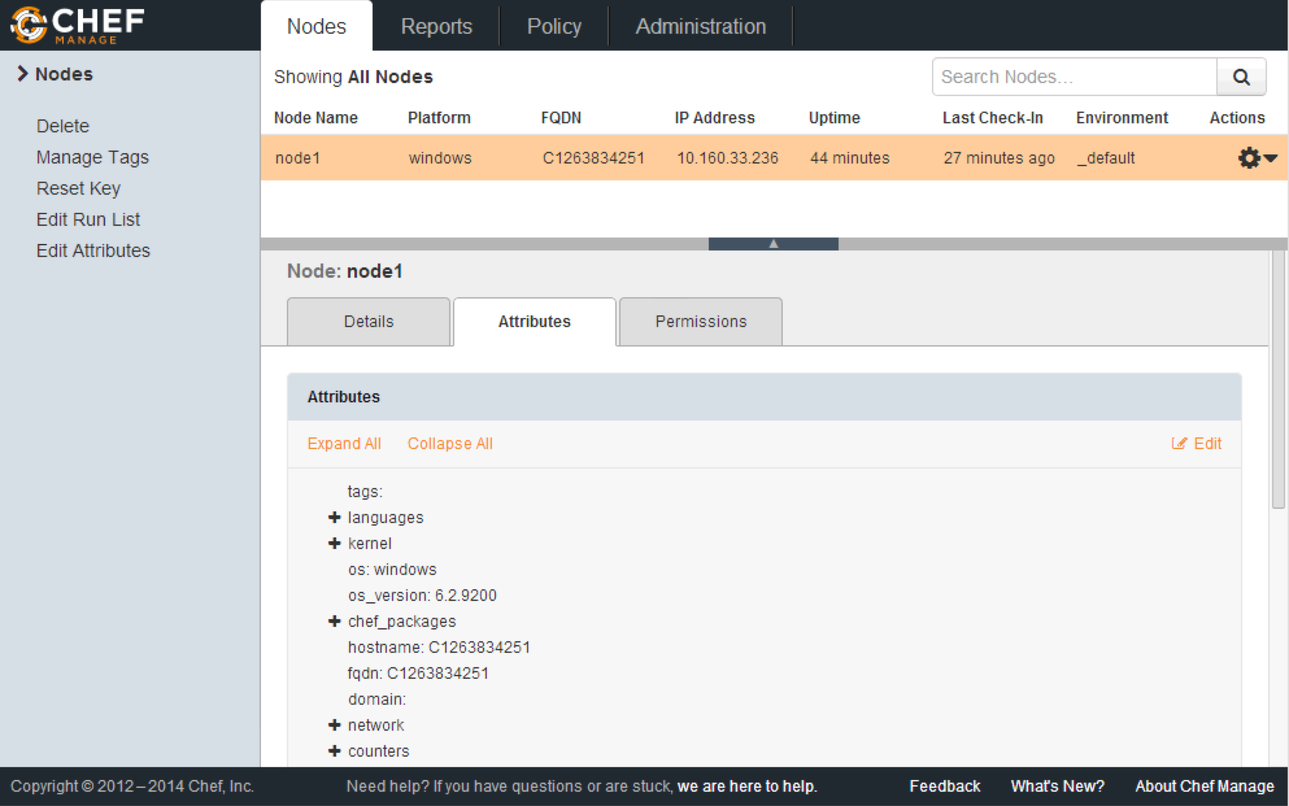
View Node Object on Chef Server
Click the 'Attributes' tab
This reads the Node Object
Created by combining Ohai output (from the node) with Chef Server output (i.e. run_list, roles and attributes)

Slide 270
How Is The Node Objected Updated?
The Node Object is updated at the beginning of each convergence with Chef Server
The Node Object is again updated at the end of each convergence to record any differences to the node caused by the convergence
Notes:
The node object is the global context in which recipes, attribute files, etc are operating in

Slide 271
Exercise: Showing details about a node
ws> knife node show <nodename>
Node Name: windowsnode
Environment: _default
FQDN: C1263834251
IP: 10.160.33.236
Run List: recipe[iis_demo]
Roles:
Recipes: iis_demo, iis_demo::default
Platform: windows 6.2.9200
Tags:
Notes:
The FQDN is made up of the 'Computer name' (i.e. right-clicking the My Computer and choosing Properties) and the domain if added to a domain. In our case we don't have a domain configured.

Slide 272
Exercise: Showing all the attributes of a node
ws> knife node show <nodename> –l
Node Name: windowsnode
Environment: _default
FQDN: C1263834251
IP: 10.160.33.236
Run List: recipe[iis_demo]
Roles:
Recipes: iis_demo, iis_demo::default
Platform: windows 6.2.9200
Tags:
Attributes:
…

Slide 273
Exercise: Format Node Object output in JSON
ws> knife node show <nodename> -l -Fj
{
"name": ”windowsnode",
"chef_environment": "_default",
"run_list": ["recipe[iis_demo]”],
"normal": {"tags": []}
}
Notes:
Also yaml formatter too with -Fy if people want to try that.

Slide 274
Exercise: Traverse the Node Object Array
ws> knife node show <nodename> -a ipaddress
linuxnode:
ipaddress: 10.35.46.77

Slide 275
Exercise: Traverse the Node Object Array
ws> knife node show <nodename> -a virtualization.system
linuxnode:
virtualization.system: vmware

Slide 276
Windows Exercise: Traverse the Node Object Array
ws> knife node show <nodename> -a kernel.os_info.build_number
windowsnode:
kernal.os_info.build_number: 9200

Slide 277
Questions
What is the Node object?
What is a Node Attribute?
How do you display all the attributes of a Node?
How would you return just the cpu attribute of your node?

Slide 278
Setting and Retrieving Node Attributes

Slide 279
Lesson Objectives
After completing the lesson, you will be able to
Understand the value of attributes
List where you can set attributes
Describe how attributes are set and retrieved
Explain the attribute merge order and precedence rules
Notes:
http://docs.opscode.com/chef_overview_attributes.html

Slide 280
Why Are Attributes Useful?
Attributes keep the program code separate from the data
Example:
You create a MySQL cookbook for your company
Users of the cookbook set the username, password and port number in a separate “attributes” file
Not much technical expertise required for this
Users never have to touch (or even understand) the MySQL recipes or configuration files
Notes:
Attributes are data points that can be static (from ohai) or variable (set in attributes file, environments, roles, and recipes)

Slide 281
Attribute Sources
Attributes can be set at various levels
From the node itself (by Ohai)
In roles
In environments
In cookbook recipes (recommended only for debugging)
In cookbook attribute files (the most common place)
Notes:
There are 15 level of precedence.

Slide 282
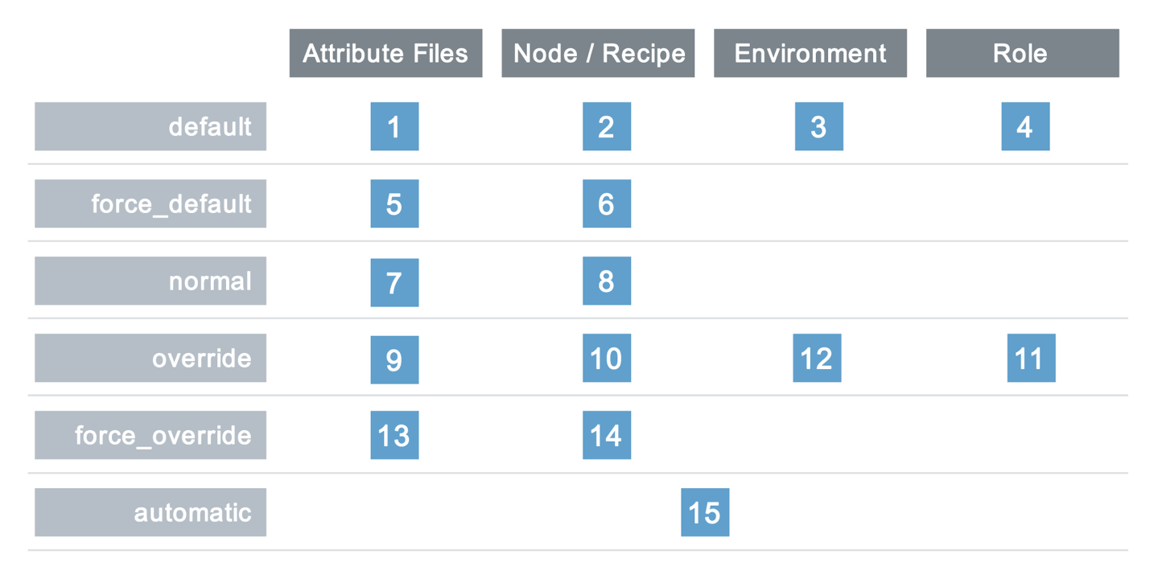
Merge Order and Precedence
Precedence levels
Attribute locations (where it is set)

Slide 283
Setting Node Attributes
Use this format to SET an attribute:
precedence[“attribute_name”] = “value”
Example:
precedence
attribute name
attribute value
default["indexfile"] = "Default.htm"
Notes:
'default' filename can be replaced with 'platform' (e.g. 'centos'), or 'platform_version' (e.g. '6.3')
Note the attribute can be an array or a hash

Slide 284
Retrieving Node Attributes
Use this format to GET an attribute:
node[“attribute_name”]
Example:
Get a node
attribute
attribute name
node["indexfile”]
This will return the attribute value “Default.htm”
Notes:
'default' filename can be replaced with 'platform' (e.g. 'centos'), or 'platform_version' (e.g. '6.3')
Note the attribute can be an array or a hash

Slide 285
Best Practice: Include cookbook in attribute name
If the cookbook “iis_demo” contains an attribute named “indexfile”
Include the cookbook name to make it easier to find the attribute later
Set with: default[“iis_demo”][“indexfile”] = “Default.htm”
Retrieve with: node[“iis_demo”][“indexfile”]
Notes:
'default' filename can be replaced with 'platform' (e.g. 'centos'), or 'platform_version' (e.g. '6.3')
Note the attribute can be an array or a hash

Slide 286
Retrieving Node Attributes
Node attributes can be set in different locations, with different precedence levels, so which value should be returned? We want whichever one wins!
Which one wins here, set in the attribute file:
default[“iis_demo”][“indexfile”] = “file1.htm”
override[“iis_demo”][“indexfile”] = “file2.htm” normal[“iis_demo”][“indexfile”] = “file3.htm”
Notes:
'default' filename can be replaced with 'platform' (e.g. 'centos'), or 'platform_version' (e.g. '6.3')
Note the attribute can be an array or a hash

Slide 287
Merge Order and Precedence
Precedence levels
Attribute locations (where it is set)

Slide 288
Retrieving Node Attributes
Retrieve the attribute with:
node[“iis_demo”][“indexfile”]
default[“iis_demo”][“indexfile”] = “file1.htm”
override[“iis_demo”][“indexfile”] = “file2.htm” normal[“iis_demo”][“indexfile”] = “file3.htm”
Override is the highest precedence in this example, so the result will be “file2.htm”
Notes:
'default' filename can be replaced with 'platform' (e.g. 'centos'), or 'platform_version' (e.g. '6.3')
Note the attribute can be an array or a hash

Slide 289
Retrieving Node Attributes
What will be returned in this case? The attribute is set in 3 different locations, with different precedence levels:
Set in Role: override[“filename”] = “homepage.html” Set in Environment: default [“filename”] = “Default.htm” Set in Attribute file: force_override[“filename”] = “index.html”
Notes:
'default' filename can be replaced with 'platform' (e.g. 'centos'), or 'platform_version' (e.g. '6.3')
Note the attribute can be an array or a hash

Slide 290
Merge Order and Precedence
Precedence levels
Attribute locations (where it is set)

Slide 291
Retrieving Node Attributes
What will be returned in this case? The attribute is set in 3 different locations, with different precedence levels:
Set in Role: override[“filename”] = “homepage.html” Set in Environment: default [“filename”] = “Default.htm” Set in Attribute file: force_override[“filename”] = “index.html”
Winner: index.html
Notes:
'default' filename can be replaced with 'platform' (e.g. 'centos'), or 'platform_version' (e.g. '6.3')
Note the attribute can be an array or a hash

Slide 292
The Problem and the Success Criteria
The Problem: We have hard coded our homepage in the recipe, but we may want to change that without altering the recipe
Success Criteria: We can change the homepage by changing an attribute value

Slide 293
Windows Exercise: Change the cookbook’s version number in the metadata
OPEN IN EDITOR:
\cookbooks\iis_demo\metadata.rb
name 'iis_demo'
maintainer 'YOUR_COMPANY_NAME'
maintainer_email 'YOUR_EMAIL'
license 'All rights reserved'
description 'Installs/Configures iis_demo'
long_description IO.read(File.join(File.dirname(__FILE__), 'README.md'))
version '0.1.1'
SAVE FILE!
Major, Minor, Patch
Semantic Versioning Policy: http://semver.org/

Slide 294
Windows Exercise: Set an attribute in the IIS_DEMO attributes file
OPEN IN EDITOR:
cookbooks\iis_demo\attributes\default.rb
default["iis_demo"]["indexfile"] = "Default1.htm"
SAVE FILE!
Set an attribute to a specific value in the attributes file
Note the addition of the number “1” in the attribute value

Slide 295
Windows Exercise: Set an attribute in the IIS_DEMO attributes file
OPEN IN EDITOR:
cookbooks\iis_demo\attributes\default.rb
default["iis_demo"]["indexfile"] = "Default1.htm"
No spaces here

Slide 296
Windows Exercise: Add Default1.htm to cookbook’s files/default directory
OPEN IN EDITOR:
cookbooks\iis_demo\files\default\Default1.htm
<html>
<body>
<h1>Hello, world!</h1>
<h2>This is Default1.htm</h2>
<p>We configured this in the attributes file</p>
</body>
</html>
SAVE FILE!

Slide 297
Windows Exercise: Retrieve attribute in a recipe
OPEN IN EDITOR:
cookbooks\iis_demo\recipes\default.rb
service ”w3svc" do
action [:enable, :start]
end
cookbook_file 'c:\inetpub\wwwroot\Default.htm' do
source “Default.htm”
rights :read, ”Everyone"
end
Replace this value
SAVE FILE!

Slide 298
Windows Exercise: Retrieve attribute in a recipe
OPEN IN EDITOR:
cookbooks\iis_demo\recipes\default.rb
service ”w3svc" do
action [:enable, :start]
end
cookbook_file 'c:\inetpub\wwwroot\Default.htm' do
source node["iis_demo"]["indexfile"]
rights :read, ”Everyone"
end
SAVE FILE!

Slide 299
Windows Exercise: Retrieve attribute in a recipe
OPEN IN EDITOR:
cookbooks\iis_demo\recipes\default.rb
service ”w3svc" do
action [:enable, :start]
end
cookbook_file 'c:\inetpub\wwwroot\Default.htm' do
source node["iis_demo"]["indexfile"]
rights :read, ”Everyone"
end
No spaces
in the orange box
Put a space here
(between “source” and “node”
SAVE FILE!

Slide 300
Windows Exercise: Upload the iis_demo cookbook
ws> knife cookbook upload iis_demo
Uploading iis_demo [0.1.0]
Uploaded 1 cookbook.
Notes:
This checks for syntax errors, bundles the cookbook up, and uploads it to the chef server for distribution to the chef clients.
If they have syntax errors in the recipe, it will get caught here.
If you get a ‘ruby’ error on Windows, you need to make the Chef repo live in a path without spaces in it.

Slide 301
Windows Exercise: Re-run Chef Client
rn> chef-client
...
* cookbook_file[c:\inetpub\wwwroot\Default.htm] action create[2014-02-25T01:39:45-08:00] INFO: Processing cookbook_file[c:\inetpub\wwwroot\Default.htm] action create (iis_demo::default line 18)
[2014-02-25T01:39:45-08:00] INFO: cookbook_file[c:\inetpub\wwwroot\Default.htm] backed up to c:/chef/backup\inetpub\wwwroot\Default.htm.chef-20140225013945.548152
[2014-02-25T01:39:45-08:00] INFO: cookbook_file[c:\inetpub\wwwroot\Default.htm] updated file contents c:\inetpub\wwwroot\Default.htm
- update content in file c:\inetpub\wwwroot\Default.htm from 231d53 to 442a41
--- c:\inetpub\wwwroot\Default.htm 2014-02-24 06:25:33.000000000 -0800
+++ C:/Users/chef/AppData/Local/Temp/4/Default.htm20140225-1272-1evzs75 2014-02-25 01:39:45.000000000 -0800
@@ -1,7 +1,8 @@
<html>
- <body>
- <h1>Hello, world!</h1>
- </body>
-</html>
-
+ <body>
+ <h1>Hello, world!</h1>
+ <h2>This is Default1.htm</h2>
+ <p>We configured this in the attributes file</p>
+ </body>
+</html>
[2014-02-25T01:39:46-08:00] INFO: Chef Run complete in 3.556801 seconds
Notes:
\

Slide 302
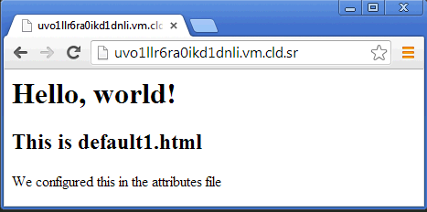
Exercise: Verify new homepage works
Open a web browser
The homepage takes the attribute file value
Notes:
You should see the new index.html from the attributes file.

Slide 303
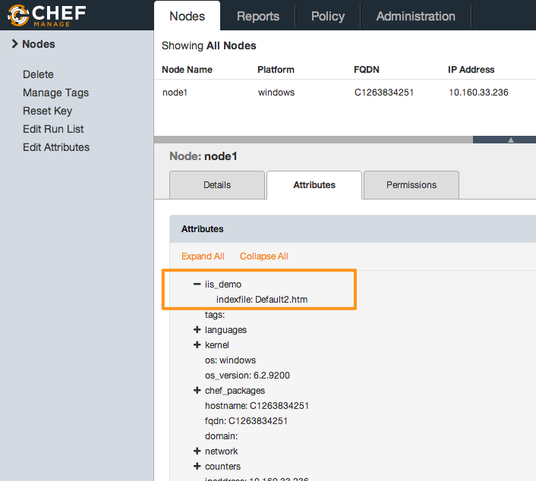
Viewing Attributes via WebUI

Slide 304
Windows: Viewing specific attributes using knife
ws> knife node show <nodename> –a iis_demo.indexfile
Default Attributes:
iis_demo:
indexfile: Default1.htm

Slide 305
Linux Exercise: Change the cookbook’s version number in the metadata
OPEN IN EDITOR:
\cookbooks\apache\metadata.rb
name ’apache'
maintainer 'YOUR_COMPANY_NAME'
maintainer_email 'YOUR_EMAIL'
license 'All rights reserved'
description 'Installs/Configures apache'
long_description IO.read(File.join(File.dirname(__FILE__), 'README.md'))
version '0.1.1'
SAVE FILE!
Major, Minor, Patch
Semantic Versioning Policy: http://semver.org/

Slide 306
Linux Exercise: Set an attribute in the Apache attributes file
OPEN IN EDITOR:
cookbooks/apache/attributes/default.rb
default[”apache"]["indexfile"] = ”index1.html"
SAVE FILE!
No spaces here

Slide 307
Linux Exercise: Add index1.html to cookbook’s files/default directory
OPEN IN EDITOR:
cookbooks/apache/files/default/index1.html
<html>
<body>
<h1>Hello, world!</h1>
<h2>This is index1.html</h2>
<p>We configured this in the attributes file</p>
</body>
</html>
SAVE FILE!

Slide 308
Linux Exercise: Set attribute in a recipe
OPEN IN EDITOR:
cookbooks/apache/recipes/default.rb
service ”httpd" do
action [:enable, :start]
end
cookbook_file “/var/www/html/index.html” do
source “index.html”
mode ”0644"
end
Replace this value
SAVE FILE!
Notes:
node[:apache][:indexfile] interpolates to the value of the attribute, which is set in two places - 'index1.html' in attributes file and 'index2.html' in recipe

Slide 309
Linux Exercise: Set attribute in a recipe
OPEN IN EDITOR:
cookbooks/apache/recipes/default.rb
service ”httpd" do
action [:enable, :start]
end
cookbook_file “/var/www/html/index.html” do
source node[”apache"]["indexfile"]
mode ”0644"
end
SAVE FILE!
Notes:
node[:apache][:indexfile] interpolates to the value of the attribute, which is set in two places - 'index1.html' in attributes file and 'index2.html' in recipe

Slide 310
Linux Exercise: Set attribute in a recipe
OPEN IN EDITOR:
cookbooks/apache/recipes/default.rb
service ”httpd" do
action [:enable, :start]
end
cookbook_file “/var/www/html/index.html” do
source node[”apache"]["indexfile"]
mode ”0644"
end
No spaces
in the orange box
Put a space here
(between “source” and “node”
SAVE FILE!
Notes:
node[:apache][:indexfile] interpolates to the value of the attribute, which is set in two places - 'index1.html' in attributes file and 'index2.html' in recipe

Slide 311
Linux Exercise: Verify new homepage works
Upload the cookbook
Converge your node
Open a web browser
The homepage takes the attribute file value
Notes:
You should see the new index.html from the attributes file.

Slide 312
Exercise: Viewing Attributes via WebUI

Slide 313
Linux: Viewing specific attributes using knife
ws> knife node show <nodename> –a apache.indexfile
...
Attributes:
tags:
Default Attributes:
apache:
indexfile: index1.html
Override Attributes:
Automatic Attributes (Ohai Data):
chef_packages:
chef:
chef_root: /opt/chef/embedded/lib/ruby/gems/1.9.1/gems/chef-11.10.4-x86-mingw32/lib
version: 11.10.4
ohai:
ohai_root: /opt/chef/embedded/lib/ruby/gems/1.9.1/gems/ohai-6.20.0/lib/ohai
version: 6.20.0
command:
counters:
network:
...

Slide 314
Linux Exercise: Revert to the original homepage
Change the attribute file back to “index.html”
Upload the cookbook, converge your node
Open a web browser
You should see the original page displayed
Notes:
You should see the new index.html from the attributes file.

Slide 315
Questions
Where can attributes be set?
What knife commands can you use to view attributes?
How many levels of attribute precedence are there?
Which takes precedence, a default attribute set in the attribute file or in a recipe?

Slide 316
Attributes, Templates, and Cookbook Dependencies
Writing a Linux MOTD Cookbook

Slide 317
Lesson Objectives
In this lesson, we will:
Introduce the Template resource
Use ERB (Embedded Ruby)
Specify cookbook dependencies

Slide 318
The /etc/motd file
On Linux systems, the contents of /etc/motd is displayed when a user logs onto the console
In the past, this was used by Administrators to send messages to users when they logged in, such as:
“Server going down at 2:30 pm for maintenance”
“You must change your login password before Monday”

Slide 319
The Problem and the Success Criteria
The Problem: We need to add a message that appears at login that states:
"This server is property of COMPANY"
"This server is in-scope for PCI compliance" if the server is, in fact, in scope.
Success Criteria: We see the message when we log in to the test node (or when we run ‘cat /etc/motd’)

Slide 320
Best Practice: One cookbook – One purpose
Create one cookbook who’s job it is to write the correct content to the /etc/motd file
Create a separate cookbook to determine PCI Compliance
MOTD cookbook will write the /etc/motd file based on the result of the PCI cookbook

Slide 321
Exercise: Create a cookbook named ‘pci’
Create a new cookbook named ‘pci’
** Creating cookbook pci
** Creating README for cookbook: pci
** Creating CHANGELOG for cookbook: pci
** Creating metadata for cookbook: pci

Slide 322
Note about PCI
In the real world, the PCI cookbook might have a complicated procedure to determine if a particular server is truly in compliance or not
For our purposes, we’re simply setting an attribute to ‘true’ or ‘false’ as a way to determine compliance:
default[“pci”][“in_scope”] = true
default[“pci”][“in_scope”] = false

Slide 323
Exercise: Create a default.rb attribute file
OPEN IN EDITOR:
cookbooks/pci/attributes/default.rb
default["pci"]["in_scope"] = true
SAVE FILE!
Creates a new Node attribute: node["pci"]["in_scope"]
Sets the value to the Ruby literal true
Notice there are no quotes around true

Slide 324
Linux Exercise: Create a cookbook named ‘motd’
ws> knife cookbook create motd
** Creating cookbook motd
** Creating README for cookbook: motd
** Creating CHANGELOG for cookbook: motd
** Creating metadata for cookbook: motd

Slide 325
Linux Exercise: Create a default.rb attribute file
OPEN IN EDITOR:
cookbooks/motd/attributes/default.rb
default["motd"]["company"] = "Chef"
SAVE FILE!
Creates a new Node attribute: node["motd"]["company"]
Sets the values to the string "Chef"
Note: there is no space between 'default' and '['
The 'motd' in the attribute is just convention so you know the cookbook the attribute was set in. This is not an enforced syntax

Slide 326
What resource should we use?
We could try and use a cookbook_file here, and rely on the file copy rules
This would create the exact same file on each server
Obviously, that’s dramatically inefficient
Instead, we will render a template - a file that is a mixture of the contents we want, and embedded Ruby code
Notes:
cookbook_file is a static file (i.e. hardcoded!!). A Template allows us the flexibility to dynamically change the file contents

Slide 327
The template[/etc/motd] resource
OPEN IN EDITOR:
cookbooks/motd/recipes/default.rb
#
# Cookbook Name:: motd
# Recipe:: default
#
# Copyright 2013, YOUR_COMPANY_NAME
#
# All rights reserved - Do Not Redistribute
#
template "/etc/motd" do
source "motd.erb"
mode "0644"
end
SAVE FILE!

Slide 328
Exercise: Open motd.erb in your Editor
OPEN IN EDITOR:
cookbooks/motd/templates/default/motd.erb
This server is property of <%= node["motd"]["company"] %>
<% if node["pci"]["in_scope"] -%>
This server is in-scope for PCI compliance
<% end -%>
SAVE FILE!
"erb" stands for "Embedded Ruby"

Slide 329
Exercise: Open motd.erb in your Editor
OPEN IN EDITOR:
cookbooks/motd/templates/default/motd.erb
This server is property of <%= node["motd"]["company"] %>
<% if node["pci"]["in_scope"] -%>
This server is in-scope for PCI compliance
<% end -%>
To embed a value within an ERB template:
Start with <%
Write your Ruby expression - most commonly a node attribute
End with %>

Slide 330
Exercise: Open motd.erb in your Editor
OPEN IN EDITOR:
cookbooks/motd/templates/default/motd.erb
This server is property of <%= node["motd"]["company"] %>
<% if node["pci"]["in_scope"] -%>
This server is in-scope for PCI compliance
<% end -%>
To print the resolution of the ruby evaluation:
Add an equal sign <%=

Slide 331
Exercise: Open motd.erb in your Editor
OPEN IN EDITOR:
cookbooks/motd/templates/default/motd.erb
This server is property of <%= node["motd"]["company"] %>
<% if node["pci"]["in_scope"] -%>
This server is in-scope for PCI compliance
<% end -%>
To print the resolution of the ruby evaluation:
Add an equal sign <%=

Slide 332
Exercise: Open motd.erb in your Editor
OPEN IN EDITOR:
cookbooks/motd/templates/default/motd.erb
This server is property of <%= node["motd"]["company"] %>
<% if node["pci"]["in_scope"] -%>
This server is in-scope for PCI compliance
<% end -%>
You can use any Ruby construct in a template
Starting with <% will evaluate the expression, but not insert the result
Note there are no spaces in 'node["pci"]["in_scope"]'

Slide 333
Exercise: Open motd.erb in your Editor
OPEN IN EDITOR:
cookbooks/motd/templates/default/motd.erb
This server is property of <%= node["motd"]["company"] %>
<% if node["pci"]["in_scope"] -%>
This server is in-scope for PCI compliance
<% end -%>
Ending with -%> will not insert a line in the resulting file

Slide 334
Exercise: Open motd.erb in your Editor
OPEN IN EDITOR:
cookbooks/motd/templates/default/motd.erb
This server is property of <%= node["motd"]["company"] %>
<% if node["pci"]["in_scope"] -%>
This server is in-scope for PCI compliance
<% end -%>
SAVE FILE!

Slide 335
Exercise: Upload both cookbooks
ws> knife cookbook upload motd pci
Upload the MOTD and PCI cookbooks
Uploading motd [0.1.0]
Uploading pci [0.1.0]
Uploaded 2 cookbooks.
Notes:
* Syntax check
* Upload to Chef Server

Slide 336
Exercise: Add the motd recipe to your test node’s run list
ws> knife node run_list add <nodename> "recipe[motd]"
linuxnode:
run_list:
recipe[apache]
recipe[motd]

Slide 337
Exercise: Show the motd recipe in your test node’s run list
ws> knife node show <nodename>
Node Name: linuxnode Environment: _default
FQDN: centos63.example.com
IP: 10.160.201.90
Run List: recipe[apache], recipe[motd]
Roles:
Recipes: apache
Platform: centos 6.4Tags:

Slide 338
Exercise: Re-run the Chef Client
rn> chef-client
Starting Chef Client, version 11.8.2...
- motdCompiling Cookbooks...Converging 4 resourcesRecipe: apache::default * package[httpd] action install[2014-01-06T09:14:33-05:00] INFO: Processing package[httpd] action install (apache::default line 9) (up to date) * service[httpd] action enable[2014-01-06T09:14:36-05:00] INFO: Processing service[httpd] action enable (apache::default line 13) (up to date) * service[httpd] action start[2014-01-06T09:14:36-05:00] INFO: Processing service[httpd] action start (apache::default line 13) (up to date) * cookbook_file[/var/www/html/index.html] action create[2014-01-06T09:14:36-05:00] INFO: Processing cookbook_file[/var/www/html/index.html] action create (apache::default line 19) (up to date)Recipe: motd::default * template[/etc/motd] action create[2014-01-06T09:14:36-05:00] INFO: Processing template[/etc/motd] action create (motd::default line 9)[2014-01-06T09:14:37-05:00] INFO: template[/etc/motd] created file /etc/motd - create new file /etc/motd================================================================================Error executing action `create` on resource 'template[/etc/motd]'================================================================================Chef::Mixin::Template::TemplateError------------------------------------undefined method `[]' for nil:NilClass
FAIL!

Slide 339
You probably see this at the bottom of your screen...
Template Context:
-----------------
on line #2
1: This server is property of <%= node["motd"]["company"] %>
2: <% if node["pci"]["in_scope"] -%>
3: This server is in-scope for PCI compliance
4: <% end -%>
[2014-01-06T09:14:37-05:00] INFO: Running queued delayed notifications before re-raising exception
[2014-01-06T09:14:37-05:00] ERROR: Running exception handlers
[2014-01-06T09:14:37-05:00] ERROR: Exception handlers complete
[2014-01-06T09:14:37-05:00] FATAL: Stacktrace dumped to /var/chef/cache/chef-stacktrace.out
Chef Client failed. 0 resources updated
[2014-01-06T09:14:37-05:00] INFO: Sending resource update report (run-id: c001b9d5-c2f6-4026-9cc6-ff0901aa563c)
[2014-01-06T09:14:37-05:00] ERROR: "\xE2" from ASCII-8BIT to UTF-8
[2014-01-06T09:14:37-05:00] FATAL: Chef::Exceptions::ChildConvergeError: Chef run process exited unsuccessfully (exit code 1)

Slide 340
Scroll up
In this case, Chef actually knows exactly what went wrong.
Scroll up to find out.
================================================================================Error executing action `create` on resource 'template[/etc/motd]'================================================================================Chef::Mixin::Template::TemplateError------------------------------------undefined method `[]' for nil:NilClass Resource Declaration:---------------------# In /var/chef/cache/cookbooks/motd/recipes/default.rb 10: template "/etc/motd" do 11: source "motd.erb" 12: mode "0644" 13: end
Notes:
Wait for reveal

Slide 341
nil:NilClass error
The bottom line is when you see this ruby error
It most often means you tried to look up a node attribute that does not exist!
undefined method `[]' for nil:NilClass

Slide 342
Linux Exercise: Add a dependency on the PCI cookbook to the MOTD cookbook
OPEN IN EDITOR:
cookbooks/motd/metadata.rb
maintainer "YOUR_COMPANY_NAME"
maintainer_email "YOUR_EMAIL”
license "All rights reserved"
description "Installs/Configures motd"
long_description IO.read(File.join(File.dirname(__FILE__), ‘README.md‘)) version "0.1.0"

Slide 343
Linux Exercise: Add a dependency on the PCI cookbook to the MOTD cookbook
OPEN IN EDITOR:
cookbooks/motd/metadata.rb
maintainer "YOUR_COMPANY_NAME"
maintainer_email "YOUR_EMAIL”
license "All rights reserved"
description "Installs/Configures motd"
long_description IO.read(File.join(File.dirname(__FILE__), ‘README.md‘)) version "0.1.0"
depends "pci"
Cookbooks that depend on other cookbooks will cause the dependent cookbook to be downloaded to the client, and evaluated

Slide 344
Exercise: Upload the motd cookbook
Upload the MOTD cookbook, since you made changes to it
Uploading motd [0.1.0]
Uploaded 1 cookbook.

Slide 345
Exercise: Re-run the Chef Client
rn> chef-client
Forking chef instance to converge...Starting Chef Client, version 11.8.2*** Chef 11.8.2 ***Chef-client pid: 15152Run List is [recipe[apache], recipe[motd]]Run List expands to [apache, motd]Starting Chef Run for linuxnode… - update content in file /etc/motd from e3b0c4 to 62ebb9 (new content is binary, diff output suppressed) - restore selinux security contextChef Run complete in 6.81035877 secondsRemoving cookbooks/apache/files/default/index2.html from the cache; it is no longer needed by chef-client.Running report handlersReport handlers completeChef Client finished, 1 resources updatedSending resource update report (run-id: f923449e-cc7b-45f7-a9fb-ac1da3653557)
WIN!

Slide 346
Exercise: Check your work
ws> knife cookbook upload motd
rn> chef-client
rn> cat /etc/motd
This server is property of Chef
This server is in-scope for PCI compliance

Slide 347
Exercise: Show your test node’s pci attribute
$ knife node show <nodename> -a pci
1 items found
linuxnode:
pci:
in_scope: true
Notes:
Think about what just happened - if you needed a report about being in/out of scope, you can generate it trivially with Chef’s search features.
In this example, a simple primitive has been turned into a powerful reporting tool.

Slide 348
Cookbook Attributes are applied for all downloaded cookbooks!
Cookbooks downloaded as dependencies will have their attribute files evaluated, even if there is no recipe from the cookbook in the run-list
If you are including a recipe from another cookbook, you must add a ‘depends’ to metadata.rb
include_recipe is discussed later in the course.

Slide 349
Exercise: Change attribute to false
OPEN IN EDITOR: cookbooks/pci/attributes/default.rb
default["pci"]["in_scope"] = false
Change the attribute to false and upload the cookbook
Make sure log_level is set to :info (in /etc/chef/client.rb)
converge the node
See the changes in the /etc/motd file
Show the pci.in_scope attribute from the command line

Slide 350
Exercise: Find the /etc/motd backup
Look at your chef-client run output
In the log output, find the location where chef-client placed the /etc/motd backup
View the backup file

Slide 351
Congratulations!
You now know the most important resources for configuration management!
Package (Linux)
Template
Service

Slide 352
Attributes, Templates, and Cookbook Dependencies
Writing a Windows Hosts Cookbook

Slide 353
Lesson Objectives
After completing the lesson, you will be able to
Use ERB Templates in Chef
Specify cookbook dependencies
Perform the cookbook creation, upload, and test loop

Slide 354
The Problem and the Success Criteria
The Problem: To comply with local regulations, we need to block access from our Windows servers located in the country of Fitzmandia to the New York Times website.
How: We will use the Windows hosts file to set the New York Times IP address to 0.0.0.0.
Success Criteria: We see the hosts file updated on the Windows server.

Slide 355
We have a small problem...
But we don’t have an attribute that reflects which region the server is in
We could add a node attribute for Location, but that will become very tiresome at scale

Slide 356
Solution
The best thing to do is create a Datacenter cookbook, and add our attribute there
Well-factored cookbooks only contain the information relevant to their domain
We know we will likely have other things related to Location (security settings, for example)

Slide 357
Windows Exercise: Create a cookbook named ‘datacenter’
> knife cookbook create datacenter
** Creating cookbook datacenter
** Creating README for cookbook: datacenter
** Creating CHANGELOG for cookbook: datacenter
** Creating metadata for cookbook: datacenter

Slide 358
Windows Exercise: Create a default.rb attribute file in the datacenter cookbook
OPEN IN EDITOR:
cookbooks\datacenter\attributes\default.rb
default["datacenter"]["location"] = ”Fitzmandia"
SAVE FILE!
The ’datacenter' in the attribute is just convention so you know the cookbook the attribute was set in. This is not an enforced syntax

Slide 359
Windows Exercise: Upload the Datacenter cookbook
> knife cookbook upload datacenter
Uploading datacenter [0.1.0]
Uploaded 1 cookbook.
Notes:
Reiterate what happens here:
* Syntax check
* Upload to Chef Server

Slide 360
Windows Exercise: Create a cookbook named ‘hosts’
Create the new cookbook named ‘hosts’
** Creating cookbook hosts
** Creating README for cookbook: hosts
** Creating CHANGELOG for cookbook: hosts
** Creating metadata for cookbook: hosts

Slide 361
Windows Exercise: Open the default recipe in your editor
OPEN IN EDITOR:
cookbooks\hosts\recipes\default.rb
#
# Cookbook Name:: hosts
# Recipe:: default
#
# Copyright 2014, YOUR_COMPANY_NAME
#
# All rights reserved - Do Not Redistribute
#

Slide 362
What resource should we use?
We could try and use a cookbook_file resource here, and rely on the file copy rules
This would create the exact same file on each server
Obviously, that’s dramatically inefficient
Instead, we will render a template resource - a file that is a mixture of the contents we want, and embedded Ruby code
Notes:
cookbook_file is a static file (i.e. hardcoded!!). A Template allows us the flexibility to dynamically change the file contents

Slide 363
The Template Resource
OPEN IN EDITOR:
cookbooks\hosts\recipes\default.rb
#
# Cookbook Name:: hosts
# Recipe:: default
# Copyright 2013, YOUR_COMPANY_NAME
#
# All rights reserved - Do Not Redistribute
#
template "#{ENV['windir']}\\System32\\drivers\\etc\\hosts" do
source "hosts.erb"
end
SAVE FILE!

Slide 364
Windows Exercise: Open hosts.erb in your Editor
OPEN IN EDITOR:
cookbooks\hosts\templates\default\hosts.erb
#This file is managed by the server <%= node["fqdn"] %>
<% case node["datacenter"]["location"] -%>
<% when ”Fitzmandia" -%>
0.0.0.0 www.nytimes.com
<% end -%>
To embed a value within an ERB template:
Start with <%=
Write your Ruby expression - most commonly a node attribute
End with %>

Slide 365
Windows Exercise: Open hosts.erb in your Editor
OPEN IN EDITOR:
cookbooks\hosts\templates\default\hosts.erb
#This file is managed by the server <%= node["fqdn"] %>
<% case node["datacenter"]["location"] -%>
<% when ”Fitzmandia" -%>
0.0.0.0 www.nytimes.com
<% end -%>

Slide 366
Windows Exercise: Open hosts.erb in your Editor
OPEN IN EDITOR:
cookbooks\hosts\templates\default\hosts.erb
#This file is managed by the server <%= node["fqdn"] %>
<% case node["datacenter"]["location"] -%>
<% when ”Fitzmandia" -%>
0.0.0.0 www.nytimes.com
<% end -%>

Slide 367
Windows Exercise: Open hosts.erb in your Editor
OPEN IN EDITOR:
cookbooks\hosts\templates\default\hosts.erb
#This file is managed by the server <%= node["fqdn"] %>
<% case node["datacenter"]["location"] -%>
<% when ”Fitzmandia" -%>
0.0.0.0 www.nytimes.com
<% end -%>

Slide 368
Windows Exercise: Open hosts.erb in your Editor
OPEN IN EDITOR:
cookbooks\hosts\templates\default\hosts.erb
#This file is managed by the server <%= node["fqdn"] %>
<% case node["datacenter"]["location"] -%>
<% when ”Fitzmandia" -%>
0.0.0.0 www.nytimes.com
<% end -%>

Slide 369
Windows Exercise: Open hosts.erb in your Editor
OPEN IN EDITOR:
cookbooks\hosts\templates\default\hosts.erb
#This file is managed by the server <%= node["fqdn"] %>
<% case node["datacenter"]["location"] -%>
<% when ”Fitzmandia" -%>
0.0.0.0 www.nytimes.com
<% end -%>
To embed a value within an ERB template:
Start with <%=
Write your Ruby expression - most commonly a node attribute
End with %>

Slide 370
Windows Exercise: Upload the hosts cookbook
Upload the hosts cookbook
Uploading hosts [0.1.0]
Uploaded 1 cookbook.
Notes:
Testing for syntax
Uploading files to the Chef Server

Slide 371
Windows Exercise: Add the hosts recipe to your test node’s run list
> knife node run_list add <nodename> 'recipe[hosts]'
windowsnode:
run_list:
recipe[iis_demo]
recipe[hosts]

Slide 372
Windows Exercise: Re-run the Chef Client
rn> chef-client
FAIL!

Slide 373
You probably see this at the bottom of your screen...
Template Context:
-----------------
on line #2
1: #This file is managed by the server <%= node["fqdn"] %>
2: <% case node["datacenter"]["location"] -%>
3: <% when ”Fitzmandia" -%>
4: 0.0.0.0 www.nytimes.com
5: <% end -%>
[2014-01-06T09:14:37-05:00] INFO: Running queued delayed notifications before re-raising exception
[2014-01-06T09:14:37-05:00] ERROR: Running exception handlers
[2014-01-06T09:14:37-05:00] ERROR: Exception handlers complete
[2014-01-06T09:14:37-05:00] FATAL: Stacktrace dumped to /var/chef/cache/chef-stacktrace.out
Chef Client failed. 0 resources updated
[2014-01-06T09:14:37-05:00] INFO: Sending resource update report (run-id: c001b9d5-c2f6-4026-9cc6-ff0901aa563c)
[2014-01-06T09:14:37-05:00] ERROR: "\xE2" from ASCII-8BIT to UTF-8
[2014-01-06T09:14:37-05:00] FATAL: Chef::Exceptions::ChildConvergeError: Chef run process exited unsuccessfully (exit code 1)

Slide 374
Scroll up
In this case, Chef actually knows exactly what went wrong.
Scroll up to find out.
================================================================================Error executing action `create` on resource 'template[c:\Windows\System32\driver\etc\hosts]’ ================================================================================Chef::Mixin::Template::TemplateError------------------------------------undefined method `[]' for nil:NilClassResource Declaration:---------------------# In c:\opscode\cache\cookbooks\hosts\recipes\default.rb 10: template ”c:\Windows\System32\drivers\etc\hosts" do 11: source ”hosts.erb”
Notes:
Wait for reveal

Slide 375
nil:NilClass error
The bottom line is when you see this ruby error
It most often means you tried to look up a node attribute that does not exist!
undefined method `[]' for nil:NilClass

Slide 376
Windows Exercise: Add a dependency on the datacenter cookbook to the hosts cookbook
OPEN IN EDITOR:
\cookbooks\hosts\metadata.rb
name 'hosts'
maintainer 'YOUR_COMPANY_NAME'
maintainer_email 'YOUR_EMAIL'
License 'All rights reserved'
description 'Installs/Configures hosts'
long_description IO.read(File.join(File.dirname(__FILE__), 'README.md'))
Version '0.1.0’
depends 'datacenter'

Slide 377
Windows Exercise: Upload the hosts cookbook
Upload the hosts cookbook
Uploading hosts [0.1.0]
Uploaded 1 cookbook.
Notes:
Testing for syntax
Uploading files to the Chef Server

Slide 378
Windows Exercise: Re-run the Chef Client
rn> chef-client
WIN!

Slide 379
Windows Exercise: Check your work
rn> gc C:\Windows\System32\drivers\etc\hosts
# This file is managed by the server C1263834251
0.0.0.0 www.nytimes.com

Slide 380
Windows Exercise: Check automated backups
rn> gci C:\chef\backup\Windows\System32\drivers\etc
Mode LastWriteTime Length Name
---- ------------- ------ ----
-a--- 7/25/2012 10:26 PM 824 hosts.chef-20140225031457.550034

Slide 381
Windows Exercise: Show your test node’s datacenter attribute
> knife node show <nodename> -a datacenter
1 items found
windowsnode:
datacenter:
location: Fitzmandia

Slide 382
Exercise: Change your node's Location
OPEN IN EDITOR:
cookbooks\datacenter\attributes\default.rb
default["datacenter"]["location"] = ”Russia"
Modify the attributes file
Upload the cookbook you modified
Re-converge
Look at the hosts file on the node
rn> gc C:\Windows\System32\drivers\etc\hosts
# This file is managed by the server C1263834251

Slide 383
Exercise: Show your test node’s datacenter attribute
> knife node show windowsnode -a datacenter
windowsnode:
datacenter:
location: Russia

Slide 384
Congratulations!
You now know the most important resources for configuration management!
Powershell_script (Windows)
Template
Service

Slide 385
Questions
What goes in a cookbook’s attribute files?
When do you need to specify a cookbook dependency?
What does <%= mean, and where will you encounter it?
Where are .erb files stored on the Workstation?
What are the most important resources in Windows configuration management?
Where is Fitzmandia?

Slide 386
Template Variables, Notifications, and Controlling Idempotency
Refactoring the Windows iis_demo cookbook for multiple websites

Slide 387
Lesson Objectives
After completing the lesson, you will be able to
Control idempotence manually with not_if
Describe the Directory resource
Implement resource notifications
Use Template Variables to dynamically generate web pages

Slide 388
The Problem and the Success Criteria
The Problem: We need to deploy multiple custom home pages running on different ports
Success Criteria: Be able to view our custom home pages
First we’ll write a Windows cookbook, then a Linux cookbook

Slide 389
The Problem and the Success Criteria
The Problem: We need to deploy multiple custom home pages running on different ports
Success Criteria: Be able to view our custom home pages

Slide 390
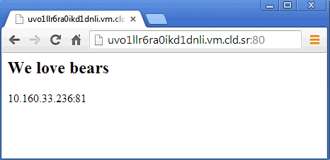

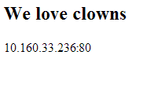
Exercise: Here is what we want to see
Note the different port numbers
Notes:
If they have trouble getting to them with a web browser, do it from within the VM
http://localhost:80
http://localhost:81

Slide 391
Windows Exercise: Change the cookbook’s version number in the metadata
OPEN IN EDITOR:
\cookbooks\iis_demo\metadata.rb
name 'iis_demo'
maintainer 'YOUR_COMPANY_NAME'
maintainer_email 'YOUR_EMAIL'
license 'All rights reserved'
description 'Installs/Configures iis_demo'
long_description IO.read(File.join(File.dirname(__FILE__), 'README.md'))
version '0.2.0'
SAVE FILE!
Major, Minor, Patch
Semantic Versioning Policy: http://semver.org/

Slide 392
Windows Exercise: Create a default.rb attribute file in the iis_demo cookbook
OPEN IN EDITOR:
\cookbooks\iis_demo\attributes\default.rb
default[“iis_demo”][“indexfile”] = “Default1.htm”
default["iis_demo"]["sites"]["clowns"] = { "port" => 80 }
default["iis_demo"]["sites"]["bears"] = { "port" => 81 }
SAVE FILE!
We add information about the sites we need to deploy
One about Clowns, running on port 80
One about Bears, running on port 81
You can ignore the existing indexfile attribute
Notes:
The marketing department loves clowns and bears. If we build pages with clowns and bears, the revenue will come.
Two schools of thought: start with data model and write cookbook or vice versa (model data to cookbook). This is preference. Here we start with data model.
Also note auto-vivification of hashes: These attributes are a ruby hashes of hashes with keys and values. Top level attribute apache has a hash of sites, one = clowns, one = bears, each has a hash value. Key of port with value = integer. Why nested under “iis_demo”? Doesn’t *need* to be for this example. Common best practice. Nest attributes into what they belong to. Since Chef will automagically create any intermediate-level hashtables automagically if they don’t exist, this is extremely useful.
Alternative: write a cookbook using data bags, but that’s a different module.

Slide 393
Windows Exercise: Comment out the existing cookbook_file resource
OPEN IN EDITOR:
\cookbooks\iis_demo\recipes\default.rb
service "w3svc" do
action [:enable, :start ]
end
#cookbook_file "c:\\inetpub\\wwwroot\\Default.htm" do
# source node["iis_demo"]["indexfile"]
# rights :read, "Everyone"
#end
SAVE FILE!
Comment out (or delete) the cookbook_file resource from recipe
Notes:
Don’t forget the * after “Default Web Site”
This is a known bug in windows, without this * get-website will return all websites instead of just the one you want.

Slide 394
Windows Exercise: Stop the Default Web Site with Powershell resource
OPEN IN EDITOR:
\cookbooks\iis_demo\recipes\default.rb
service "w3svc" do
action [:enable, :start ]
end
#cookbook_file "c:\\inetpub\\wwwroot\\Default.htm" do
# source node["iis_demo"]["indexfile"]
# rights :read, "Everyone"
#end
powershell_script "disable default site" do
code 'get-website "Default Web Site*" | where {$_.state -ne "Stopped"} | Stop-Website'
end
SAVE FILE!
Use powershell resource to stop Default Web Site if running.
Notes:
Don’t forget the * after “Default Web Site”
This is a known bug in windows, without this * get-website will return all websites instead of just the one you want.

Slide 395
Idempotency Guarantees
powershell_script "disable default site" do
code 'get-website "Default Web Site*" | where {$_.state -ne "Stopped"} | Stop-Website'
end
Stop the existing default web site
With powershell_script resource it’s up to you to make resources idempotent
Either do it in Powershell, or Chef idempotency guards (later)
Notes:
There is an outstanding bug to have not_if run within the context of parent resource. As of now not_if starts as a CMD

Slide 396
Windows Exercise: Iterate over each IIS site
OPEN IN EDITOR:
\cookbooks\iis_demo\recipes\default.rb
powershell_script "disable default site" do
code 'get-website "Default Web Site*" | where {$_.state -ne "Stopped"} | Stop-Website'
end
node["iis_demo"]["sites"].each do |site_name, site_data|
SAVE FILE!
node["iis_demo"]["sites"] is the Ruby hash, with keys and values we defined in our default attributes

Slide 397
Windows Exercise: Iterate over each IIS site
node["iis_demo"]["sites"].each do |site_name, site_data|
Calling .each loops over each site
default["iis_demo"]["sites"]["clowns"] = { "port" => 80 }
default["iis_demo"]["sites"]["bears"] = { "port" => 81 }
First pass
site_name = "clowns"
site_data = { “port” => 80 }
Second pass
site_name = "bears"
site_data = { “port” => 81 }
Notes:
More new syntax, this time “.each”. Ruby does have a “for” loop, but it is rarely used. Instead, we use “iterators” to yield values to blocks. In this case, we are walking all the sites we defined earlier, and assigning two pieces of data between the “|” (arms) - site_name for the key, and site_data for the value.

Slide 398
Windows Exercise: Iterate over each IIS site
OPEN IN EDITOR:
\cookbooks\iis_demo\recipes\default.rb
powershell_script "disable default site" do
code 'get-website "Default Web Site*" | where {$_.state -ne "Stopped"} | Stop-Website'
end
node["iis_demo"]["sites"].each do |site_name, site_data|
site_dir = "#{ENV['SYSTEMDRIVE']}\\inetpub\\wwwroot\\#{site_name}”
SAVE FILE!
Create a ruby variable (for use only inside this loop) for the site directory

Slide 399
Windows Exercise: Add the Directory resource
node[”iis_demo"]["sites"].each do |site_name, site_data|
site_dir = "#{ENV['SYSTEMDRIVE']}\\inetpub\\wwwroot\\#{site_name}”
directory site_dir
What do you think is the default action for the ‘directory’ resource?
Notes:
Call out that site_dir is already a string so we don’t have to interpolate it.
More syntax. Variables within blocks use the “=” for assignment, and are locally scoped.
#{..} in a string
Scoping: var exists on this block and only this block. Globals have $ for global. In java, php, perl: $ just means variable. In ruby, it means global var. (vs. local _ , instance @, or class @@)

Slide 400
Windows: Variables and interpolation
Given the following variable for 'document_root'
site_dir = "c:\foo\foobar"
What directory will be created in each of the following?
directory site_dir do ...
directory "site_dir" do ...
directory "#{site_dir}" do ...
c:\foo\foobar
c:\site_dir
c:\foo\foobar

Slide 401
Powershell_script resources are generally not idempotent
Chef will stop your run if a resource fails
Most command line utilities are not idempotent - they assume a human being is interacting with, and understands, the state of the system
The result is - it’s up to you to make powershell_script resources idempotent
Notes:
If you have to color outside the lines, it's up to you to make stuff work.
In this case, add-windowsfeature Web has built-in idempotentcy

Slide 402
Windows: Enter the not_if and only_if metaparameters
not_if "C:\\Windows\\System32\\inetsrv\\appcmd.exe list apppool #{site_name}"
The only_if parameter causes the resources actions to be taken only if its argument returns true
The not_if parameter is the opposite of only_if - the actions are taken only if its argument returns false
Notes:
only_if and not_if are part of Chef, not part of Ruby
We don’t use “If” and “Unless” because they are reserved for the language that is hosting the DSL

Slide 403
Windows Exercise: Add an iis_site resource to install the new sites
node["iis_demo"]["sites"].each do |site_name, site_data|
site_dir = "#{ENV['SYSTEMDRIVE']}\\inetpub\\wwwroot\\#{site_name}”
directory site_dir
powershell_script "create app pool for #{site_name}" do
code "New-WebAppPool #{site_name}"
not_if "C:\\Windows\\System32\\inetsrv\\appcmd.exe list appPool #{site_name}"
end
SAVE FILE!
Create App Pool, but only if one doesn’t already exist.
Notes:
1st Pass - we create an iis_site resource for the “clowns” site
2nd Pass - we create an iis_site resource for the “bears” site
We encounter 3 new pieces of syntax here:
1) do..end being used as a block (and sub-block). depending on the crowd, explain anonymous functions and lambdas, or just explain that it means “execute this code and return the result”.
iis_site "string" plus whole block. Checks valid syntax. But code block gets called later when we are ready to call the function. It gets read in very early. But not_if is executed when the function is called. If executed outside the block, it would execute at compile time not at action time (and would always fail). So when you're wrapping functions, you are declaring when they should be executed. We create objects and then do stuff with them conditionally. Nesting is for deferring execution. Which is why we need special nonruby syntax to defer.
2) File - this is a class name
3) File.exists? is a class method, which returns true/false based on whether the symlink exists. In idiomatic Ruby, methods that end with a ? return true or false.
The next few slides go into greater detail.

Slide 404
Windows Exercise: Add a Web Site with Powershell_script resource
powershell_script "create app pool for #{site_name}" do
code "New-WebAppPool #{site_name}"
not_if "C:\\Windows\\System32\\inetsrv\\appcmd.exe list apppool #{site_name}"
end
powershell_script "new website for #{site_name}" do
code <<-EOH
Import-Module WebAdministration
if(-not(test-path IIS:\\Sites\\#{site_name})){
New-WebSite -name #{site_name} -Port #{site_data["port"]} -PhysicalPath #{site_dir} -ApplicationPool #{site_name}
}
EOH
end
Create Web Site, but only if one doesn’t already exist.
SAVE FILE!
Notes:
You may encounter an error here. If student deleted Default Web Site manually, you will get Index out of bound. Simply recreate the default website and the error will go away.
* Import-Module webadministration - need to load this because IIS: provider is not loaded by default. Quirks of windows.
* if(-not(test-path…. - same as ! in ruby. Can be supplemented with a !, –not makes it slightly easier for the noobies.
New-Website takes all the same parameters as IIS_Site except that you have to explicitly specify Application Pool.
<<-EOH stuff is known as a Here Document - https://en.wikipedia.org/wiki/Here_document in case people ask.

Slide 405
Template Variables
Not all data you might need in a template is necessarily node attributes
The variables parameter lets you pass in custom data for use in a template
Notes:
We will show how to use these variables when we write the template in a few slides
In this class, within the Template block we only ever use node attributes. Not all your data may be attributes (e.g. data from your own DBS - chef is good at integrating with other data sources). But let’s walk before we run.

Slide 406
Windows Exercise: Use a template to create Default.htm for each site
.... #{site_dir} -ApplicationPool #{site_name}
}
EOH
end
template "#{site_dir}\\Default.htm" do
source "Default.htm.erb”
rights :read, "Everyone"
variables(
:site_name => site_name,
:port => site_data["port"]
)
notifies :restart, "service[w3svc]"
end
end
Notes:
New resource parameter for templates, in the “variables” parameter. Explained in future slides.

Slide 407
Notifications
notifies :restart, "service[w3svc]"
Resource Notifications in Chef are used to trigger an action on a resource when the current resources actions are successful.
“If we delete the site, restart iis”
The first argument is an action, and the second argument is the string representation of a given resource
Like not_if and only_if, notifies is a resource metaparameter - any resource can notify any other

Slide 408
Exercise: Add Default.htm.erb to your templates directory
OPEN IN EDITOR:
cookbooks\iis_demo\templates\default\Default.htm.erb
<html>
<body>
<h2>We love <%= @site_name %></h2>
<%= node["ipaddress"] %>:<%= @port %>
</body>
</html>
Note: reference variables passed into the template by prefixing the variable with an @ symbol
Notes:
New syntax here:
* Ruby has “instance” variables, which are bound to the instance of an object. When we render templates and pass in the variables parameter, we are adding instance variables to the context of the template render. Hence, we prefix them with an “@” symbol. The node, on the other hand, is supplied as part of the context itself, and so requires no @ symbol.
Re-affirm the ERB syntax, of -%> on the end and <%= on the front
Gist: https://gist.github.com/2866421

Slide 409
Exercise: Converge and test your code
<html>
<body>
<h2>We love <%= @site_name %></h2>
<%= node["ipaddress"] %>:<%= @port %>
</body>
</html>
Upload your cookbook
Converge your node
Verify the new websites are working on their respective port numbers
Notes:
New syntax here:
* Ruby has “instance” variables, which are bound to the instance of an object. When we render templates and pass in the variables parameter, we are adding instance variables to the context of the template render. Hence, we prefix them with an “@” symbol. The node, on the other hand, is supplied as part of the context itself, and so requires no @ symbol.
Re-affirm the ERB syntax, of -%> on the end and <%= on the front
Gist: https://gist.github.com/2866421

Slide 410
The entire recipe
Windows Powershell Example:
https://gist.github.com/johnfitzpatrick/9207666

Slide 411
Exercise: Add zebras!
Modify your attributes file
Add “zebras” on port “82”
Upload, converge, and see if port 82 works

Slide 412
Chef resources on Windows
Resources in Chef that work on Windows:
file, remote_file, cookbook_file, template
registry
directory, remote_directory
user, group
mount, env
service
execute
ruby_block, powershell_script, batch
Check the Docs…

Slide 413
Questions
How do you control the idempotence of a powershell_script resource?
Where can you learn the details about all the core resources in Chef?
What is a notification?
What is a template variable?
What does #{foo} do in a Ruby string?

Slide 414
Template Variables, Notifications, and Controlling Idempotency
Refactoring the Linux apache cookbook for multiple websites

Slide 415
Lesson Objectives
After completing the lesson, you will be able to
Use the execute resource
Control idempotence manually with not_if and only_if
Describe the Directory resource
Implement resource notifications
Use Template Variables to dynamically generate web pages

Slide 416
What we want to accomplish
Notes:
Again, if they have trouble getting to them with a web browser, do it from within the VM
http://localhost:80
http://localhost:81
I

Slide 417
Linux Exercise: Change the cookbook’s version number in the metadata
OPEN IN EDITOR:
/cookbooks/apache/metadata.rb
name ’apache'
maintainer 'YOUR_COMPANY_NAME'
maintainer_email 'YOUR_EMAIL'
license 'All rights reserved'
description 'Installs/Configures apache'
long_description IO.read(File.join(File.dirname(__FILE__), 'README.md'))
version '0.2.0'
SAVE FILE!
Major, Minor, Patch
Semantic Versioning Policy: http://semver.org/

Slide 418
Linux Exercise: Create a default.rb attribute file in the apache cookbook
OPEN IN EDITOR:
/cookbooks/apache/attributes/default.rb
default[“apache”][“indexfile”] = index.html”
default["apache"]["sites"]["clowns"] = { "port" => 80 }
default["apache"]["sites"]["bears"] = { "port" => 81 }
We add information about the sites we need to deploy
One about Clowns, running on port 80
One about Bears, running on port 81
You can ignore the indexfile attribute
Notes:
The marketing department loves clowns and bears. If we build pages with clowns and bears, the revenue will come.
Two schools of thought: start with data model and write cookbook or vice versa (model data to cookbook). This is preference. Here we start with data model.
Also note auto-vivification of hashes: These attributes are a ruby hashes of hashes with keys and values. Top level attribute apache has a hash of sites, one = clowns, one = bears, each has a hash value. Key of port with value = integer. Why nested under “iis_demo”? Doesn’t *need* to be for this example. Common best practice. Nest attributes into what they belong to. Since Chef will automagically create any intermediate-level hashtables automagically if they don’t exist, this is extremely useful.
Alternative: write a cookbook using data bags, but that’s the next module.

Slide 419
Linux Exercise: Comment out the ‘cookbook_file’ resource
OPEN IN EDITOR:
/cookbooks/apache/recipes/default.rb
service ”httpd" do
action [:enable, :start ]
end
#cookbook_file ”/var/www/html/index.html" do
# source node[”apache"]["indexfile"]
# mode “0644”
#end
SAVE FILE!
Comment out the cookbook_file resource from recipe
Notes:
Don’t forget the * after “Default Web Site”
This is a known bug in windows, without this * get-website will return all websites instead of just the one you want.

Slide 420
Linux Exercise: Stop the Default Web Site with ‘execute’ resource
OPEN IN EDITOR:
/cookbooks/apache/recipes/default.rb
service ”httpd" do
action [:enable, :start ]
end
#cookbook_file ”/var/www/html/index.html" do
# source node[”apache"]["indexfile"]
# mode “0644”
#end
execute "mv /etc/httpd/conf.d/welcome.conf /etc/httpd/conf.d/welcome.conf.disabled" do
only_if do
File.exist?("/etc/httpd/conf.d/welcome.conf")
end
notifies :restart, "service[httpd]"
end
SAVE FILE!
Comment out the cookbook_file resource from recipe
Use execute resource to stop Default Web Site if running.
Notes:
Don’t forget the * after “Default Web Site”
This is a known bug in windows, without this * get-website will return all websites instead of just the one you want.

Slide 421
Linux Exercise: Iterate over each Apache site
OPEN IN EDITOR:
/cookbooks/apache/recipes/default.rb
execute "mv /etc/httpd/conf.d/welcome.conf /etc/httpd/conf.d/welcome.conf.disabled" do
only_if do
File.exist?("/etc/httpd/conf.d/welcome.conf")
end
notifies :restart, "service[httpd]"
end
node[”apache"]["sites"].each do |site_name, site_data|
SAVE FILE!
node[”apache"]["sites"] is the Ruby hash, with keys and values we defined in our default attributes

Slide 422
Linux Exercise: Iterate over each IIS site
node[”apache"]["sites"].each do |site_name, site_data|
Calling .each loops over each site
default[”apache"]["sites"]["clowns"] = { "port" => 80 }
default[”apache"]["sites"]["bears"] = { "port" => 81 }
First pass
site_name = "clowns"
site_data = { “port” => 80 }
Second pass
site_name = "bears"
site_data = { “port” => 81 }
Notes:
More new syntax, this time “.each”. Ruby does have a “for” loop, but it is rarely used. Instead, we use “iterators” to yield values to blocks. In this case, we are walking all the sites we defined earlier, and assigning two pieces of data between the “|” (arms) - site_name for the key, and site_data for the value.

Slide 423
Windows: Variables and interpolation
Given the following variable for 'document_root'
document_root = ”/foo/foobar"
What directory will be created in each of the following?
directory document_root do ...
directory "document_root" do ...
directory "#{document_root}" do ...
/foo/foobar
document_root
/foo/foobar

Slide 424
Linux Exercise: Iterate over each Apache site
OPEN IN EDITOR:
/cookbooks/apache/recipes/default.rb
execute "mv /etc/httpd/conf.d/welcome.conf /etc/httpd/conf.d/welcome.conf.disabled" do
only_if do
File.exist?("/etc/httpd/conf.d/welcome.conf")
end
notifies :restart, "service[httpd]"
end
node[”apache"]["sites"].each do |site_name, site_data|
document_root = ”/srv/apache/#{site_name}”
SAVE FILE!
node[”apache"]["sites"] is the Ruby hash, with keys and values we defined in our default attributes

Slide 425
Exercise: Add the Directory resource
node[”apache"]["sites"].each do |site_name, site_data|
document_root = ”/srv/apache/#{site_name}”
directory document_root do
mode “0755”
recursive true
end
Notes:
Call out that site_dir is already a string so we don’t have to interpolate it.
More syntax. Variables within blocks use the “=” for assignment, and are locally scoped.
#{..} in a string
Scoping: var exists on this block and only this block. Globals have $ for global. In java, php, perl: $ just means variable. In ruby, it means global var. (vs. local _ , instance @, or class @@)

Slide 426
Linux Exercise: Add an apache resource to configure the new sites
node[”apache"]["sites"].each do |site_name, site_data|
document_root = ”/srv/apache/#{site_name}”
directory document_root do
mode “0755”
recursive true
end
# Add a template for Apache virtual host configuration
template "/etc/httpd/conf.d/#{site_name}.conf" do
source "custom.erb"
mode "0644"
variables(
:document_root => document_root,
:port => site_data["port"]
)
notifies :restart, "service[httpd]"
end
Notes:
1st Pass - we create an iis_site resource for the “clowns” site
2nd Pass - we create an iis_site resource for the “bears” site
We encounter 3 new pieces of syntax here:
1) do..end being used as a block (and sub-block). depending on the crowd, explain anonymous functions and lambdas, or just explain that it means “execute this code and return the result”.
iis_site "string" plus whole block. Checks valid syntax. But code block gets called later when we are ready to call the function. It gets read in very early. But not_if is executed when the function is called. If executed outside the block, it would execute at compile time not at action time (and would always fail). So when you're wrapping functions, you are declaring when they should be executed. We create objects and then do stuff with them conditionally. Nesting is for deferring execution. Which is why we need special nonruby syntax to defer.
2) File - this is a class name
3) File.exists? is a class method, which returns true/false based on whether the symlink exists. In idiomatic Ruby, methods that end with a ? return true or false.
The next few slides go into greater detail.

Slide 427
Linux Exercise: Use a template to create index.html for each site
:document_root => document_root,
:port => site_data["port"]
)
notifies :restart, "service[httpd]"
end
# Add a template resource for the virtual host's index.html
template "#{document_root}/index.html" do
source "index.html.erb"
mode "0644"
variables(
:site_name => site_name,
:port => site_data["port"]
)
end
end
SAVE FILE!
Notes:
You may encounter an error here. If student deleted Default Web Site manually, you will get Index out of bound. Simply recreate the default website and the error will go away.
* Import-Module webadministration - need to load this because IIS: provider is not loaded by default. Quirks of windows.
* if(-not(test-path…. - same as ! in ruby. Can be supplemented with a !, –not makes it slightly easier for the noobies.
New-Website takes all the same parameters as IIS_Site except that you have to explicitly specify Application Pool.
<<-EOH stuff is known as a Here Document - https://en.wikipedia.org/wiki/Here_document in case people ask.

Slide 428
Linux Exercise: Move Service block to the END of the Recipe
# Add a template resource for the virtual host's index.html
template "#{document_root}/index.html" do
source "index.html.erb"
mode "0644"
variables(
:site_name => site_name,
:port => site_data["port"]
)
end
end
service ”httpd" do
action [:enable, :start ]
end
SAVE FILE!
Notes:
You may encounter an error here. If student deleted Default Web Site manually, you will get Index out of bound. Simply recreate the default website and the error will go away.
* Import-Module webadministration - need to load this because IIS: provider is not loaded by default. Quirks of windows.
* if(-not(test-path…. - same as ! in ruby. Can be supplemented with a !, –not makes it slightly easier for the noobies.
New-Website takes all the same parameters as IIS_Site except that you have to explicitly specify Application Pool.
<<-EOH stuff is known as a Here Document - https://en.wikipedia.org/wiki/Here_document in case people ask.

Slide 429
The entire recipe
Linux Example:
https://gist.github.com/johnfitzpatrick/8954699

Slide 430
Exercise: Add index.html.erb to your templates directory
OPEN IN EDITOR:
cookbooks/apache/templates/default/index.html.erb
<html>
<body>
<h2>We love <%= @site_name %></h2>
<%= node["ipaddress"] %>:<%= @port %>
</body>
</html>
Note: reference variables passed into the template by prefixing the variable with an @ symbol
Notes:
New syntax here:
* Ruby has “instance” variables, which are bound to the instance of an object. When we render templates and pass in the variables parameter, we are adding instance variables to the context of the template render. Hence, we prefix them with an “@” symbol. The node, on the other hand, is supplied as part of the context itself, and so requires no @ symbol.
Re-affirm the ERB syntax, of -%> on the end and <%= on the front
Gist: https://gist.github.com/2866421

Slide 431
Exercise: Add custom.erb to your templates directory
OPEN IN EDITOR:
cookbooks/apache/templates/default/custom.erb
Copy the following file: http://tinyurl.com/n4ggmh8 Follow the instructions to create your custom.erb file.
Note the two template variables are prefixed with an @ symbol
We are using a conditional if here
Notes:
New syntax here:
* Ruby has “instance” variables, which are bound to the instance of an object. When we render templates and pass in the variables parameter, we are adding instance variables to the context of the template render. Hence, we prefix them with an “@” symbol. The node, on the other hand, is supplied as part of the context itself, and so requires no @ symbol.
Re-affirm the ERB syntax, of -%> on the end and <%= on the front
Gist: https://gist.github.com/2866421

Slide 432
Custom.erb solution
Solution to the custom.erb re-write
http://tinyurl.com/mfw9xln
What apache sees
http://tinyurl.com/loakgdz
Notes:
New syntax here:
* Ruby has “instance” variables, which are bound to the instance of an object. When we render templates and pass in the variables parameter, we are adding instance variables to the context of the template render. Hence, we prefix them with an “@” symbol. The node, on the other hand, is supplied as part of the context itself, and so requires no @ symbol.
Re-affirm the ERB syntax, of -%> on the end and <%= on the front
Gist: https://gist.github.com/2866421

Slide 433
Linux Exercise: Upload the apache cookbook
Upload the cookbook
Uploading apache [0.2.0]
Uploaded 1 cookbook.

Slide 434
Linux Exercise: Re-run the Chef Client
Run chef-client on the node
”/opt/chef/AppData/Local/Temp/2/chef-script20130918-1312-ebgd1i.ps1"
* template[/etc/httpd/conf.d/bears/index.html] action create
INFO: Processing template[/etc/httpd/conf.d/bears/index.html] action create (apache::default line 45)
(up to date)
Recipe: hosts::default
* template[/etc/hosts] action create
INFO: Processing template[/etc/hosts] action create (hosts::default line 11)
(up to date)
[2013-09-18T21:02:52+00:00] INFO: Chef Run complete in 13.1508 seconds
[2013-09-18T21:02:52+00:00] INFO: Running report handlers
[2013-09-18T21:02:52+00:00] INFO: Report handlers complete
Chef Client finished, 6 resources updated
Notes:
We ran a resource with a notification, which...

Slide 435
Exercise: Verify our two sites are working!
Notes:
Again, if they have trouble getting to them with a web browser, do it from within the VM
http://localhost:80
http://localhost:81

Slide 436
Exercise: Add zebras!
Modify your attributes file
Add “zebras” on port “82”
Converge, and see if port 82 works

Slide 437
Questions
How do you control the idempotence of an execute resource?
Where can you learn the details about all the core resources in Chef?
What is a notification?
What is a template variable?
What does #{foo} do in a Ruby string?

Slide 438
Search

Slide 439

Search
Huge part of what makes Chef so awesome!
Search for nodes by dozens of different criteria
Return dozens of attributes about any node
http://www.flickr.com/photos/kathycsus/2686772625
Notes:
Chef Search is one of its killer features. It enables you to do a lot of heavy lifting easily.
Search for nodes by their roles, or other attributes (you assign, or assume via cookbooks).

Slide 440
Lesson Objectives
After completing the lesson, you will be able to
Describe the query syntax used in Search
Invoke a search from command line
Build a search into your recipe code
Notes:
http://docs.opscode.com/essentials_search.html

Slide 441
Node Object Review
Chef Server
Node Object
Node (Windows/Linux)
Workstation

Slide 442
What is search?
Use search to query data indexed on the chef server
Eg: from the Node Object
Syntax is
Where index can be client, environment, node, role, (or the name of a data bag)
Search query runs on the Chef Server and is invoked from within a recipe, using knife or via WebUI
knife search INDEX SEARCH_QUERY
Notes:
More in data bags later...
http://wiki.apache.org/solr/SolrQuerySyntax

Slide 443
Query Syntax
Chef search uses the Solr 'key:search_pattern' syntax
Use an asterisk ("*") for >=0 chars in a wildcard search
Use a question mark ("?") to replace a single character
knife search node "ipaddress:10.20.30.40"
knife search node "ipaddress:10.*"
knife search node "platfo*:windows"
knife search node "platform_version:6.2.920?"
Notes:
platfor* could match "platform" or "platform_family"

Slide 444
Exercise: Use knife search
ws> knife search node "*:*"
Node Name: windowdnode
Environment: _default
FQDN: C1263834251
IP: 10.160.33.236
Run List: recipe[iis_demo], recipe[hosts]
Roles:
Recipes: iis_demo, hosts, iis_demo::default, hosts::default
Platform: windows 6.2.9200
Tags:
Notes:
Search for all nodes

Slide 445
Exercise: Find a node with the specific attribute value
ws> knife search node "ipaddress:10.*"
2 items found
Node Name: windowsnode
Environment: _default
FQDN: C1263834251
IP: 10.160.33.236
Run List: recipe[iis_demo], recipe[hosts]
Roles:
Recipes: iis_demo, hosts, iis_demo::default, hosts::default
Platform: windows 6.2.9200
Tags:
Notes:
Here we are searching for nodes. Output is shortened by default - to see all attributes for the node use the '-l' switch
Note student IP may be be different - use the result on previous slide

Slide 446
Exercise: Using Knife to find an attribute value
ws> knife search node "*:*" -a ipaddress
2 items found
windowsnode:
ipaddress: 10.160.33.236
linuxnode:
ipaddress: 10.20.134.17
Notes:
Here we are trying to find the IP Address for our nodes, i.e. the value of the 'ipaddress' attribute

Slide 447
Exercise: Return just the attribute value
ws> knife search node "ipaddress:10.*" -a ipaddress
2 items found
windowsnode:
ipaddress: 10.160.33.236
linuxnode:
ipaddress: 10.20.134.17
Notes:
Here we are searching for a node. Output is shortened by default - to see all attributes for the node use the '-l' switch
Note student IP may be be different - use the result on previous slide

Slide 448
Exercise: Boolean matching
> knife search node "ipaddress:10* AND platform:windows"
> knife search node "ipaddress:10* AND platform:centos"
1 item found
Node Name: node1
Environment: _default
FQDN: C1263834251
IP: 10.160.33.236
Run List: recipe[iis_demo], recipe[hosts]
Roles:
Recipes: iis_demo, hosts, iis_demo::default, hosts::default
Platform: windows 6.2.9200
Tags:
Notes:
Make sure 'AND' is in upper case

Slide 449
Exercise: Boolean matching
> knife search node "ipaddress:[10.0.* TO 10.2.*]"
1 item found
Node Name: windowsnode
Environment: _default
FQDN: C1263834251
IP: 10.160.33.236
Run List: recipe[iis_demo], recipe[hosts]
Roles:
Recipes: iis_demo, hosts, iis_demo::default, hosts::default
Platform: windows 6.2.9200
Tags:
Notes:
For more details see http://docs.opscode.com/knife_search.html

Slide 450
Search Use Case
5,000 total nodes in our Organization
4,000 of them are webservers
Our monitoring server needs to know the IP Address and Hostname of every available webserver
The monitoring server needs to automatically update this list every 30 minutes
Method: Search for every webserver, then add its IP Address and Hostname to the correct config file

Slide 451
Search for nodes – Windows Example
This is inside a recipe:
my_webservers = search("node","role:webserver”)
template "C:\Monitoring App\cfg\servers.list" do
source "servers.list.erb“
variables :my_webservers =>my_webservers.uniq
notifies :restart, "service[monitoring_svc]“
end
Notes:
We’re configuring a generic monitoring application...
We’re doing a search for nodes with the role of “webserver”, and adding them to a list of servers to be monitored. The monitoring service will then be restarted, prompting a re-read of the configuration file we just generated.

Slide 452
Search for nodes – Windows Example
my_webservers = search("node","role:webserver”)
template "C:\Monitoring App\cfg\servers.list" do
source "servers.list.erb“
variables :my_webservers =>my_webservers.uniq
notifies :restart, "service[monitoring_svc]“
end
Notes:
We’re configuring a generic monitoring application...
We’re doing a search for nodes with the role of “webserver”, and adding them to a list of servers to be monitored. The monitoring service will then be restarted, prompting a re-read of the configuration file we just generated.

Slide 453
Search for nodes – Windows Example
my_webservers = search("node","role:webserver”)
template "C:\Monitoring App\cfg\servers.list" do
source "servers.list.erb“
variables :my_webservers =>my_webservers.uniq
notifies :restart, "service[monitoring_svc]“
end
Notes:
We’re configuring a generic monitoring application...
We’re doing a search for nodes with the role of “webserver”, and adding them to a list of servers to be monitored. The monitoring service will then be restarted, prompting a re-read of the configuration file we just generated.

Slide 454
Search for nodes – Windows Example
my_webservers = search("node","role:webserver”)
template "C:\Monitoring App\cfg\servers.list" do
source "servers.list.erb“
variables :my_webservers =>my_webservers.uniq
notifies :restart, "service[monitoring_svc]“
end
Notes:
We’re configuring a generic monitoring application...
We’re doing a search for nodes with the role of “webserver”, and adding them to a list of servers to be monitored. The monitoring service will then be restarted, prompting a re-read of the configuration file we just generated.

Slide 455
Search for nodes – Windows Example
my_webservers = search("node","role:webserver”)
template "C:\Monitoring App\cfg\servers.list" do
source "servers.list.erb“
variables :my_webservers =>my_webservers.uniq
notifies :restart, "service[monitoring_svc]“
end
Notes:
We’re configuring a generic monitoring application...
We’re doing a search for nodes with the role of “webserver”, and adding them to a list of servers to be monitored. The monitoring service will then be restarted, prompting a re-read of the configuration file we just generated.

Slide 456
Pass the results into a Templates
Content of templates/default/servers.list.erb
# List of web servers to monitor
<% @my_webservers.each do |member| -%>
server <%= member[:hostname] %> <%= member[:ipaddress] %>:>
<% end -%>
Loop through once for each webserver found, adding that webserver’s info to the Monitoring Server’s config file

Slide 457
Pass the results into a Templates
# List of servers to monitor
<% @my_webservers.each do |member| -%>
server <%= member[:hostname] %> <%= member[:ipaddress] %>:>
<% end -%>

Slide 458
Pass the results into a Templates
# List of servers to monitor
<% @my_webservers.each do |member| -%>
server <%= member[:hostname] %> <%= member[:ipaddress] %>
<% end -%>
1

Slide 459
Pass the results into a Templates
# List of servers to monitor
<% @my_webservers.each do |member| -%>
server <%= member[:hostname] %> <%= member[:ipaddress] %>
<% end -%>

Slide 460
Linux Search Use Case
5,000 total nodes in our Organization
4,000 of them are webservers
Our load balancer needs to know the IP Address and Hostname of every available webserver
The load balancer needs to automatically update this list every 30 minutes
Method: Search for every webserver, then add its IP Address and Hostname to the correct config file

Slide 461
Search for Nodes – Linux Example
pool_members = search("node","role:webserver")
template "/etc/haproxy/haproxy.cfg" do
source "haproxy-app_lb.cfg.erb"
owner "root"
group "root"
mode 0644
variables :pool_members => pool_members.uniq
notifies :restart, "service[haproxy]"
end

Slide 462
Search for Nodes – Linux Example
pool_members = search("node","role:webserver")
template "/etc/haproxy/haproxy.cfg" do
source "haproxy-app_lb.cfg.erb"
owner "root"
group "root"
mode 0644
variables :pool_members => pool_members.uniq
notifies :restart, "service[haproxy]"
end
Notes:
Execute a search against the Chef Server’s search index and store the results of that search in the “pool_member” variable.
Pass the unique pool_members to the template as a template variable named pool_members.

Slide 463
Pass results into Templates
# Set up application listeners here.
listen application 0.0.0.0:80
balance roundrobin
<% @pool_members.each do |member| -%>
server <%= member[:hostname] %> <%= member[:ipaddress] %>
weight 1 maxconn 1 check
<% end -%>
Loop through once for each webserver found, adding that webserver’s info to the load balancer’s config file

Slide 464
So when this...
Solarwinds
Nagios
.NET on IIS
App Fabric - Caching Layer
Microsoft SQL Slaves
Microsoft SQL Server Master

Slide 465
...becomes this
Solarwinds
Solarwinds
Nagios
.NET on IIS
App Fabric - Caching Layer
Microsoft SQL Slaves
Microsoft SQL Server Master

Slide 466
...this can happen automatically
Solarwinds
Nagios
.NET on IIS
App Fabric - Caching Layer
Microsoft SQL Slaves
Microsoft SQL Server Master

Slide 467
Search from within a recipe
You can invoke a search within a recipe, and use the results to apply further Chef primitive
search(INDEX, SEARCH_QUERY).each do |result|
foo
end

Slide 468
Exercise: Search for an attribute in a recipe
OPEN IN EDITOR:
cookbooks/ip-logger/recipes/default.rb
search("node",”ipaddress:10.*").each do |server|
log "The servers in your organization have the following FQDN/IP Addresses:- #{server['fqdn']}/#{server['ipaddress']}"
end
Create a new cookbook, called ip-logger
Write the default recipe (see content above)
Upload the cookbook
Add the recipe to the run_list on the node(s)
Converge the node(s) and see the results in your chef-client output

Slide 469
Questions
What search engine is chef search built upon?
What is searchable in chef?
What characters can you use for a wildcard search in SOLR?
Why should you not set an attribute and then immediately search for it?

Slide 470
Recipe Inclusion, Data Bags and Search (Linux Only)
Writing a Users cookbook

Slide 471
Lesson Objectives
After completing the lesson, you will be able to
Explain what Data Bags are, and how they are used
Describe the User and Group resources
Describe the role Search plays in recipes
Use include_recipe

Slide 472
The Problem and the Success Criteria
The Problem: Employees should have local user accounts created on all servers, along with custom groups
Success Criteria: We can add new employees and groups to servers dynamically

Slide 473
Where should we store the user data?
As we’ve seen, we could start by storing information about users as Node Attributes
This would duplicate a lot of information - every user in the company would be stored in every Node object!
Additionally, it would be very hard to integrate such a solution with another source of truth about users

Slide 474
Introducing Data Bags
A data bag is a container for items that represent information about your infrastructure that is not tied to a single node
Examples
Users
Groups
Application Release Information
Passwords (in an encrypted data bag)
Notes:
These “containers” take JSON. Anything you can do in JSON you can do in a databag.

Slide 475
Best Practice: Data Bags are commonly managed in two ways
By creating files in the data_bags directory of your chef-repo
We would use this to manage data bags by hand
This is the model we will be using in this section
By creating and managing data bag items directly through the Chef API via a custom script
We would use this for LDAP or AD integration

Slide 476
Exercise: Make a data_bags directory in chef-repo
ws> cd chef-repo
ws> mkdir data_bags
Directory: C:\windows\temp\chef-repo
Mode LastWriteTime Length Name
---- ------------- ------ ----
d---- 25-Feb-14 3:23 PM data_bags

Slide 477
Exercise: Create a data bag named users
ws> mkdir data_bags\users
ws> knife data_bag create users
Mode LastWriteTime Length Name
---- ------------- ------ ----
d---- 25-Feb-14 3:24 PM users
Created data_bag[users]

Slide 478
Exercise: Create a data bag named users
ws> mkdir data_bags\users
ws> knife data_bag create users
Mode LastWriteTime Length Name
---- ------------- ------ ----
d---- 25-Feb-14 3:24 PM users
Created data_bag[users]

Slide 479
Exercise: Create a data bag named groups
> mkdir data_bags\groups
> knife data_bag create groups
Mode LastWriteTime Length Name
---- ------------- ------ ----
d---- 9/18/2013 3:07 PM groups
Created data_bag[groups]

Slide 480
Linux Exercise: Create a user item in the users data bag
data_bags/users/daisy.json
data_bags/users/rosco.json
{
"id": ”daisy",
"comment": ”Daisy Duke",
"uid": 2003,
"gid": 0,
"home": “/home/daisy”,
"shell": “/bin/bash”,
”platform": “centos”
}
{
"id": ”rosco",
"comment": ”Rosco P. Coltrane",
"uid": 2004,
"gid": 0,
"home": “/home/rosco”,
"shell": “/bin/bash”,
”platform": “centos”
}

Slide 481
Exercise: Upload the data bag item to Chef Server
> knife data_bag from file users filename.json
Upload all additional users to the USERS data_bag
Updated data_bag_item[users::bobo]

Slide 482
Exercise: Show all the users in the data_bag
$ knife search users “*:*”
2 items found
chef_type: data_bag_item
comment: Daisy Duke
data_bag: users
gid: 0
home: /home/daisy
id: daisy
Shell: /bin/bash
uid 2003
chef_type: data_bag_item
comment: Roscoe P. Coltrain
data_bag: users
gid: 0
home: /home/rosco
id: rosco
Notes:
Whats important here is that more than just the nodes get indexed for search - it is everything in Chef!
If they don’t see this right away after uploading the data bags, ask the students to wait a few seconds and try again. Sometimes there can be lag after uploading a data bag, because the information is being indexed.

Slide 483
Exercise: Find a user’s id from the data bag
ws> knife search users 'comment:Daisy*' -a id
1 items found
data_bag_item_users_daisy:
id: daisy
Notes:
knife help search You can use boolean values e.g. knife search INDEX 'field:value OR field:value'

Slide 484
Linux Exercise: Create a group item in the group data bag
OPEN IN EDITOR:
data_bags/groups/clowns.json
{
"id": ”clowns",
”gid": 3000,
"members": [ ”daisy", ”rosco" ],
”platform": “centos”
}
SAVE FILE!

Slide 485
Exercise: Upload the data bag items
Upload all items in the GROUPS data bag
Updated data_bag_item[groups::clowns]

Slide 486
Exercise: Create a cookbook named ‘users’
Create A Users Cookbook
** Creating cookbook users
** Creating README for cookbook: users
** Creating CHANGELOG for cookbook: users
** Creating metadata for cookbook: users

Slide 487
Using Variables In Search (don’t write this recipe yet)
THIS ->
user “bobo” do
comment “Bobo T. Clown”
password “iAm@Cl0wN!!!”
end
BECOMES THIS ->
search(:users, ”platform:windows").each do |user_data|
user user_data["id"] do
comment user_data["comment"]
password user_data[”password"]
end
end
Notes:
This shows how the variable search and replacement works within the USER resource

Slide 488
Create a new recipe: create-users.rb
OPEN IN EDITOR:
cookbooks/users/recipes/create-users.rb
search("users", "platform:centos").each do |user_data|
user user_data["id"] do
comment user_data["comment"]
uid user_data["uid"]
gid user_data["gid"]
home user_data["home"]
shell user_data["shell"]
end
end
Notes:
The search syntax is new here, but we’ve been doing lots of searching throughout. Relate that the objects bound to user_data during each iteration are the same as what we got in the search results.

Slide 489
Create a new recipe: create-groups.rb
OPEN IN EDITOR:
cookbooks/users/recipes/create-groups.rb
search(”groups", "platform:centos").each do |group_data|
group group_data["id"] do
gid group_data["gid"]
members group_data[”members"]
end
end

Slide 490
include_recipe
Allows one recipe to launch another recipe
Syntax to be used in the calling recipe: include_recipe “cookbook::recipe”
Can reference a recipe in the same cookbook or in a different cookbook
If the included recipe is located in a different cookbook, add to the metadata.rb file of calling cookbook: depends “<cookbook_name>”
Chef will only run a named recipe one time in a run list
Notes:
These “containers” take JSON. Anything you can do in JSON you can do in a databag.

Slide 491
Multi-Platform Exercise: Add an Include at the end of the create-users recipe
OPEN IN EDITOR:
cookbooks/users/recipes/create-users.rb
search("users", "platform:centos").each do |user_data|
user user_data["id"] do
comment user_data["comment"]
uid user_data["uid"]
gid user_data["gid"]
home user_data["home"]
shell user_data["shell"]
end
end
include_recipe "users::create-groups"
Notes:
The search syntax is new here, but we’ve been doing lots of searching throughout. Relate that the objects bound to user_data during each iteration are the same as what we got in the search results.

Slide 492
Exercise: Upload the users cookbook
> knife cookbook upload users
Uploading users [0.1.0]
Uploaded 1 cookbook.

Slide 493
Exercise: Add the correct users recipe to your node’s run list
> knife node run_list add <nodename> 'recipe[cookbook::recipe]'
windowsnode:
run_list:
recipe[iis_demo]
recipe[hosts]
recipe[users::recipe-name]
Notes:
knife node show [node] (to see without edit)
-Fj to see it in JSON

Slide 494
Exercise: Reconverge Windows nodes
> chef-client
…
Recipe: users::default
* user[bobo] action create[2014-02-25T07:56:24-08:00] INFO: Processing user[bobo] action create (users::default line 10)
[2014-02-25T07:56:24-08:00] INFO: user[daisy] created
- create user user[bobo]
* user[frank] action create[2014-02-25T07:56:24-08:00] INFO: Processing user[frank] action create (users::default line 10)
[2014-02-25T07:56:24-08:00] INFO: user[rosco] created
- create user user[frank]
Recipe: users::groups
* group[win-clowns] action create[2014-02-25T07:56:24-08:00] INFO: Processing group[win-clowns] action create (users::groups line 2)
[2014-02-25T07:56:24-08:00] INFO: group[clowns] created
- create group[win-clowns]
[2014-02-25T07:56:25-08:00] INFO: Chef Run complete in 6.203709 seconds
Notes:
If you get errors, a common cause is that arguments to adduser are not valid - fat-fingered shells, for example.
This is another chance to talk about how knowledge of the system you are automating is vital to success - it’s easy to debug that error if you know how adduser behaves.

Slide 495
Linux Exercise: Verify the users and groups exist on the node
user@hostname:~$ cat /etc/passwd
sheldon:x:2003:0:Daisy Duke:/home/daisy:/bin/bash
rosco:x:2004:0:Rosco P Coltrain:/home/rosco:/bin/bash
user@hostname:~$ cat /etc/group
clowns:x:3000:daisy,rosco
Notes:
We did not create home directories for these users, because it’s not the default adduser behavior.
The docs can show you how to get it done (manage_home)

Slide 496
Let’s review..
We just created a centralized user and group repository, from scratch
(That’s kind of like what LDAP and Active Directory do, only they are fancier)
Between Data Bags and Node Attribute precedence, Chef provides a plethora of ways to inform the patterns you use to configure your infrastructure
Notes:
What happened here is epic. This doesn't do all the same things as AD. But we’ve done something fairly close using ~40 lines of ruby and JSON. The idea is that primitives driven by data are very powerful. All you need is an abstract notion of data about stuff you’re managing, then apply the same pattern. This is the stuff!

Slide 497
Questions
What are Data Bags?
What does the User resource do?
What is include_recipe, and why is it useful?
How does search work inside a recipe?
What other applications do you see for search?
How could we have used Data Bags in the refactored webserver recipe?
Where would you go to find out more?

Slide 498
Recipe Inclusion, Data Bags and Search in Cross-Platform recipes
Writing a Users cookbook

Slide 499
Lesson Objectives
After completing the lesson, you will be able to
Explain what Data Bags are, and how they are used
Describe the User and Group resources
Describe the role Search plays in recipes
Understand how to write a cross-platform recipe
Use include_recipe

Slide 500
The Problem and the Success Criteria
The Problem: Employees should have local user accounts created on all servers, along with custom groups
Success Criteria: We can add new employees and groups to servers dynamically

Slide 501
Where should we store the user data?
As we’ve seen, we could start by storing information about users as Node Attributes
This would duplicate a lot of information - every user in the company would be stored in every Node object!
Additionally, it would be very hard to integrate such a solution with another source of truth about users

Slide 502
Introducing Data Bags
A data bag is a container for items that represent information about your infrastructure that is not tied to a single node
Examples
Users
Groups
Application Release Information
Passwords (in an encrypted data bag)
Notes:
These “containers” take JSON. Anything you can do in JSON you can do in a databag.

Slide 503
Best Practice: Data Bags are commonly managed in two ways
By creating files in the data_bags directory of your chef-repo
We would use this to manage data bags by hand
This is the model we will be using in this section
By creating and managing data bag items directly through the Chef API via a custom script
We would use this for LDAP or AD integration

Slide 504
Exercise: Make a data_bags directory in chef-repo
ws> cd chef-repo
ws> mkdir data_bags
Directory: C:\windows\temp\chef-repo
Mode LastWriteTime Length Name
---- ------------- ------ ----
d---- 25-Feb-14 3:23 PM data_bags

Slide 505
Exercise: Create a data bag named users
ws> mkdir data_bags\users
ws> knife data_bag create users
Mode LastWriteTime Length Name
---- ------------- ------ ----
d---- 25-Feb-14 3:24 PM users
Created data_bag[users]

Slide 506
Exercise: Create a data bag named users
ws> mkdir data_bags\users
ws> knife data_bag create users
Mode LastWriteTime Length Name
---- ------------- ------ ----
d---- 25-Feb-14 3:24 PM users
Created data_bag[users]

Slide 507
Exercise: Create a data bag named groups
> mkdir data_bags\groups
> knife data_bag create groups
Mode LastWriteTime Length Name
---- ------------- ------ ----
d---- 9/18/2013 3:07 PM groups
Created data_bag[groups]

Slide 508
Windows Exercise: Create a user item in the users data bag
data_bags\users\bobo.json
data_bags\users\frank.json
{
"id": "bobo",
"comment": "Bobo T. Clown",
"password": "iAm@Cl0wN!!!”,
”platform": ”windows”
}
{
"id": ”frank",
"comment": ”Frank Belson",
"password”: ”h@ppyCl0wns!!”,
"platform": “windows”
}

Slide 509
Linux Exercise: Create a user item in the users data bag
data_bags/users/daisy.json
data_bags/users/rosco.json
{
"id": ”daisy",
"comment": ”Daisy Duke",
"uid": 2003,
"gid": 0,
"home": “/home/daisy”,
"shell": “/bin/bash”,
”platform": “centos”
}
{
"id": ”rosco",
"comment": ”Rosco P. Coltrane",
"uid": 2004,
"gid": 0,
"home": “/home/rosco”,
"shell": “/bin/bash”,
”platform": “centos”
}

Slide 510
Exercise: Upload the data bag item to Chef Server
> knife data_bag from file users filename.json
Upload all additional users to the USERS data_bag
Updated data_bag_item[users::bobo]

Slide 511
Exercise: Show all the users in the data_bag
$ knife search users “*:*”
2 items found
chef_type: data_bag_item
comment: Frank Belson
data_bag: users
gid: 0
home: /home/frank
id: frank
Shell: /bin/bash
uid 2001
password: sP3nC3r4Hire!
chef_type: data_bag_item
comment: Bobo T. Clown
data_bag: users
gid: 0
home: /home/bobo
id: bobo
Notes:
Whats important here is that more than just the nodes get indexed for search - it is everything in Chef!
If they don’t see this right away after uploading the data bags, ask the students to wait a few seconds and try again. Sometimes there can be lag after uploading a data bag, because the information is being indexed.

Slide 512
Exercise: Find a user’s id from the data bag
ws> knife search users 'comment:Bobo*' -a id
1 items found
data_bag_item_users_bobo:
id: bobo
Notes:
knife help search You can use boolean values e.g. knife search INDEX 'field:value OR field:value'

Slide 513
Exercise: Find a user’s id from the data bag
ws> knife search users 'comment:Daisy*' -a id
1 items found
data_bag_item_users_daisy:
id: daisy
Notes:
knife help search You can use boolean values e.g. knife search INDEX 'field:value OR field:value'

Slide 514
Windows Exercise: Create a group item in the group data bag
OPEN IN EDITOR:
data_bags/groups/win-clowns.json
{
"id": ”win-clowns”,
"members": [ "bobo", "frank" ],
”platform": “windows”
}
SAVE FILE!
Notes:
JSON syntax again. Arrays in JSON have brackets.
Quotes around strings.
No trailing commas.
https://gist.github.com/vinyar/6616444

Slide 515
Linux Exercise: Create a group item in the group data bag
OPEN IN EDITOR:
data_bags/groups/lin-clowns.json
{
"id": ”lin-clowns",
”gid": 3000,
"members": [ ”daisy", ”rosco" ],
”platform": “centos”
}
SAVE FILE!

Slide 516
Exercise: Create a group item in the group data bag
data_bags/groups/lin-clowns.json
{
"id": ”lin-clowns",
”gid": 3000,
"members": [ ”daisy", ”rosco" ],
”platform": “centos”
}
data_bags/groups/win-clowns.json
{
"id": ”win-clowns”,
"members": [ "bobo", "frank" ],
”platform": “windows”
}

Slide 517
Exercise: Upload the data bag items
Upload all items in the GROUPS data bag
Updated data_bag_item[groups::win-clowns]

Slide 518
Exercise: Create a cookbook named ‘users’
Create A Users Cookbook
** Creating cookbook users
** Creating README for cookbook: users
** Creating CHANGELOG for cookbook: users
** Creating metadata for cookbook: users

Slide 519
Using Variables In Search (don’t write this recipe yet)
THIS ->
user “bobo” do
comment “Bobo T. Clown”
password “iAm@Cl0wN!!!”
end
BECOMES THIS ->
search(:users, ”platform:windows").each do |user_data|
user user_data["id"] do
comment user_data["comment"]
password user_data[”password"]
end
end
Notes:
This shows how the variable search and replacement works within the USER resource

Slide 520
Multi-Platform Exercise: Create a new recipe: create-users.rb
OPEN IN EDITOR:
cookbooks/users/recipes/create-users.rb
case node["platform"]
when "windows"
search("users", “platform:windows").each do |user_data|
user user_data["id"] do
comment user_data["comment"]
password user_data["password"]
end
end
//File continues on next slide
Notes:
The search syntax is new here, but we’ve been doing lots of searching throughout. Relate that the objects bound to user_data during each iteration are the same as what we got in the search results.

Slide 521
Multi-Platform Exercise: Create a new recipe: create-users.rb
OPEN IN EDITOR:
cookbooks/users/recipes/create-users.rb
//This is a continuation of the previous slide
when "centos"
search("users", "platform:centos").each do |user_data|
user user_data["id"] do
comment user_data["comment"]
uid user_data["uid"]
gid user_data["gid"]
home user_data["home"]
shell user_data["shell"]
end
end
end
Notes:
The search syntax is new here, but we’ve been doing lots of searching throughout. Relate that the objects bound to user_data during each iteration are the same as what we got in the search results.

Slide 522
Full create-users.rb recipe
case node["platform"]
when "windows"
search("users", “platform:windows").each do |user_data|
user user_data["id"] do
comment user_data["comment"]
password user_data["password"]
end
end
when "centos"
search("users", "platform:centos").each do |user_data|
user user_data["id"] do
comment user_data["comment"]
uid user_data["uid"]
gid user_data["gid"]
home user_data["home"]
shell user_data["shell"]
end
end
end
Notes:
The search syntax is new here, but we’ve been doing lots of searching throughout. Relate that the objects bound to user_data during each iteration are the same as what we got in the search results.

Slide 523
Multi-Platform Exercise: Create a new recipe: create-groups.rb
OPEN IN EDITOR:
cookbooks/users/recipes/create-groups.rb
case node["platform"]
when "windows"
search(”groups", “platform:windows").each do |group_data|
group group_data["id"] do
members group_data[”members”]
end
end
//File continues on next slide
Notes:
The search syntax is new here, but we’ve been doing lots of searching throughout. Relate that the objects bound to user_data during each iteration are the same as what we got in the search results.

Slide 524
Multi-Platform Exercise: Create a new recipe: create-groups.rb
OPEN IN EDITOR:
cookbooks/users/recipes/create-groups.rb
//Continuation of the previous slide
when "centos"
search(”groups", "platform:centos").each do |group_data|
group group_data["id"] do
gid group_data["gid"]
members group_data["home"]
end
end
end

Slide 525
Full create-groups.rb recipe
case node[“platform”]
when "windows"
search(:groups, "platform:windows").each do |group_data|
group group_data["id"] do
members group_data["members"]
end
end
when "centos"
search(:groups, "platform:centos").each do |group_data|
group group_data["id"] do
gid group_data["gid"]
members group_data["members"]
end
end
end
Notes:
The search syntax is new here, but we’ve been doing lots of searching throughout. Relate that the objects bound to user_data during each iteration are the same as what we got in the search results.

Slide 526
include_recipe
Allows one recipe to launch another recipe
Syntax to be used in the calling recipe: include_recipe “cookbook::recipe”
Can reference a recipe in the same cookbook or in a different cookbook
If the included recipe is located in a different cookbook, add to the metadata.rb file of calling cookbook: depends “<cookbook_name>”
Chef will only run a named recipe one time in a run list
Notes:
These “containers” take JSON. Anything you can do in JSON you can do in a databag.

Slide 527
Multi-Platform Exercise: Add an Include at the end of the create-users recipe
OPEN IN EDITOR:
cookbooks/users/recipes/create-users.rb
when "centos"
search("users", "platform:centos").each do |user_data|
user user_data["id"] do
comment user_data["comment"]
uid user_data["uid"]
gid user_data["gid"]
home user_data["home"]
shell user_data["shell"]
end
end
end
include_recipe "users::create-groups"
Notes:
The search syntax is new here, but we’ve been doing lots of searching throughout. Relate that the objects bound to user_data during each iteration are the same as what we got in the search results.

Slide 528
Windows Exercise: Open the default recipe in your editor
OPEN IN EDITOR:
cookbooks/users/recipes/windows-users.rb
search(:users, ”platform:windows").each do |user_data|
user user_data["id"] do
comment user_data["comment"]
password user_data[”password"]
end
end
We use the same search we just tried with knife in the recipe
Each item is bound to user_data
Use the Chef Docs for information about the user resource
Notes:
The search syntax is new here, but we’ve been doing lots of searching throughout. Relate that the objects bound to user_data during each iteration are the same as what we got in the search results.

Slide 529
Windows Exercise: Open the users::group recipe in your editor
OPEN IN EDITOR:
cookbooks/users/recipes/win-groups.rb
search(:groups, ”platform:windows").each do |group_data|
group group_data["id"] do
members group_data["members"]
end
end
SAVE FILE!
This file follows the same pattern as the default users recipe
Use the Chef Docs for information about the group resource

Slide 530
include_recipe
Allows one recipe to launch another recipe
Syntax to be used in the calling recipe: include_recipe “cookbook::recipe”
Can reference a recipe in the same cookbook or in a different cookbook
If the included recipe is located in a different cookbook, add to the metadata.rb file of calling cookbook: depends “<cookbook_name>”
Chef will only run a named recipe one time in a run list
Notes:
These “containers” take JSON. Anything you can do in JSON you can do in a databag.

Slide 531
Windows Exercise: Open the windows-users.rb recipe in your editor
OPEN IN EDITOR:
cookbooks/users/recipes/windows-users.rb
search(:users, ”platform:windows").each do |user_data|
user user_data["id"] do
comment user_data["comment"]
password user_data[”password"]
end
end
include_recipe "users::win-groups"
Notes:
The search syntax is new here, but we’ve been doing lots of searching throughout. Relate that the objects bound to user_data during each iteration are the same as what we got in the search results.

Slide 532
Linux Exercise: Open the default recipe in your editor
OPEN IN EDITOR:
cookbooks/users/recipes/linux-users.rb
search(:users, ”platform:centos").each do |user_data|
user user_data["id"] do
comment user_data["comment"]
uid user_data[”uid"]
gid user_data[”gid"]
home user_data[”home"]
shell user_data[”shell"]
end
end
We use the same search we just tried with knife in the recipe
Each item is bound to user_data
Use the Chef Docs for information about the user resource
Notes:
The search syntax is new here, but we’ve been doing lots of searching throughout. Relate that the objects bound to user_data during each iteration are the same as what we got in the search results.

Slide 533
Linux Exercise: Open the users::group recipe in your editor
OPEN IN EDITOR:
cookbooks/users/recipes/lin-groups.rb
search(:groups, ”platform:centos").each do |group_data|
group group_data["id"] do
gid group_data[”gid"]
members group_data["members"]
end
end
SAVE FILE!
This file follows the same pattern as the default users recipe
Use the Chef Docs for information about the group resource

Slide 534
include_recipe
Allows one recipe to launch another recipe
Syntax to be used in the calling recipe: include_recipe “cookbook::recipe”
Can reference a recipe in the same cookbook or in a different cookbook
If the included recipe is located in a different cookbook, add to the metadata.rb file of calling cookbook: depends “<cookbook_name>”
Chef will only run a named recipe one time in a run list
Notes:
These “containers” take JSON. Anything you can do in JSON you can do in a databag.

Slide 535
Linux Exercise: Open the linux-users.rb recipe in your editor
OPEN IN EDITOR:
cookbooks/users/recipes/linux-users.rb
search(:users, ”platform:centos").each do |user_data|
user user_data["id"] do
comment user_data["comment"]
uid user_data[”uid"]
gid user_data[”gid"]
home user_data[”home"]
shell user_data[”shell"]
end
end
include_recipe "users::lin-groups"
Notes:
The search syntax is new here, but we’ve been doing lots of searching throughout. Relate that the objects bound to user_data during each iteration are the same as what we got in the search results.

Slide 536
Exercise: Upload the users cookbook
> knife cookbook upload users
Uploading users [0.1.0]
Uploaded 1 cookbook.

Slide 537
Exercise: Add the correct users recipe to your node’s run list
> knife node run_list add <nodename> 'recipe[cookbook::recipe]'
windowsnode:
run_list:
recipe[iis_demo]
recipe[hosts]
recipe[users::recipe-name]
Notes:
knife node show [node] (to see without edit)
-Fj to see it in JSON

Slide 538
Exercise: Reconverge Windows nodes
> chef-client
…
Recipe: users::default
* user[bobo] action create[2014-02-25T07:56:24-08:00] INFO: Processing user[bobo] action create (users::default line 10)
[2014-02-25T07:56:24-08:00] INFO: user[bobo] created
- create user user[bobo]
* user[frank] action create[2014-02-25T07:56:24-08:00] INFO: Processing user[frank] action create (users::default line 10)
[2014-02-25T07:56:24-08:00] INFO: user[frank] created
- create user user[frank]
Recipe: users::groups
* group[win-clowns] action create[2014-02-25T07:56:24-08:00] INFO: Processing group[win-clowns] action create (users::groups line 2)
[2014-02-25T07:56:24-08:00] INFO: group[win-clowns] created
- create group[win-clowns]
[2014-02-25T07:56:25-08:00] INFO: Chef Run complete in 6.203709 seconds
Notes:
If you get errors, a common cause is that arguments to adduser are not valid - fat-fingered shells, for example.
This is another chance to talk about how knowledge of the system you are automating is vital to success - it’s easy to debug that error if you know how adduser behaves.

Slide 539
Exercise: Verify the users and groups exist on the node
Windows
Linux
rn> net users
rn> cat /etc/passwd
User accounts for \\C1263834251
-------------------------------------------------------------
Administrator bobo
frank Guest
The command completed successfully.
daisy:x:2003:0:Daisy Duke:/home/daisy:/bin/bash
rosco:x:2004:0:Rosco P. Coltrane:/home/rosco:/bin/bash
rn> net localgroup
rn> cat /etc/group
Aliases for \\WIN-BBNT36Q0RB2
*Administrators
….
*win-clowns
*Performance Log Users
clowns:x:3000:daisy,rosco
Notes:
We did not create home directories for these users, because it’s not the default adduser behavior.
The docs can show you how to get it done (manage_home)

Slide 540
Windows Exercise: Verify the users and groups exist on the node
rn> net users
User accounts for \\C1263834251
-------------------------------------------------------------
Administrator bobo
frank Guest
The command completed successfully.
rn> net localgroup
Aliases for \\WIN-BBNT36Q0RB2
*Administrators
….
*win-clowns
*Performance Log Users
Notes:
We did not create home directories for these users, because it’s not the default adduser behavior.
The docs can show you how to get it done (manage_home)

Slide 541
Linux Exercise: Verify the users and groups exist on the node
user@hostname:~$ cat /etc/passwd
sheldon:x:2003:0:Daisy Duke:/home/daisy:/bin/bash
rosco:x:2004:0:Rosco Noseeeum:/home/rosco:/bin/bash
user@hostname:~$ cat /etc/group
clowns:x:3000:sheldon,rosco
Notes:
We did not create home directories for these users, because it’s not the default adduser behavior.
The docs can show you how to get it done (manage_home)

Slide 542
Let’s review..
We just created a centralized user and group repository, from scratch
(That’s kind of like what LDAP and Active Directory do, only they are fancier)
Between Data Bags and Node Attribute precedence, Chef provides a plethora of ways to inform the patterns you use to configure your infrastructure
Notes:
What happened here is epic. This doesn't do all the same things as AD. But we’ve done something fairly close using ~40 lines of ruby and JSON. The idea is that primitives driven by data are very powerful. All you need is an abstract notion of data about stuff you’re managing, then apply the same pattern. This is the stuff!

Slide 543
Questions
What are Data Bags?
What does the User resource do?
What is include_recipe, and why is it useful?
How does search work inside a recipe?
What other applications do you see for search?
How could we have used Data Bags in the refactored webserver recipe?
Where would you go to find out more?

Slide 544
Environments
Cookbook Version Constraints,
Override Attributes

Slide 545
Lesson Objectives
After completing the lesson, you will be able to
Describe what an Environment is, and how it is different from an Organization
Set cookbook version constraints
Explain how to set attributes in an environment
Notes:
Note: when this module is finished, we will have learned every core primitive

Slide 546
Environments
Development
Staging
Production
Organization

Slide 547
Environments
Every Organization starts with a single environment
_default
Environments reflect your patterns and workflow
Development
Test
Staging
Production
etc.

Slide 548
Environment Best Practice
We cannot share cookbooks, roles or data_bags between organizations
Best Practice: If you need to share cookbooks, roles or data_bags you likely want an Environment rather than an Organization
Environments allow for isolating resources within a single organization
Notes:
Cookbooks can be shared within environments, as opposed to organizations. (Organizations *can* share cookbooks through work arounds)

Slide 549
Environments Define Policy
Each environment may include attributes necessary for configuring the infrastructure in that environment
Production needs certain Yum repos
QA needs different Yum repos
The version of the Chef cookbooks to be used

Slide 550
Exercise: Make an environments directory on your workstation (in the chef-repo directory)
ws> cd chef-repo ws> mkdir environments
Mode LastWriteTime Length Name
---- ------------- ------ ----
d---- 26-Feb-14 9:36 AM environments
Notes:
Another manual directory creation – like an animal

Slide 551
Exercise: List the current environments
> knife environment list
_default
The _default environment is read-only, and sets no policy at all

Slide 552
Windows Exercise: Use knife to show the available cookbook versions
> knife cookbook show iis_demo
iis_demo 0.2.0 0.1.1 0.1.0
Notes:
Remember the version bump from earlier? This was why.

Slide 553
Windows Exercise:
Create a dev environment
OPEN IN EDITOR:
environments/windows-dev.rb
name ”windows-dev"
description "For developers!"
cookbook ”iis_demo", "= 0.2.0"
SAVE FILE!
Environments have names
Environments have a description
Environments can have one or more cookbook constraints
Notes:
Again, these can be defined either via Ruby or JSON. In a minute, we’ll see one of the benefits of defining via Ruby

Slide 554
Windows Exercise:
Create a dev environment
OPEN IN EDITOR:
environments/windows-dev.rb
name ”windows-dev"
description "For developers!"
cookbook ”iis_demo", "= 0.2.0"
SAVE FILE!
Environments have names
Environments have a description
Environments can have one or more cookbook constraints
You need a space here
Notes:
Again, these can be defined either via Ruby or JSON. In a minute, we’ll see one of the benefits of defining via Ruby

Slide 555
Windows Exercise: Create the dev environment
> knife environment from file windows-dev.rb
Updated Environment windows-dev

Slide 556
Windows Exercise: Show your Chef dev environment
> knife environment show windows-dev
chef_type: environment
cookbook_versions:
iis_demo: = 0.2.0
default_attributes:
description: For developers!
json_class: Chef::Environment
name: dev
override_attributes:

Slide 557
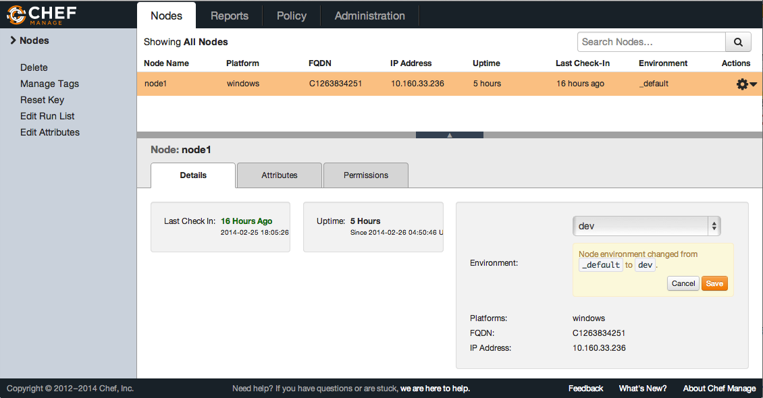
Exercise: Change your node’s environment to "dev"
Click the ‘Nodes’ tab then select node ‘windowsnode’
Select dev from the ‘Environments’ drop-down list
Click‘Save’
Notes:
Click the Node tab then select node ‘node1’
Might look at knife flip plugin - https://github.com/jonlives/knife-flip

Slide 558
Exercise: Re-converge the nodes
Converge the Windows nodes
* template[/etc/hosts] action create[2014-02-26T01:57:44-08:00] INFO: Processing template[/etc/hosts] action create (hosts::default line 9)
[2014-02-26T01:57:44-08:00] INFO: template[/etc/hosts] backed up to /var/chef/backup/etc/hosts.chef-20140226015744.972901
[2014-02-26T01:57:44-08:00] INFO: template[/etc/hosts] updated file /etc/hosts
- update content in file /etc/hosts from 1f8bdf to 94a261
--- /etc/hosts 2014-02-25 03:26:02.000000000 -0800
+++ /home/chef/AppData/Local/Temp/2/chef-rendered-template20140226-3540-w4vntg 2014-02-26 01:57:44.000000000 -0800
@@ -1,3 +1,4 @@
#This file is managed by server at centos63.example.com
+ 0.0.0.0 nytimes.com
Notes:
We went back in time! Whoa!
Point out that we downloaded the old files, we removed the ones that we had that were newer, and we applied the old policy
If students have cookbook errors, the last uploaded cookbook at the time of the version roll probably had syntax errors in it.

Slide 559
Windows Exercise: Create a production environment
OPEN IN EDITOR:
environments/win-production.rb
Make sure the apache cookbook is set to version 0.1.0
Set an override attribute for being in_scope for PCI
name ”win-production"
description "For Prods!"
cookbook ”iis_demo", "= 0.1.0"
override_attributes({
”datacenter" => {
”location" => “Chile”
}
})
SAVE FILE!

Slide 560
Windows Exercise: Create a production environment
OPEN IN EDITOR:
environments/win-production.rb
Make sure the apache cookbook is set to version 0.1.0
Set an override attribute for being in_scope for PCI
name ”win-production"
description "For Prods!"
cookbook ”iis_demo", "= 0.1.0"
override_attributes({
”datacenter" => {
”location" => “Chile”
}
})
SAVE FILE!

Slide 561
Merge Order and Precedence

Slide 562
Exercise: Create the production environment
Upload the Production Environment
Updated Environment win-production

Slide 563
Exercise: Move your node to new environment
ws> knife node environment set <nodename> <new_environment>
ws> knife node environment set windowsnode win-production
Looking for an fqdn of node1 or name of node1
Setting environment to production
1 items found
Node Name: windowsnode
Environment: win-production
FQDN:
IP: 10.160.201.90
Run List:
Roles:
Recipes:
Platform: windows
Tags:

Slide 564
Exercise: Re-converge the nodes
Converge the Windows nodes
* template[/etc/hosts] action create[2014-02-26T01:57:44-08:00] INFO: Processing template[/etc/hosts] action create (hosts::default line 9)
[2014-02-26T01:57:44-08:00] INFO: template[/etc/hosts] backed up to /var/chef/backup/etc/hosts.chef-20140226015744.972901
[2014-02-26T01:57:44-08:00] INFO: template[/etc/hosts] updated file /etc/hosts
- update content in file /etc/hosts from 1f8bdf to 94a261
--- /etc/hosts 2014-02-25 03:26:02.000000000 -0800
+++ /home/chef/AppData/Local/Temp/2/chef-rendered-template20140226-3540-w4vntg 2014-02-26 01:57:44.000000000 -0800
@@ -1,3 +1,4 @@
#This file is managed by server at centos63.example.com
+ 0.0.0.0 nytimes.com
Notes:
We went back in time! Whoa!
Point out that we downloaded the old files, we removed the ones that we had that were newer, and we applied the old policy
If students have cookbook errors, the last uploaded cookbook at the time of the version roll probably had syntax errors in it.

Slide 565
Linux Exercise: Use knife to show the available cookbook versions
> knife cookbook show apache
apache 0.2.0 0.1.1 0.1.0
Notes:
Remember the version bump from earlier? This was why.

Slide 566
Linux Exercise:
Create a dev environment
OPEN IN EDITOR:
environments/linux-dev.rb
name ”linux-dev"
description "For developers!"
cookbook ”apache", "= 0.2.0"
SAVE FILE!
Environments have names
Environments have a description
Environments can have one or more cookbook constraints
Notes:
Again, these can be defined either via Ruby or JSON. In a minute, we’ll see one of the benefits of defining via Ruby

Slide 567
Linux Exercise:
Create a dev environment
OPEN IN EDITOR:
environments/linux-dev.rb
name ”linux-dev"
description "For developers!"
cookbook ”apache", "= 0.2.0"
SAVE FILE!
Environments have names
Environments have a description
Environments can have one or more cookbook constraints
You need a space here
Notes:
Again, these can be defined either via Ruby or JSON. In a minute, we’ll see one of the benefits of defining via Ruby

Slide 568
Linux Exercise: Create the dev environment
> knife environment from file linux-dev.rb
Updated Environment linux-dev

Slide 569
Linux Exercise: Show your Chef dev environment
> knife environment show linux-dev
chef_type: environment
cookbook_versions:
apache: = 0.2.0
default_attributes:
description: For developers!
json_class: Chef::Environment
name: dev
override_attributes:

Slide 570
Exercise: Move your node to new environment
ws> knife node environment set <nodename> <new_environment>
Looking for an fqdn of node1 or name of node1
Setting environment to linux-dev
1 items found
Node Name: linuxnode
Environment: linux-dev
FQDN:
IP: 10.160.201.90
Run List:
Roles:
Recipes:
Platform: centos
Tags:

Slide 571
Exercise: Re-converge the nodes
* template[/etc/hosts] action create[2014-02-26T01:57:44-08:00] INFO: Processing template[/etc/hosts] action create (hosts::default line 9)
[2014-02-26T01:57:44-08:00] INFO: template[/etc/hosts] backed up to /var/chef/backup/etc/hosts.chef-20140226015744.972901
[2014-02-26T01:57:44-08:00] INFO: template[/etc/hosts] updated file /etc/hosts
- update content in file /etc/hosts from 1f8bdf to 94a261
--- /etc/hosts 2014-02-25 03:26:02.000000000 -0800
+++ /home/chef/AppData/Local/Temp/2/chef-rendered-template20140226-3540-w4vntg 2014-02-26 01:57:44.000000000 -0800
@@ -1,3 +1,4 @@
#This file is managed by server at centos63.example.com
+ 0.0.0.0 nytimes.com
Notes:
We went back in time! Whoa!
Point out that we downloaded the old files, we removed the ones that we had that were newer, and we applied the old policy
If students have cookbook errors, the last uploaded cookbook at the time of the version roll probably had syntax errors in it.

Slide 572
Linux Exercise: Create a production environment
OPEN IN EDITOR:
environments/lin-production.rb
Make sure the apache cookbook is set to version 0.1.0
Set an override attribute for being in_scope for PCI
Use knife node show linuxnode –a pci to see how pci is currently set
name “lin-production”
description “For Prods!”
cookbook ”apache”, “= 0.1.0”
override_attributes(
{”pci” => {”in_scope” => true}}
)

Slide 573
Exercise: Create the production environment
> knife environment from file lin-production.rb
Updated Environment lin-production

Slide 574
Exercise: Move your node to new environment
ws> knife node environment set <nodename> <new_environment>
ws> knife node environment set linuxnode lin-production
Looking for an fqdn of node1 or name of node1
Setting environment to production
1 items found
Node Name: linuxnode
Environment: lin-production
FQDN:
IP: 10.160.201.90
Run List:
Roles:
Recipes:
Platform: centos
Tags:

Slide 575
Exercise: Re-converge the nodes
Converge the Linux nodes
* template[/etc/hosts] action create[2014-02-26T01:57:44-08:00] INFO: Processing template[/etc/hosts] action create (hosts::default line 9)
[2014-02-26T01:57:44-08:00] INFO: template[/etc/hosts] backed up to /var/chef/backup/etc/hosts.chef-20140226015744.972901
[2014-02-26T01:57:44-08:00] INFO: template[/etc/hosts] updated file /etc/hosts
- update content in file /etc/hosts from 1f8bdf to 94a261
--- /etc/hosts 2014-02-25 03:26:02.000000000 -0800
+++ /home/chef/AppData/Local/Temp/2/chef-rendered-template20140226-3540-w4vntg 2014-02-26 01:57:44.000000000 -0800
@@ -1,3 +1,4 @@
#This file is managed by server at centos63.example.com
+ 0.0.0.0 nytimes.com
Notes:
We went back in time! Whoa!
Point out that we downloaded the old files, we removed the ones that we had that were newer, and we applied the old policy
If students have cookbook errors, the last uploaded cookbook at the time of the version roll probably had syntax errors in it.

Slide 576
Rollbacks and Desired State Best Practice
Chef is not magic - it manages state for declared resources
We just rolled back to an earlier version of the webserver cookbook
While the recipe applied fine, investigating the system will reveal the webserver is still configured as it was in the 0.2.0 cookbook
A better way to ensure a smooth rollback: write contra-resources to clean up.

Slide 577
Example of contra resources
service “httpd” do
action :stop
end
package “httpd” do
action :remove
end
directory “/var/www” do
action :delete
recursive true
end
directory “/etc/httpd” do
action :delete
recursive true
end

Slide 578
Questions?
What is an Environment?
How is an Environment different from an Organization?
What is a cookbook version constraint?
What is the best way to move nodes between environments
Notes:
We need to add:
* Showing how to use chef_environment in a recipe
* How to write data-driven recipes that can do contra-state

Slide 579
Roles
Simplifying The Run List

Slide 580
Lesson Objectives
After completing the lesson, you will be able to
Explain what Roles are, and how they are used to provide clarity
Show a Role with Knife
Describe nested Roles
Bootstrap a node using Roles and Environments

Slide 581
What is a Role?
So far, we’ve been just adding recipes directly to a single node
But that’s not how your infrastructure works - think about how you refer to servers:
“It’s a web server”
“It’s a database server”
“It’s a monitoring server”

Slide 582
Why do we use Roles?
Roles allow you to conveniently encapsulate the run lists and attributes required for a server to “be” what you already think it is
In practice, Roles make it easy to configure many nodes identically without repeating yourself each time

Slide 583
Pre-lab Exercise: Request additional node(s) from CloudShare (for use later)
Provision new instance(s) now, for use at the end of this module (we’ll use our existing nodes for the majority of this module)
Return to the CloudShare URL from the Welcome email to get new instances, but use different email addresses
The email address doesn’t need to be a real address, you only need it to log into CloudShare (Eg. bogusWindowsNode@gmail.com)

Slide 584
Windows Bug Regarding Role Names
If you see “recipe[roles]” in your run_list, there is a bug in Microsoft Visual C runtime See: http://sourceforge.net/p/mingw/bugs/1621/
This causes a failure in Windows if there is a letter ‘s’ in the role name (i.e. role[webserver])
Workaround 1: use back-tics to escape the single-quotes `’role[webserver]`’
Workaround 2: don’t use the letter ‘s’ in role name
Notes:
You should see the new index.html from the attributes file.

Slide 585
Windows Exercise: Create the webserver role
OPEN IN EDITOR:
chef-repo\roles\win-webhead.rb
A Role has a:
name
description
run_list
name ”win-webhead"
description ”IIS Web Server"
run_list "recipe[iis_demo]”
SAVE FILE!

Slide 586
Windows Exercise: Upload the role to Chef Server
> knife role from file win-webhead.rb
Updated Role win-webhead!

Slide 587
Windows Exercise: Show the role with knife
> knife role show win-webhead
chef_type: role
description: IIS Web Server
env_run_lists:
json_class: Chef::Role
name: win-webhead
override_attributes:
run_list: recipe[iis_demo]

Slide 588
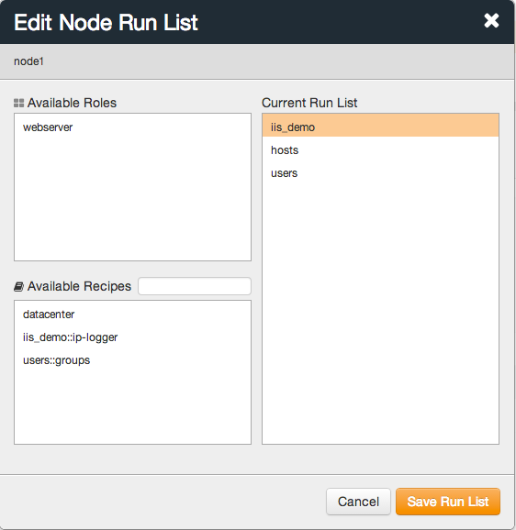
Windows Exercise: Replace recipe[iis_demo] with role[win-webhead] in the run list, using the GUI
Click the ‘Nodes’ tab then select node ‘windowsnode’
Click ‘Edit Run List’ from left navigation bar
Drag ‘iis_demo’ over from ‘Current Run List’ to ‘Available Recipes’
Drag ‘win-webhead’ over from ‘Available Roles’ to the top of ‘Current Run List’
Click ‘Save Run List’

Slide 589
Windows Exercise: Re-run the Chef Client
rn> chef-client
[2014-02-25T09:44:14-08:00] INFO: Run List is [role[win-webhead], recipe[hosts], recipe[users]]
[2014-02-25T09:44:14-08:00] INFO: Run List expands to [iis_demo, hosts, users]
[2014-02-25T09:44:14-08:00] INFO: Starting Chef Run for node1
[2014-02-25T09:44:14-08:00] INFO: Running start handlers
[2014-02-25T09:44:14-08:00] INFO: Start handlers complete.
resolving cookbooks for run list: ["iis_demo", "hosts", "users"]
[2014-02-25T09:44:15-08:00] INFO: Loading cookbooks [datacenter, hosts, iis_demo, users]
Synchronizing Cookbooks:
- iis_demo
- hosts
Notes:
Talk about run list expansion - we looked at the role, grabbed it’s runlist, and stuck it in place.
We are coming back to run list expansion when we finish the base role

Slide 590
Windows Exercise: Add an attribute to the role
OPEN IN EDITOR:
roles\win-webhead.rb
name ”win-webhead"
description ”IIS Web Server"
run_list "recipe[iis_demo]"
default_attributes({
“iis_demo" => {
"sites" => {
"admins" => {
"port" => 8000
}
}
}
})
You can set default node attributes within a role.
SAVE FILE!

Slide 591
Node Attributes that are hashes are merged
The iis_demo cookbooks attribute file contains:
Default["iis_demo"]["sites"]["clowns"] = { "port" => 80 }
Default["iis_demo"]["sites"]["bears"] = { "port" => 81 }
default_attributes({
"iis_demo" => {
"sites" => {
"admins" => {
"port" => 8000
}
}
}
})
While our role has...
Notes:
And the results are merged together.
We will get to merge order in just a few more slides...

Slide 592
Windows Exercise: Verify the new homepage works
Upload the Role you just modified
Converge your Windows node (on your existing node, not the node you just launched)
Open a web browser Go to http://<windows-hostname>:8000 You should see the “We love Admins” home page
Notes:
You should see the new index.html from the attributes file.

Slide 593
Windows Exercise: Search for the IIS sites attribute on all nodes with the role iis-webserver
> knife search node 'role:iis-webhead' -a iis_demo.sites
1 items found
windowsnode:
iis_demo.sites:
admins:
port: 8000
bears:
port: 81
clowns:
port: 80
Notes:
This is the first time we use the “dot” notation with -a in knife - talk about using it to show deeply nested attributes easily.
It is also in contrast to how you search for that field, which is to join on an “_”. The inconsistency is lame, but it is because “.” is a stopword in the search query parser, and the index itself. So we used _ in the search, and when I did knife’s attribute lookup, I switched it to a “.” without thinking about it. Sad but true.
Talk about the ‘role’ field, and how commonly used in search it is

Slide 594
Linux Exercise: Create the webserver role
OPEN IN EDITOR:
chef-repo\roles\lin-webhead.rb
A Role has a:
name
description
run_list
name ”lin-webhead"
description ”Apache Web Server"
run_list "recipe[apache]”
SAVE FILE!

Slide 595
Linux Exercise: Upload the role to Chef Server
> knife role from file lin-webhead.rb
Updated Role lin-webhead!

Slide 596
Linux Exercise: Show the role with knife
> knife role show lin-webhead
chef_type: role
description: Apache Web Server
env_run_lists:
json_class: Chef::Role
name: lin-webhead
override_attributes:
run_list: recipe[apache]

Slide 597
Lindows Exercise: Use knife to replace recipe[apache] with role[lin-webhead] in run list
First, remove the existing apache recipe from the run list
> knife node run_list remove linuxnode ‘recipe[apache]’
Next, add the lin-webhead role to the run list, placing it after ‘recipe[users]’
> knife node run_list add linuxnode ‘role[lin-webhead]’ –a ‘recipe[users::create-users]’

Slide 598
Linux Exercise: Re-run the Chef Client
rn> chef-client
[2014-02-25T09:44:14-08:00] INFO: Run List is [role[lin-webhead], recipe[motd], recipe[users]]
[2014-02-25T09:44:14-08:00] INFO: Run List expands to [apache, motd, users]
[2014-02-25T09:44:14-08:00] INFO: Starting Chef Run for node1
[2014-02-25T09:44:14-08:00] INFO: Running start handlers
[2014-02-25T09:44:14-08:00] INFO: Start handlers complete.
resolving cookbooks for run list: [”apache", ”motd", "users"]
[2014-02-25T09:44:15-08:00] INFO: Loading cookbooks [pci, motd, apache, users]
Synchronizing Cookbooks:
- apache
- motd
Notes:
Talk about run list expansion - we looked at the role, grabbed it’s runlist, and stuck it in place.
We are coming back to run list expansion when we finish the base role

Slide 599
Linux Exercise: Add an attribute to the role
OPEN IN EDITOR:
roles/lin-webhead.rb
name ”lin-webhead"
description ”Apache Web Server"
run_list "recipe[apache]"
default_attributes({
“apache" => {
"sites" => {
"admins" => {
"port" => 8000
}
}
}
})
Modify role file
Upload Role
Converge Node
Browse to <hostname>:8000
See “We Love Admins” in homepage
SAVE FILE!

Slide 600
Node Attributes that are hashes are merged
The iis_demo cookbooks attribute file contains:
Default[”apache"]["sites"]["clowns"] = { "port" => 80 }
Default["apache"]["sites"]["bears"] = { "port" => 81 }
default_attributes({
"apache" => {
"sites" => {
"admin" => {
"port" => 8000
}
}
}
})
While our role has...

Slide 601
Linux Exercise: Search for the Apache sites attribute on all nodes with the role apache-webserver
> knife search node “role:lin-webhead” -a apache.sites
1 items found
linuxnode:
apache.sites:
admin:
port: 8000
bears:
port: 81
clowns:
port: 80
Notes:
This is the first time we use the “dot” notation with -a in knife - talk about using it to show deeply nested attributes easily.
It is also in contrast to how you search for that field, which is to join on an “_”. The inconsistency is lame, but it is because “.” is a stopword in the search query parser, and the index itself. So we used _ in the search, and when I did knife’s attribute lookup, I switched it to a “.” without thinking about it. Sad but true.
Talk about the ‘role’ field, and how commonly used in search it is

Slide 602
Best Practice: Roles get default attributes
While it is awesome that you can use overrides, in practice there is little need
If you always set default node attributes in your cookbook attribute files
You can almost always set default node attributes in your role, and let merge order do the rest
Notes:
Drive home that people should use defaults!

Slide 603
Best Practice: Have “base” roles
In addition to obvious roles, such as “webserver”, it is a common practice to group any functionality that “goes together” in a role
The most common example here is a base (or core) role, where you include all the recipes that should be run on every node
Notes:
Almost every org has this

Slide 604
When to use a Base (core) Role
App LBs
Cache
App Servers
DB Cache
DB slaves
DBs

Slide 605
Windows Exercise: Create the core role
OPEN IN EDITOR:
roles/core.rb
name ”core"
description ”Core Windows Role"
run_list "recipe[del_val]”,"recipe[hosts]", "recipe[users]”,"recipe[ip-logger]”
SAVE FILE!

Slide 606
Windows Exercise:
Add the core role to the win-webhead role’s run list
OPEN IN EDITOR:
roles\win-webhead.rb
name ”win-webhead"
description ”Windows Web Server"
run_list "role[core]","recipe[iis_demo]”
Put role[core] at the front of the run_list
SAVE FILE!

Slide 607
Exercise: Set the run list to just the webhead role
Remove all the entries in the node’s run list other than the webserver role, then save and close.

Slide 608
Exercise: Upload the roles and converge
Upload the core role
Upload the webserver role
Converge the Node, look for the following:
…
[2014-02-25T10:05:36-08:00] INFO: Run List is [role[win-webhead]]
[2014-02-25T10:05:36-08:00] INFO: Run List expands to [del-val, hosts, users, ip-logger, iis_demo]
resolving cookbooks for run list: [“del-val”, ”hosts", "users", “ip-logger”, ”iis_demo"]
[2014-02-25T10:05:37-08:00] INFO: Loading cookbooks [del-val, hosts, users, iis_demo]
Synchronizing Cookbooks:
- del_val
- hosts
- users
- iis_demo
Compiling Cookbooks...
…
Notes:
Almost every org has this

Slide 609
Linux Exercise: Create the base role
OPEN IN EDITOR:
roles/core.rb
name ”core"
description ”Core (base) Linux Role"
run_list "recipe[del_val]”, "recipe[motd]”, "recipe[users]”, "recipe[ip-logger]”
SAVE FILE!

Slide 610
Linux Exercise: Create the base role
OPEN IN EDITOR:
roles/core.rb
name ”core"
description ”Core (base) Linux Role"
run_list "recipe[del_val]”, "recipe[motd]”, "recipe[users::create-users]”, "recipe[ip-logger]”
SAVE FILE!

Slide 611
Linux Exercise:
Add the core role to the lin-webhead role’s run list
OPEN IN EDITOR:
roles/lin-webhead.rb
name ”lin-webhead"
description ”Linux Web Server"
run_list "role[core]","recipe[apache]”
Put role[core] at the front of the run_list
SAVE FILE!

Slide 612
Exercise: Set the run list to just the webhead role
Remove all the entries in the node’s run list other than the webserver role, then save and close.

Slide 613
Exercise: Upload the roles and converge
Upload the core role
Upload the lin-webhead role
Converge the Node, look for the following:
…
[2014-02-25T10:05:36-08:00] INFO: Run List is [role[lin-webhead]]
[2014-02-25T10:05:36-08:00] INFO: Run List expands to [del-val, motd, users, ip-logger, apache]
resolving cookbooks for run list: [“del-val”, ”motd", "users", “ip-logger”, ”apache"]
[2014-02-25T10:05:37-08:00] INFO: Loading cookbooks [del_val, motd, users, ip-logger, apache]
Synchronizing Cookbooks:
- del-val
- motd
- users
- ip-logger
- apache
Compiling Cookbooks...
…
Notes:
Almost every org has this

Slide 614
Best Practice: Be explicit about what you need or expect
Chef will only execute a recipe the first time it appears in the run list
So be explicit about your needs and expectations - either by nesting roles or using include_recipe

Slide 615
Bootstraping Nodes with Roles and Environments
You can assign BOTH a Role and an Environment to a node when bootstrapping it
This means the node goes from not being Chef-enabled, to existing as a complete Chef-enabled webserver (or database server, load balancer, etc.) in the Environment you specify
Use –r “role[rolename]” and –E “environmentname”
Note the capitalization of the –r and –E options

Slide 616
"Bootstrap” with Role and Environment
To Bootstrap a Windows node
ws> knife bootstrap windows winrm <EXTERNAL_ADDRESS> -x username –P password -N ”windowsnode2” –r `’role[win-webhead]`’ –E “windows-dev”
To Bootstrap a Linux node
ws> knife bootstrap <EXTERNAL_ADDRESS> -x username –P password -N ”linuxnode2”
–r `’role[lin-webhead]`’ –E “linux-dev”
NOTE: If you are using more then one node for this course,
name them differently or Chef Server will give you an error!

Slide 617
Questions
What is a Role?
What makes for a “good” role?
How do you search for roles with a given recipe in their run list?
How many times will Chef execute a recipe in the same run?
How can you bootstrap using Roles and Environments?

Slide 618
Using Community Cookbooks
Open Source: Saving you time!

Slide 619
Lesson Objectives
After completing the lesson, you will be able to
Find, preview and download cookbooks from the Chef Community site
Use knife to work with the Community Site API

Slide 620
The easy way...
We've been writing cookbooks so far
Hundreds already exist for a large number of use cases and purposes.
Many (but only a fraction) are maintained by Chef.
Think of it like RubyGems.org, CPAN.org, or other focused plugin-style distribution sites.
https://supermarket.chef.io

Slide 621
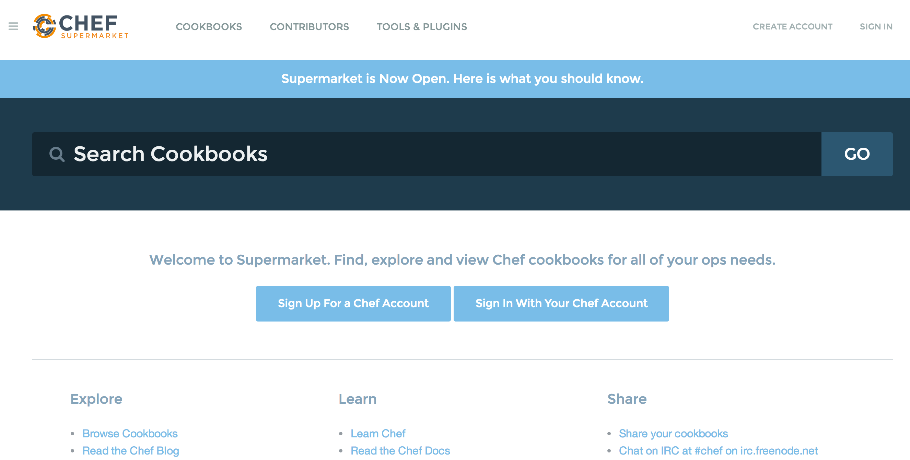
Exercise: Find and preview cookbooks on the site
https://supermarket.chef.io
Cookbooks!
Notes:
Let's go look around on the community site. This is the main portal, and more features will come, explore on your own after class.

Slide 622
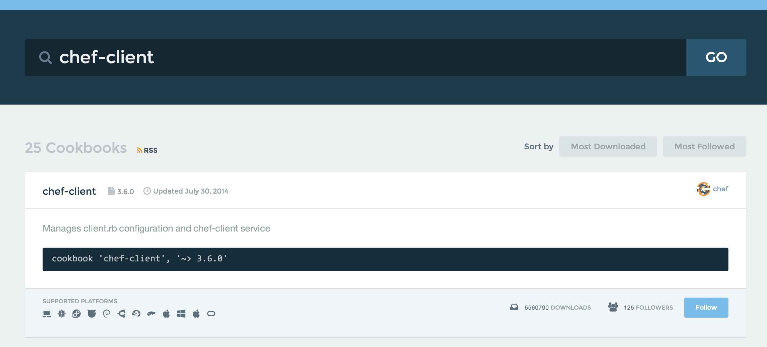
Exercise: Search for a chef-client cookbook
Search for: chef-client
Notes:
The cookbooks main page.
Perform a search using the search box. Simply type in 'chef-client' and hit enter.

Slide 623
You can download cookbooks directly from the site...
You can download cookbooks directly from the community site, but:
It doesn't put them in your Chef Repository
It isn't fast if you know what you're looking for (click, click...)
It isn't necessarily fast if you don't know what you're looking for.
You're already using knife for managing cookbooks and other things in your Chef Repository.

Slide 624
Introducing Knife Cookbook Site plugin
Knife includes a "cookbook site" plugin with some sub-commands:
search
show
download
... and more!

Slide 625
Download and use chef-client cookbook

Slide 626
Windows Versus Linux
The following exercises will work the same on Windows or Linux
You can work on either platform using the same commands
We are using Windows for our Community Cookbook examples

Slide 627
Exercise: Download the chef-client cookbook
ws> cd chef-repo
ws> knife cookbook site download chef-client
Downloading chef-client from the cookbooks site at version 3.3.2 to /Users/YOU/chef-repo/chef-client-3.3.2.tar.gz
Cookbook saved: /Users/YOU/chef-repo/chef-client-3.3.2.tar.gz

Slide 628
Exercise: Extract chef-client cookbook tarball
ws> tar -zxvf chef-client-3.9.0.tar.gz -C cookbooks
x chef-client/
x chef-client/attributes/
x chef-client/CHANGELOG.md
x chef-client/CONTRIBUTING
x chef-client/LICENSE
x chef-client/metadata.json
x chef-client/metadata.rb
x chef-client/README.md
x chef-client/recipes/
x chef-client/templates/
x chef-client/templates/arch/
x chef-client/templates/default/
x chef-client/templates/windows/
x chef-client/templates/default/debian/
x chef-client/templates/default/redhat/
x chef-client/templates/default/solaris/
x chef-client/templates/arch/conf.d/
x chef-client/templates/arch/rc.d/
x chef-client/recipes/config.rb
x chef-client/recipes/cron.rb
x chef-client/recipes/default.rb
x chef-client/recipes/delete_validation.rb
x chef-client/recipes/service.rb
x chef-client/attributes/default.rb

Slide 629
What we just did...
Cookbooks are distributed as a versioned .tar.gz archive.
The latest version is downloaded by default (you can specify the version).
Extract the cookbook into the "cookbooks" directory with tar.
Next, let's examine the contents.

Slide 630
Best Practice: well written cookbooks have a README!
Documentation for cookbooks doesn't need to be extensive, but a README should describe some important aspects of a cookbook:
Expectations (cookbooks, platform, data)
Recipes and their purpose
LWRPs, Libraries, etc.
Usage notes
Read the README first!

Slide 631
Best Practice: This runs as Administrator!
So, you just downloaded source code from the InterWebs.
As root.
To load in the magic machine that:
Makes your computers run code
Read the entire cookbook first!

Slide 632
Examining the chef-client cookbook
We're going to use two recipes on the node from the chef-client cookbook.
delete_validation
service (via default)

Slide 633
Exercise: View the chef-client::delete_validation recipe
OPEN IN EDITOR:
cookbooks\chef-client\recipes\delete_validation.rb
class ::Chef::Recipe
include ::Opscode::ChefClient::Helpers
end
unless chef_server?
file Chef::Config[:validation_key] do
action :delete
backup false
only_if { ::File.exists?(Chef::Config[:client_key]) }
end
end
SAVE FILE!

Slide 634
Exercise: Add chef-client::delete_validation to your base role
OPEN IN EDITOR:
roles\base.rb
name "base"
description "Base Server Role"
run_list "recipe[chef-client::del_val]", “recipe[chef-client]”, "recipe[hosts]", "recipe[users]", "recipe[ip-logger]"
SAVE FILE!
Add the delete_validation recipe

Slide 635
Best Practice: Delete the validation certificate when it isn't required
Once Chef enters the actual run, synchronizing cookbooks, it has register its own API client with the validation certificate.
That certificate is no longer required. We do this first because in case the run fails for another reason, we know at least the validation certificate is gone.

Slide 636
Exercise: View the chef-client::default recipe
OPEN IN EDITOR:
cookbooks\chef-client\recipes\default.rb
#
# Unless required by applicable law or agreed to in writing, software
# distributed under the License is distributed on an "AS IS" BASIS,
# WITHOUT WARRANTIES OR CONDITIONS OF ANY KIND, either express or implied.
# See the License for the specific language governing permissions and
# limitations under the License.
#
include_recipe "chef-client::service"
SAVE FILE!

Slide 637
Best Practice: Sane defaults do "pretty much" what you expect
The main point of the "chef-client" cookbook is managing the "chef-client" program. It is designed that it can run as a daemonized service.
The least surprising thing for most users is that the default recipe starts the service.
You can manage the service in a number of ways, see the cookbook's README.md.

Slide 638
Exercise: View the chef-client::service recipe
OPEN IN EDITOR:
cookbooks\chef-client\recipes\service.rb
The recipe supports a number of service providers and styles.
It works on a lot of platforms.
Everything is controllable through attributes.
supported_init_styles = [
'arch',
'bluepill',
'bsd',
'daemontools',
'init',
'launchd',
'runit',
'smf',
'upstart',
'winsw'
]
init_style = node["chef_client"]["init_style"]
# Services moved to recipes
if supported_init_styles.include? init_style
include_recipe "chef-client::#{init_style}_service"
else
log "Could not determine service init style, manual intervention required to start up the chef-client service."
end

Slide 639
Best Practice: Well-written cookbooks change behavior based on attributes
Ideally, you don't have to modify the contents of a cookbook to use it for your specific use case.
Look at the attributes directory for things you can override through roles to affect behavior of the cookbook.
Of course, well written cookbooks have sane defaults, and a README to describe all this.

Slide 640
Exercise: Upload the chef-client cookbook
> knife cookbook upload chef-client
Uploading chef-client [3.3.2]
ERROR: Cookbook chef-client depends on cookbook 'cron' version '>= 1.2.0',
ERROR: which is not currently being uploaded and cannot be found on the server.
FAIL!
Notes:
Need to grab the cron cookbook too

Slide 641
Exercise: Download the cron cookbook
> knife cookbook site download cron
Downloading cron from the cookbooks site at version 1.2.8 to /Users/YOU/SOMEFOLDER/cron-1.2.8.tar.gz
Cookbook saved: /Users/YOU/chef-repo/cron-1.2.8.tar.gz

Slide 642
Exercise: Extract cron cookbook tarball
> tar -zxvf cron-1.3.0.tar.gz -C cookbooks\
x cron/
x cron/CHANGELOG.md
x cron/CONTRIBUTING
x cron/Gemfile
x cron/LICENSE
x cron/README.md
x cron/metadata.json
x cron/metadata.rb
x cron/providers/
x cron/providers/d.rb
x cron/recipes/
x cron/recipes/default.rb
x cron/resources/
x cron/resources/d.rb
x cron/templates/
x cron/templates/default/
x cron/templates/default/cron.d.erb

Slide 643
Exercise: Upload the cron cookbook
> knife cookbook upload cron
Uploading cron [1.2.8]
Uploaded 1 cookbook.

Slide 644
Exercise: Upload the chef-client cookbook
> knife cookbook upload chef-client
Uploading chef-client [3.3.2]
ERROR: Cookbook chef-client depends on cookbook 'cron' version '>= 1.2.0',
ERROR: which is not currently being uploaded and cannot be found on the server.
FAIL!

Slide 645
Exercise: Download the logrotate cookbook
> knife cookbook site download logrotate
Downloading logrotate from the cookbooks site at version 1.5.0 to C:/Users/somefolder/logrotate-1.5.0.tar.gz
Cookbook saved: C:/Users/somefolder/logrotate-1.5.0.tar.gz

Slide 646
Exercise: Extract logrotate cookbook tarball
> tar -zxvf logrotate-1.5.0.tar.gz -C cookbooks\
x logrotate/
x logrotate/CHANGELOG.md
x logrotate/README.md
x logrotate/attributes
x logrotate/attributes/default.rb
x logrotate/definitions
x logrotate/definitions/logrotate_app.rb
x logrotate/libraries
x logrotate/libraries/logrotate_config.rb
x logrotate/metadata.json
x logrotate/metadata.rb
x logrotate/recipes
x logrotate/recipes/default.rb
x logrotate/recipes/global.rb
x logrotate/templates
x logrotate/templates/default
x logrotate/templates/default/logrotate-global.erb
x logrotate/templates/default/logrotate.erb`

Slide 647
Exercise: Upload the logrotate cookbook
> knife cookbook upload logrotate
Uploading logrotate [1.3.0]
Uploaded 1 cookbook.

Slide 648
Exercise: Upload the chef-client cookbook
> knife cookbook upload chef-client
Uploading chef-client [3.3.2]
ERROR: Cookbook chef-client depends on cookbook 'cron' version '>= 1.2.0',
ERROR: which is not currently being uploaded and cannot be found on the server.
WIN!

Slide 649
Exercise: Add chef-client recipe to base role
OPEN IN EDITOR:
roles\core.rb
name ”core"
description "Base Server Role"
run_list "recipe[chef-client::delete_validation]","recipe[chef-client]", "recipe[hosts]", "recipe[users]"
SAVE FILE!

Slide 650
Exercise: upload the base role
> knife role from file base.rb
Updated Role base!

Slide 651
Exercise: Re-run the Chef Client
rn> chef-client
Starting Chef Client, version 11.10.4
[2014-02-26T04:08:21-08:00] INFO: *** Chef 11.10.4 ***
[2014-02-26T04:08:21-08:00] INFO: Chef-client pid: 3412
[2014-02-26T04:08:36-08:00] INFO: Run List is [role[webserver], recipe[hosts], recipe[users]]
[2014-02-26T04:08:36-08:00] INFO: Run List expands to [chef-client::delete_validation, chef-client, hosts, users, iis_de
mo]
[2014-02-26T04:08:36-08:00] INFO: Starting Chef Run for node1
[2014-02-26T04:08:36-08:00] INFO: Running start handlers
[2014-02-26T04:08:36-08:00] INFO: Start handlers complete.
resolving cookbooks for run list: ["chef-client::delete_validation", "chef-client", "hosts", "users", "iis_demo"]
[2014-02-26T04:08:37-08:00] INFO: Loading cookbooks [chef-client, cron, datacenter, hosts, iis_demo, logrotate, users]
Synchronizing Cookbooks:
[2014-02-26T04:08:38-08:00] INFO: Storing updated cookbooks/chef-client/recipes/arch_service.rb in the cache. ipes/config.rb in the cache.
…

Slide 652
Examine chef-client output
…
Recipe: chef-client::delete_validation
* file[c:/chef/validation.pem] action delete[2014-02-26T04:08:55-08:00] INFO: Processing file[c:/chef/validation.pem]
action delete (chef-client::delete_validation line 25)
[2014-02-26T04:08:55-08:00] INFO: file[c:/chef/validation.pem] deleted file at c:/chef/validation.pem
- delete file c:/chef/validation.pem
…

Slide 653
Examine chef-client output
…
Recipe: chef-client::windows_service
…
* execute[register-chef-service] action run[2014-02-26T04:08:55-08:00] INFO: Processing execute[register-chef-service]
action run (chef-client::windows_service line 34)
Service 'chef-client' has successfully been installed.
[2014-02-26T04:08:59-08:00] INFO: execute[register-chef-service] ran successfully
- execute chef-service-manager -a install
* service[chef-client] action enable[2014-02-26T04:08:59-08:00] INFO: Processing service[chef-client] action enable (chef-client::windows_service line 39)
(up to date)
* service[chef-client] action start[2014-02-26T04:08:59-08:00] INFO: Processing service[chef-client] action start (chef-client::windows_service line 39)
[2014-02-26T04:09:07-08:00] INFO: service[chef-client] started
- start service service[chef-client]
…

Slide 654
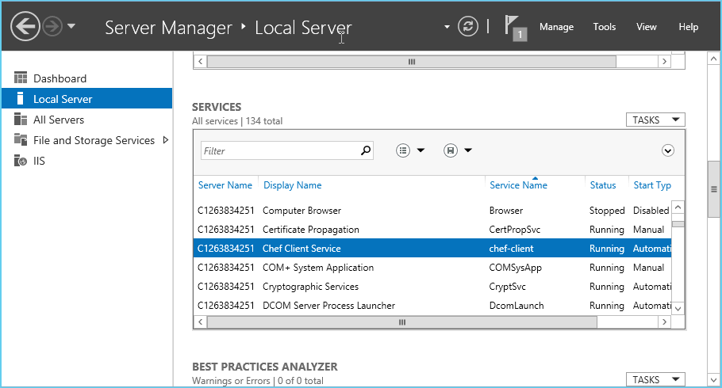
Windows Exercise: Verify chef-client is running

Slide 655
Linux Exercise: Verify chef-client is running
rn> ps awux | grep chef-client
root 8933 0.3 2.2 130400 37816 ? Sl 03:19 0:01 /opt/chef/embedded/bin/ruby /usr/bin/chef-client -d -c /etc/chef/client.rb -L /var/log/chef/client.log -P /var/run/chef/client.pid -i 1800 -s 300
Notes:
Its using our full-stack installation path automatically, and the -d says "runs as a daemon in the background"
We log to /var/log/chef/client.log (configurable). The -i is the interval, a number of seconds (30 minutes here) (configurable) and the last bit is splay (mitigating the thundering herd problem)
Note: embdded dir path -- talk about Omnibus installer if not mentioned already

Slide 656
Exercise: Verify chef-client is running
Windows
Linux
rn> get-service chef*
rn> ps awux | grep chef-client
Status Name DisplayName
------ ---- -----------
Running chef-client Chef Client Service
root 8933 0.3 2.2 130400 37816 ? Sl 03:19 0:01 /opt/chef/embedded/bin/ruby /usr/bin/chef-client -d -c /etc/chef/client.rb -L /var/log/chef/client.log -P /var/run/chef/client.pid -i 1800 -s 300
Notes:
Its using our full-stack installation path automatically, and the -d says "runs as a daemon in the background"
We log to /var/log/chef/client.log (configurable). The -i is the interval, a number of seconds (30 minutes here) (configurable) and the last bit is splay (mitigating the thundering herd problem)
Note: embdded dir path -- talk about Omnibus installer if not mentioned already

Slide 657
Convergent infrastructure
Our node is now running chef-client as a service, and it will converge itself over time on a (by default) 30 minute interval.
The amount of resources converged may vary with longer intervals, depending on configuration drift on the system.
Because Chef resources are idempotent, it will only configure what it needs to on each run.
Notes:
Get nerdy about convergence!
chef-client daemon can be signaled with USR1 to wake it up

Slide 658
Questions
What is the Chef Community site URL?
What are two ways to download cookbooks from the community site?
What is the first thing you should read when downloading a cookbook?
Who vets the cookbooks on the community site?
Who has two thumbs and reads the recipes they download from the community site?

Slide 659
Further Resources

Slide 660
Working with Chef, the company

Slide 661
Chef Status
Status for Chef related systems can be found by browsing to
http://status.chef.io, or
https://twitter.com/opscode_status

Slide 662
How do I interact with Chef support?
There are two ways to raise a ticket with Chef Support
Via the Web UI at https://help2.chef.io
By sending an email to support@chef.io
The Web UI allows you to submit any severity level ticket, however emailed tickets default to 'severity 3'
The Web UI allows you to view previously submitted tickets for an org

Slide 663
Dealing with Support
When an org signs up for a support contract, the email domain of the primary user is used used as a key, and anyone with an email in that domain can submit tickets
E.g. user1@domain.com starts a support contract for an org, then user2@domain.com and user3@domain.com can also submit tickets on behalf of "domain.com" for that org
Any user email address can be added explicitly to the Support Tool for your org by emailing sales@chef.io or submitting a ticket

Slide 664
New releases
Release Notes can be found here
http://docs.chef.io

Slide 665
Further Resources

Slide 666
Further Resources
http://chef.io/
http://supermarket.chef.io/
http://docs.chef.io/
http://learnchef.com
http://lists.chef.io
http://youtube.com/user/Opscode
irc.freenode.net #chef, #chef-hacking, #learnchef
Twitter @chef.io #getchef

Slide 667
Food Fight Show
http://foodfightshow.org
The Podcast Where DevOps Chef Do Battle
Regular updates about new Cookbooks, Knife-plugins, and more
Best Practices for working with Chef

Slide 668
Local Meetup Groups
Find your local DevOps or Chef meetup group!
Notes:
ref0038

Slide 669
Thank you for attending Chef Fundamentals for Linux!

Slide 670
Thank you for attending Chef Fundamentals for Windows and Linux!

Slide 671
Using Github
Using an external repo allows for
team collaboration
version control
Chef code backups
Go to http://github.com to create a new Github account

Slide 672
Initialize a git repository
> git init
Initialized empty Git repository in /Users/your_name/chef-repo/.git/
Notes:
This is an optional slide!
If git is installed (it should be), initialize a git repository

Slide 673
Check git status
> git status
# On branch master
#
# Initial commit
#
# Untracked files:
# (use "git add <file>..." to include in what will be committed)
#
# .berkshelf/
# .chef/
# .gitignore
# Berksfile
# README.md
# Vagrantfile
# chefignore
# cookbooks/
# roles/
nothing added to commit but untracked files present (use "git add" to track)
Notes:
This is an optional slide!
Check the status of the current git repository

Slide 674
Add all files to git
> git add .
[~/chef-repo]$
Notes:
This is an optional slide!
Add all the files to the git repository.
There is no output

Slide 675
Add files to git
> git commit -m "add the starter kit from Chef"
[master (root-commit) 2af68fb] add the starter kit from Chef
13 files changed, 360 insertions(+)
create mode 100644 .berkshelf/config.json
create mode 100644 .chef/knife.rb
create mode 100644 .gitignore
create mode 100644 Berksfile
create mode 100644 README.md
create mode 100644 Vagrantfile
create mode 100644 chefignore
create mode 100644 cookbooks/starter/attributes/default.rb
create mode 100644 cookbooks/starter/files/default/sample.txt
create mode 100644 cookbooks/starter/metadata.rb
create mode 100644 cookbooks/starter/recipes/default.rb
create mode 100644 cookbooks/starter/templates/default/sample.erb
create mode 100644 roles/starter.rb
Notes:
This is an optional slide!
Commit the files to the git repository

Slide 676
Push files to your repo
> git push
Counting objects: 9, done.
Delta compression using up to 8 threads
Compressing objects: 100% (5/5), done/
Writing objects: 100% (5/5), 411 bytes | 0 bytes/s, done.
Total 5 (delta 4), reused 0 (delta 0)
To https://github.com/your_git_account/your_repo.git
0f555d4..3b7630e master -> master
$
Notes:
This is an optional slide!
Push the files to the git repository

Slide 677
Get files from your repo
> git pull
remote: Counting objects: 147, done.
remote: Compressing objects: 100% (89/89), done.
Receiving objects: 100% (145/145), 109.51 KiB | 0 bytes/s, done.ects: 94% (137/145)
Resolving deltas: 100% (31/31), done.
From https://github.com/your_git_account/your_repo.git
2cfd221..1585e9a master -> origin/master
Updating 2cfd221..1585e9a
Fast-forward
chef-client-3.6.0.tar.gz | Bin 0 -> 33109 bytes
cookbooks/apache/CHANGELOG.md | 13 +
cookbooks/apache/README.md | 68 ++++
Notes:
This is an optional slide!
Pull (get) the files from the git repository

